Slide 1
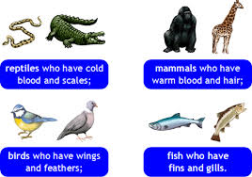
Vertebrates!
Chapters 17-18

Slide 2
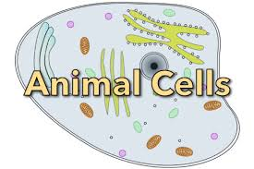
What is an animal?
Eukaryotic cells
Multicellular
Organized tissues, organs
Consumers—have to eat!
Move

Slide 4
Nine Life Processes
Movement
Support
Protection/Defense
Response (Nervous System)
Reproduction
Respiration
Circulation
Nutrition (Eating/Digestive Features)
Excretion (cleaning blood and lymph)

Slide 5
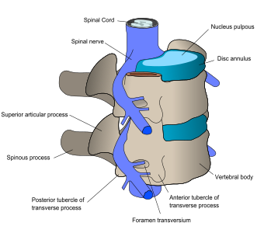
Support
A vertebrate has a brain, backbone, with spinal cord inside
Has an endoskeleton made of bone and/or cartilage (living tissues)
Vertebral column is connected to a skull with nerves that connect to each bone
Many have ribs, limbs/wings—but not all

Slide 6
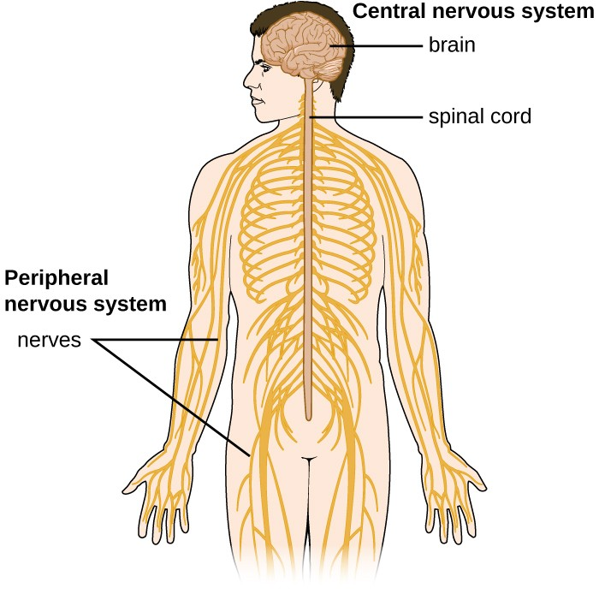
Response, Movement
Nervous System
Made up of a central nervous system and a peripheral nerve system
Nerves branch off to sensory organs (eyes, ears…) and sensory receptors (cells in skin and organ membranes)
Allows an organism to respond to stimulus: the more developed, the more sensitive and complex the response

Slide 7
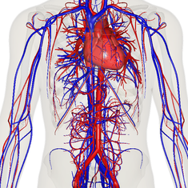
Circulation
Blood carries oxygen and key nutrients throughout the body
Circulates wastes away
Arteries (away) and veins (towards)
Hearts have chambers: 2 for fish, 3 for amphibians and reptiles, 4 for birds, mammals, people

Slide 8
Circulation & Blood
Cold-blooded (fish, amphibians, reptiles)
Ectothermic: Cannot regulate their own body temp; use sun
Warm-blooded (birds, mammals)
Endothermic: Can regulate/stabilize their own temp (using food)
Note: Birds are not on the evolutionary tree!

Slide 9
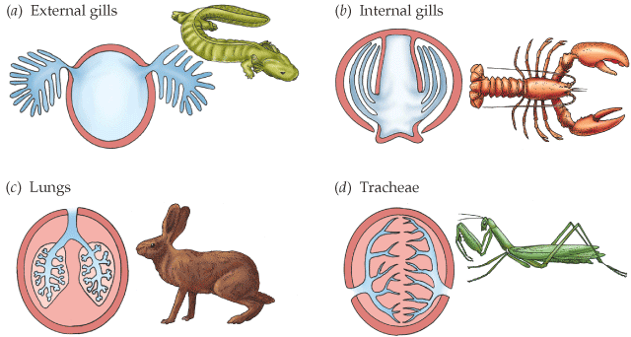
Respiration Types

Slide 10
Respiration
Respiratory system
Gills (water) and lungs (land)
Connected to circulatory system
Gills or lungs must provide (inhale) oxygen and carry away (expel) carbon dioxide
Must separate oxygen from air or water

Slide 11
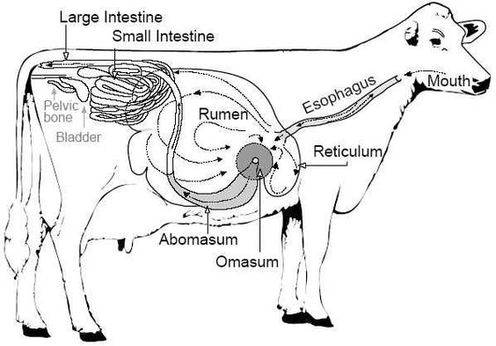
Nutrition
Digestive System
Eating, digesting, elimination
Formed from a digestive tube from mouth to end
Contains enzymes to break down food, and intestines to absorb nutrients from it
Many other organs attach to the tube which help digestion of difficult materials: liver, pancreas, gallbladder…

Slide 12
Nutrition
Methods of eating (and what is eaten) is extremely diverse all throughout the animal kingdom
Carnivores
Omnivores
Herbivores
Ruminants chew the cud and have a special organ (the rumen) to reiterate the digestion of grass/green plants
Teeth and digestive organs reflect the diet

Slide 13
Excretion
Excretory System
Blood and lymph store wastes from cellular respiration, metabolism, immune system, etc.
Kidneys filter out wastes from blood and get rid of them
Wastes are often combined with water to ensure they do not poison the animal
Usually stored in bladder before excreted

Slide 14
Endocrine Systems
Endocrine System
Manufactures and regulates special chemicals (hormones) for all kinds of processes
growth, maturation, appetite, attention, emotions, calming, fight/flight…
Often involved (controller switches: on/off, how much) in many of the 9 Life Processes

Slide 15
Reproduction
Contain organs for maturation, development/birth of offspring
Also extremely diverse throughout the animal kingdom
Some animals can reproduce asexually, but almost all reproduce sexually (require mates for genetic variety, recombination)
Oviparous
Many eggs, versus few
Eggs may be abandoned, eggs may be incubated
Incubation can be done by female or buried
Ovoviparous
Live offspring hatch from eggs inside the female’s body

Slide 16
Reproduction
External Fertilization versus Internal Fertilization
External always occurs in oviparous animals, but usually only water-dwelling animals (i.e. fish); many oviparous animals reproduce by internal fertilization (i.e. birds)
Internal Fertilization
Results in a fertilized egg that may be laid or implanted in a female’s uterus
Gestation (length of pregnancy) results in live birth (Viviparous)
Generally, the more offspring produced at once, the greater the chance they won’t survive, OR the amount of food they provide for predators
Reproductive Balance

Slide 17
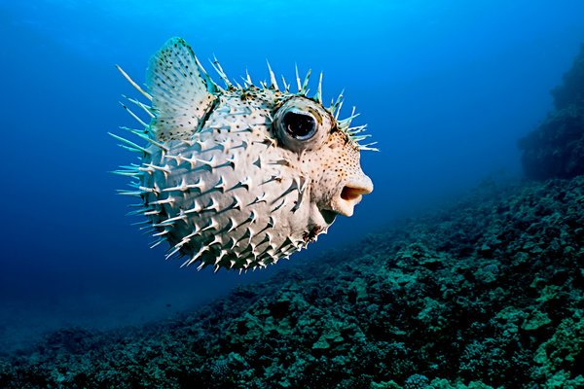
Fish
Notes:
Fugu, pufferfish

Slide 19
Characteristics of Fish
Ectothermic
Fins, gills, scales, plates
Scales most common but not all—i.e. the catfish
Many have countershading or camouflage for protection
Swim bladder helps bony fish float/sink
The lateral line is a sensory canal on each side of the spine. It is sensitive to vibrations and pressure changes in water
Two-chambered hearts

Slide 20
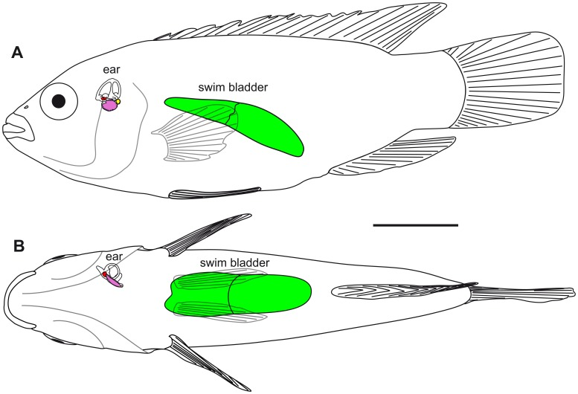
Bony v. Cartilaginous Fish
Fish species are each restricted to certain ranges (because the swim bladder has air pressure that contracts or expands)
The swim bladder makes bony fish very precise divers
Sharks can move between greater depths than normal fish
They lift or dive by tilting their large pectoral fins like “wings on a plane
They have large livers with great amounts of oil, that provide a better ability to float/lift

Slide 21
Fish Respiration
Gills help extract breathable oxygen from dissolved oxygen gas in water
Carbon dioxide is “exhaled” producing bubbles

Slide 22
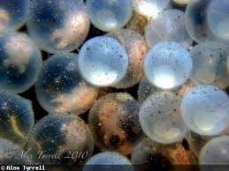
Fish Reproduction
Reproduce by spawning
Females lay eggs
Males come along later to fertilize them
Eggs are soft to receive the sperm
Usually extremely large numbers of eggs and sperm are produced because only a fraction will get fertilized and survive
Many are eaten
Strange:
Some sharks bear live young: one of the only non-mammals that do!

Slide 23
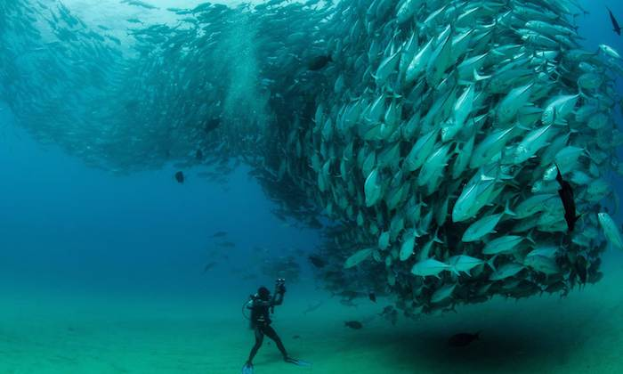
Spawning Behavior

Slide 24
Post-Spawning

Slide 25
NOT fish!
Whales, porpoises, dolphins (mammals; cetaceans)
Manatees (mammals; sea cows)
Squid, octopus (mollusks)
Starfish (echinoderms)
Tadpoles (amphibians)

Slide 26
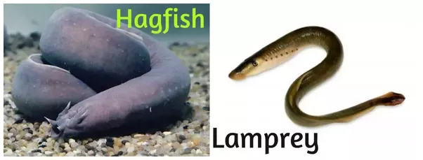
Kinds of Fish
Bony fish have the standard jaws, scales, paired fins, skeletons of bone
The largest group: Nemo and friends
Cartilaginous fish have skeletons made of cartilage
Sharks, rays
Jawless fish do not have jaws, scales, paired fins
Hagfish, lamprey

Slide 27
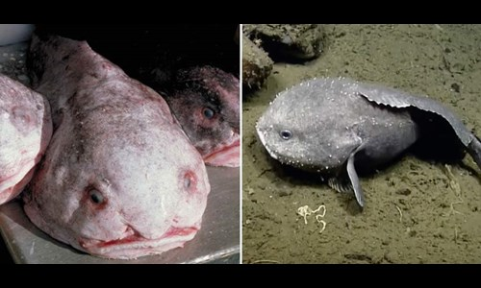
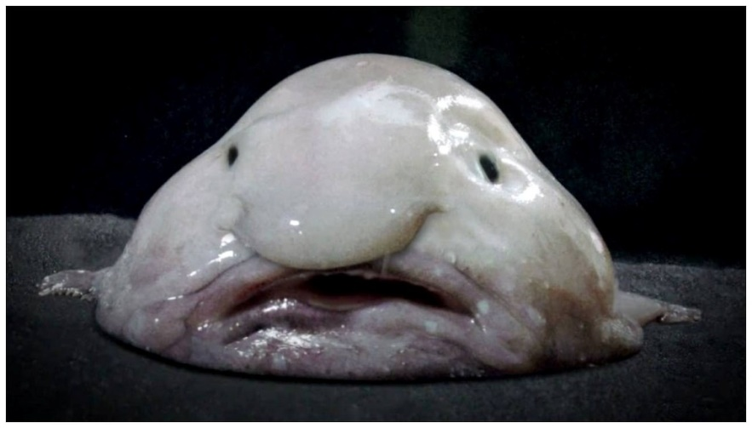
Blobfish!!

Slide 28
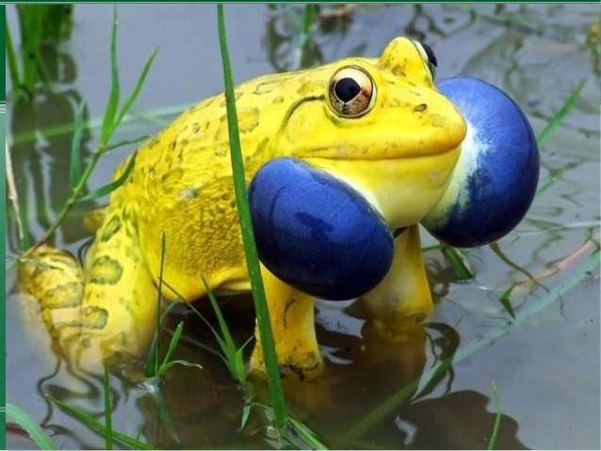
Amphibians

Slide 29
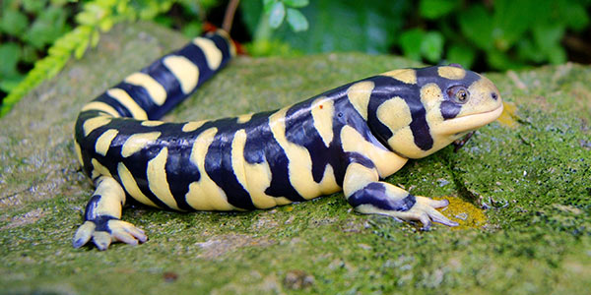
Amphibians
“amph” means both: both land and water
When young, they have gills and live in water
As adults, they breathe through lungs and live on land
Metamorphosis changes from young to adult
They molt their skin
Egg-laying, usually clear and near water where they hatch
Cold-blooded
Breathe through skin, similar to insects—thin, moist, smooth
They often secrete harmful substances; some are toxic
Frogs, toads, salamanders, newts

Slide 30
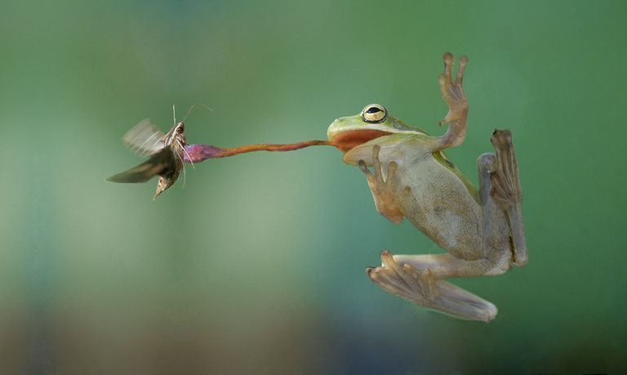
Predation

Slide 31
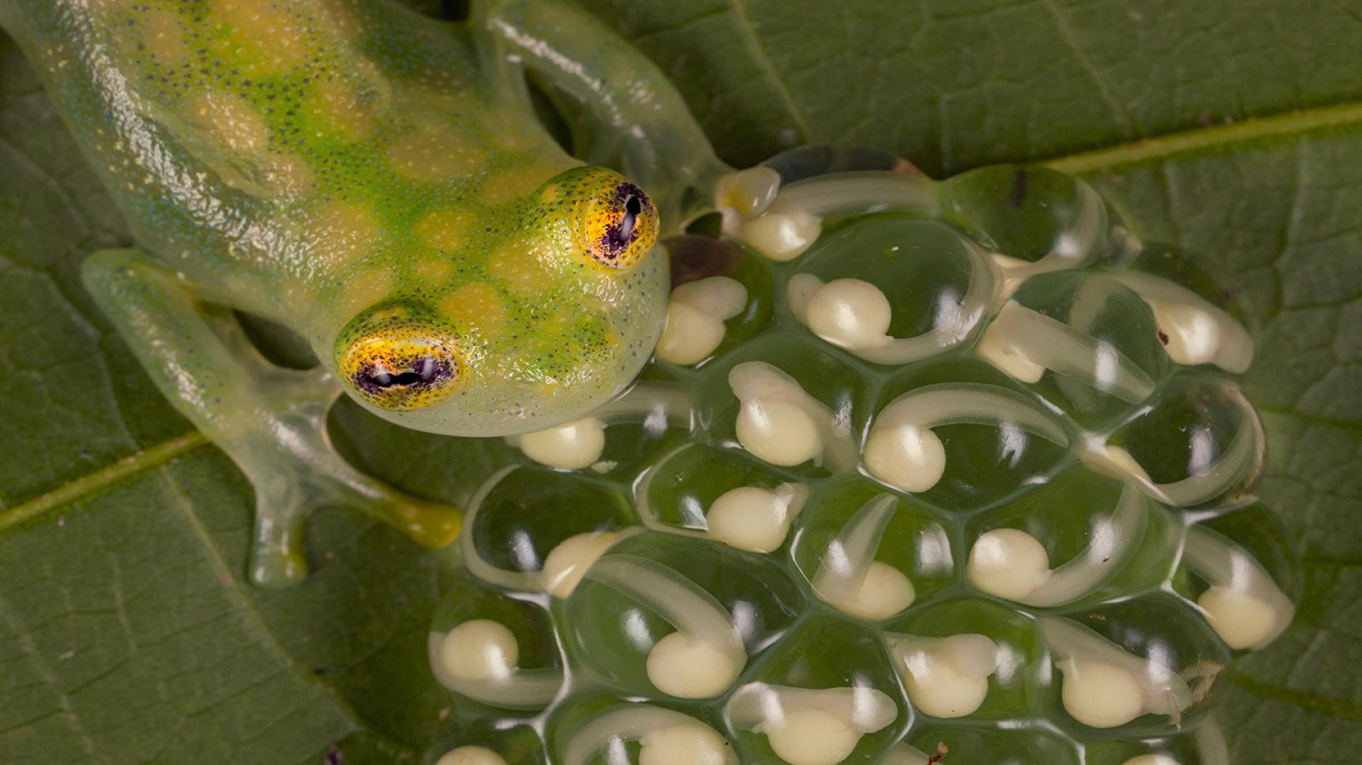
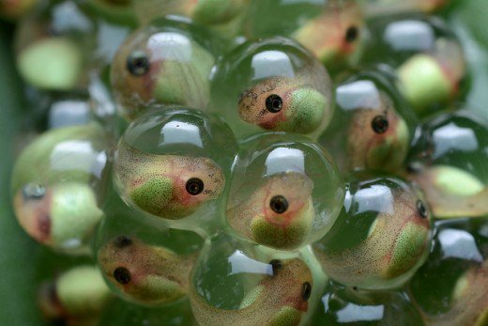
Metamorphosis: tadpoles

Slide 32
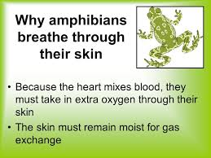
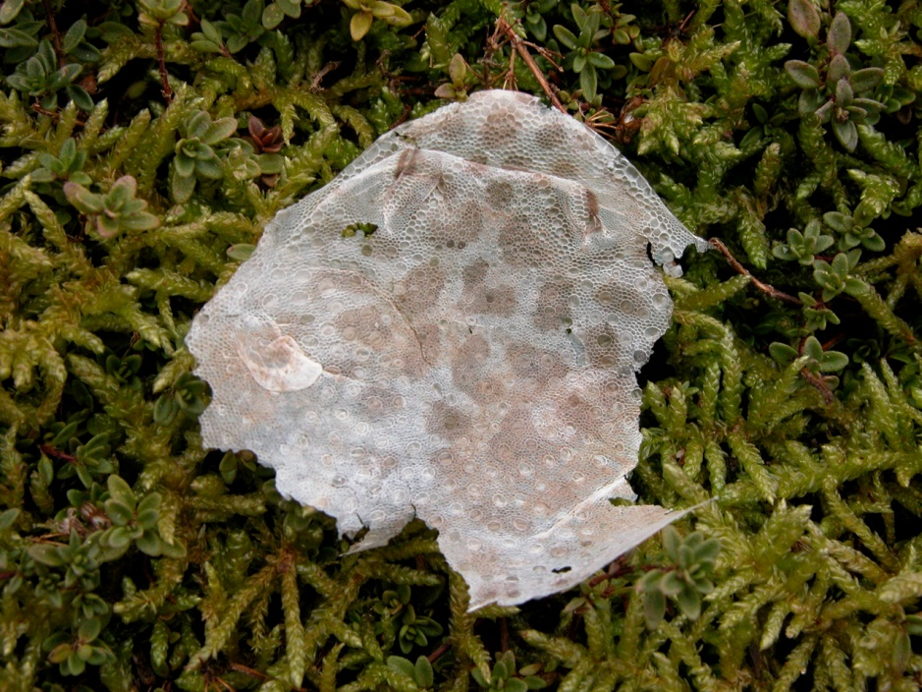
Skin: Breathing/Molting

Slide 33
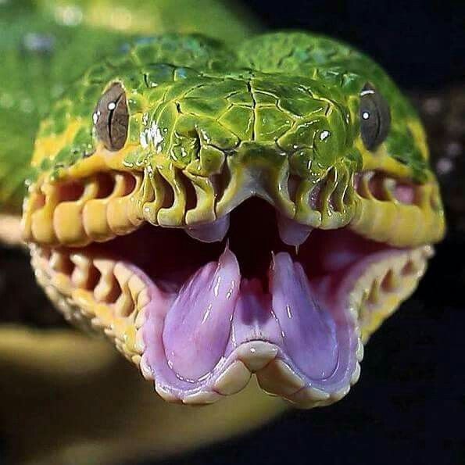
Reptiles
Notes:
Tree Boa

Slide 34
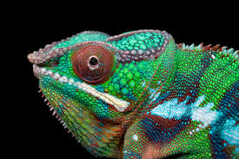
Reptiles
Cold-blooded
Breathe with lungs; those in water need to come up to breathe in oxygen
Three-chambered hearts
Do not go through metamorphosis
Lay eggs—leathery ones, usually on land, buried under ground
Have dry, leathery, scaly skin made of keratin
Most molt their skin or shed it in patches
Snakes, lizards, crocodiles, alligators, turtles, tortoises, dinosaurs, komodo dragons

Slide 35
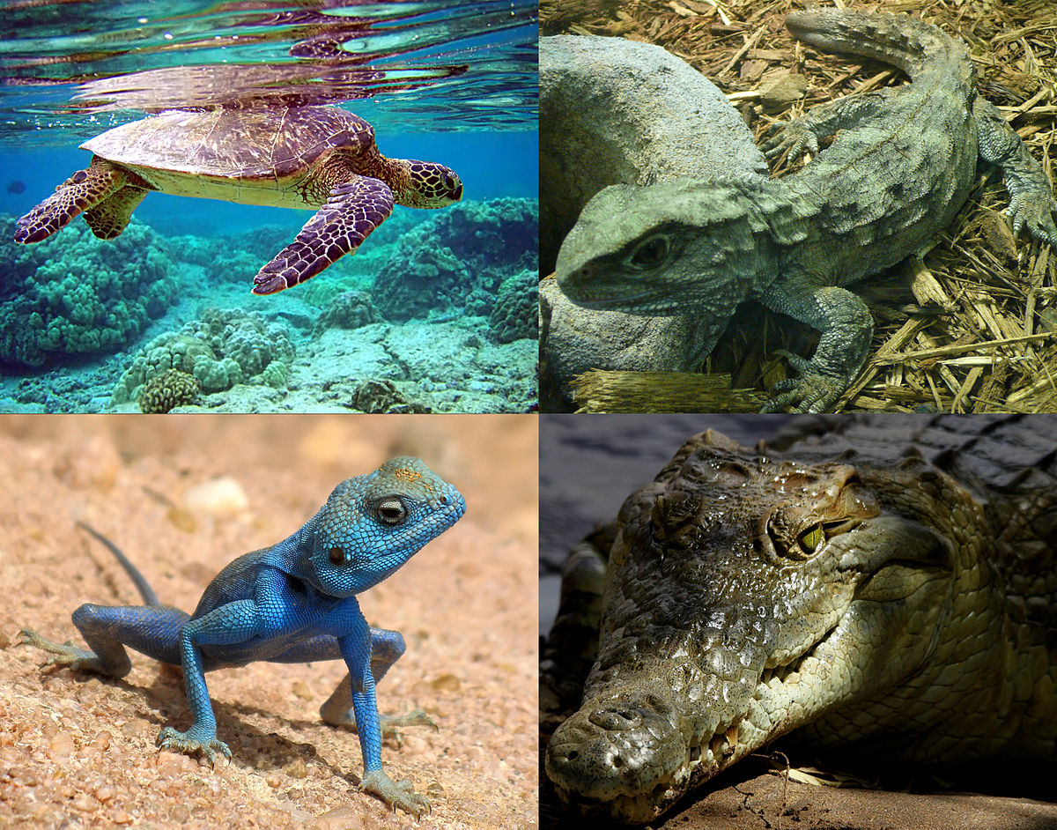

Slide 36
Snakes
Jacobsen’s organs help snakes sense things, compensate for bad ears
Snakes slither in a variety of ways/patterns
They may use venom to stun their prey
They may constrict their prey
They have hinge jaws to swallow eggs and large items whole (no chewing)

Slide 37
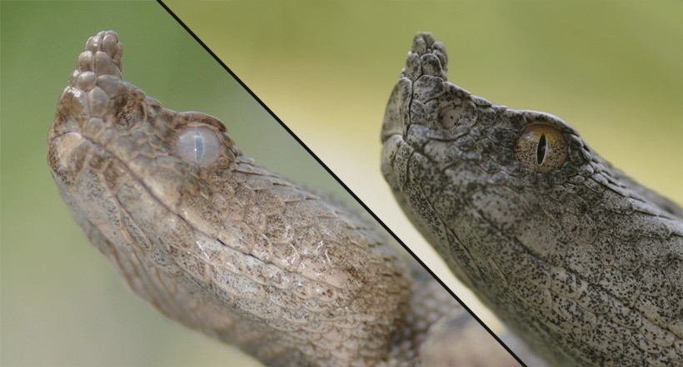
Molting

