Slide 1
Intro to animals

Slide 2
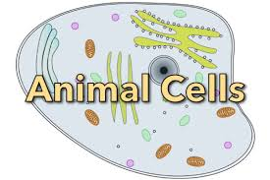
What is an animal?
Eukaryotic cells
Multicellular
Organized tissues, organs
Consumers—have to eat!
Move

Slide 3
Nine Life Processes
Movement
Support
Protection
Response (Nervous System)
Reproduction
Respiration
Circulation
Nutrition (Eating/Digestive Features)
Excretion

Slide 5
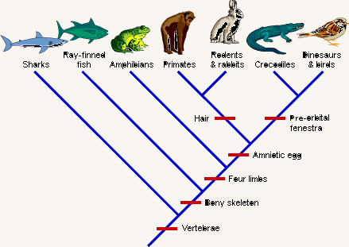
Evolutionary Tree?
Notes:
Cladogram: note warm blooded mammals developing alongside cold-blooded reptiles/warm blooded birds—how do both share a common ancestor?

Slide 6
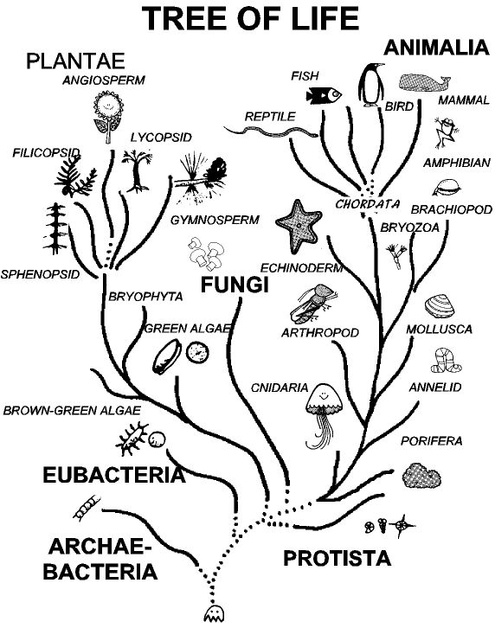

Slide 7
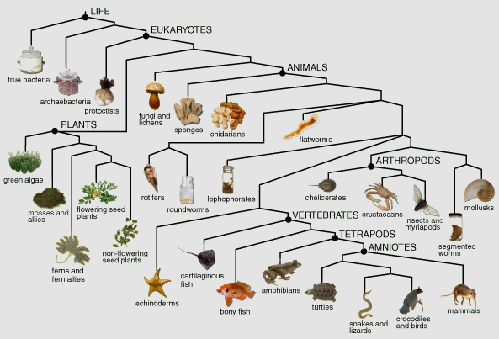

Slide 8
Invertebrates
Chapter 12

Slide 9
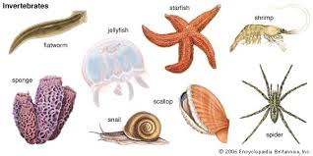
What is an invertebrate?
No backbone
Has an internal or external skeleton made of protein, glass, limestone, water (not bone!)
Usually small
Over 95% of animals are invertebrates!

Slide 10
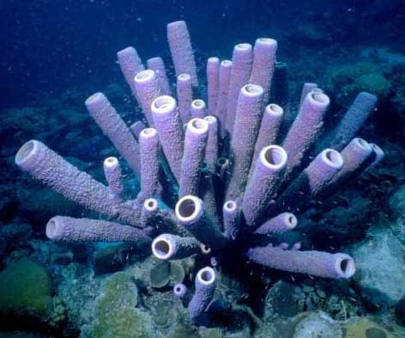
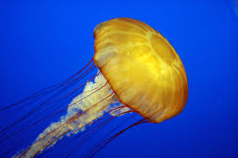
Sponges & jellyfish

Slide 11
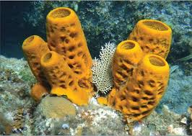
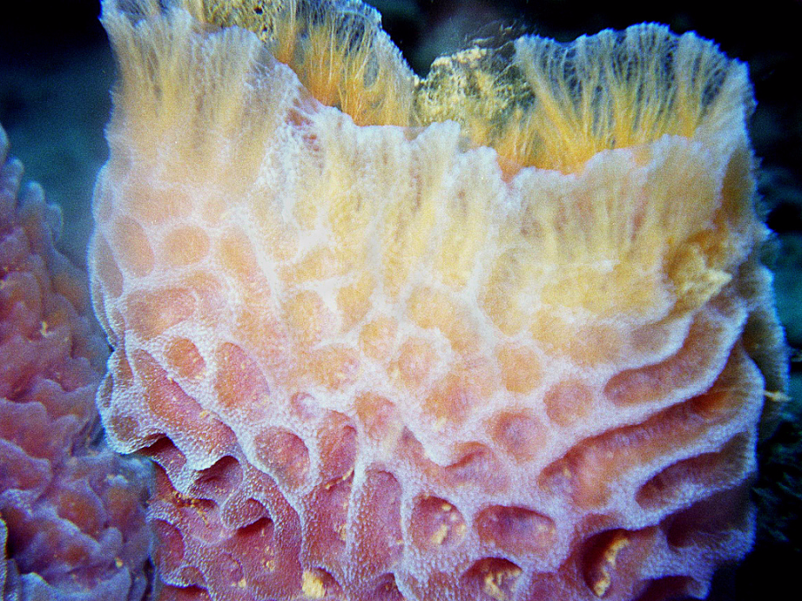
Porifera: Sponges
Sessile: permanently planted
Filter feeder: filters its food as water passes through it
Pores: small openings for water to enter/exit
Flagella line the body cavity and whip water into a current
Skeletons are made of spongy proteins or spicules (spikes made of rocklike material)
Grow around the cavity
Phylum Porifera

Slide 12
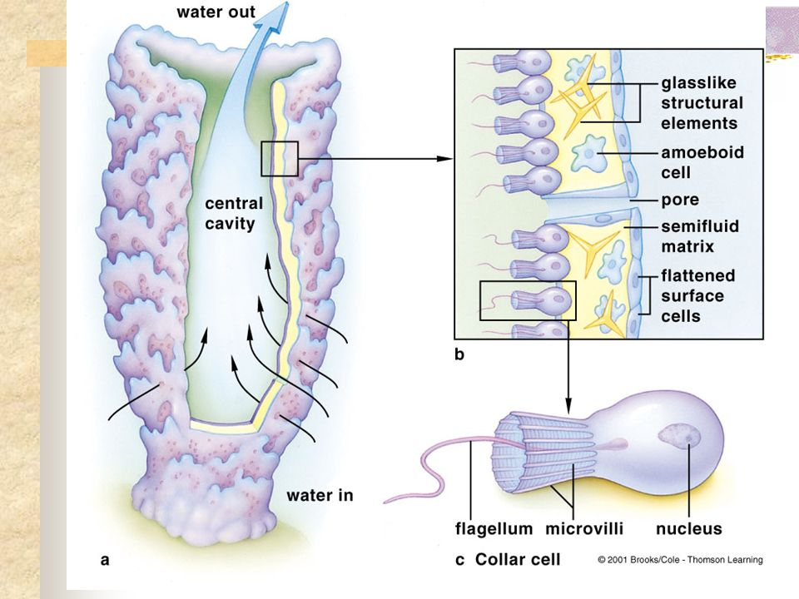
Filter Feeder
Catch algae or particles that flow through the body cavity with the current. Aided by flagella on collar cells that whip the water through.

Slide 13
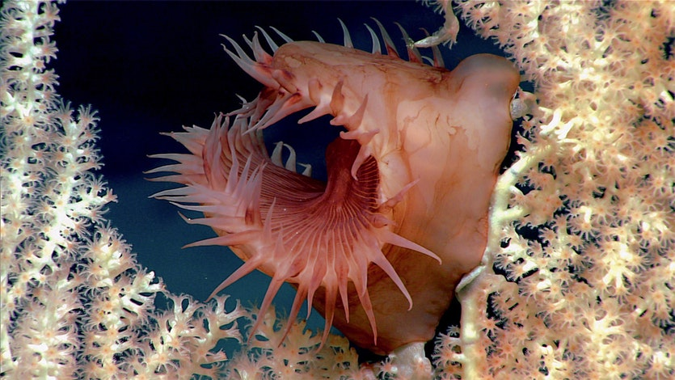

Slide 14
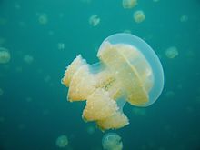
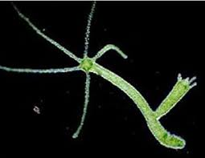
Cnidaria: Jellyfish & Hydra
Shaped in tubular (hydra) or medusa (jellyfish) shapes
Have radial symmetry
Some are sessile, but most move through contraction of water in and out of its body cavity (NOT by tentacles)

Slide 15
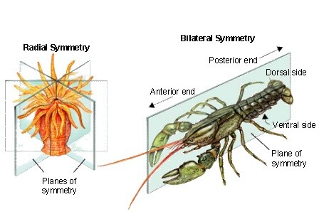
Symmetry

Slide 16
Jellyfish
Phylum Cnidaria
Along with Portuguese-man-of-war, corals, sea anemones
Structure & Movement
Jellyfish have hydrostatic skeletons (water)
Drift with the current, no coordinated movement
Digestion
Has a mouth that leads to a “stomach” called the gastrovascular cavity
Enzymes digest the material which then moves into cells
Has network of nerves and muscle fibers but no brain
Has nematocysts (stinging cells) in their tentacles for defense and to paralyze its food

Slide 17
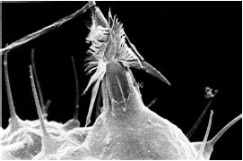
Nematocyst

Slide 18
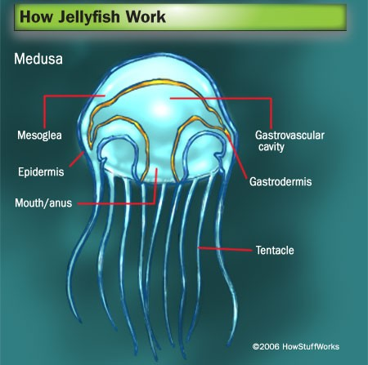

Slide 19
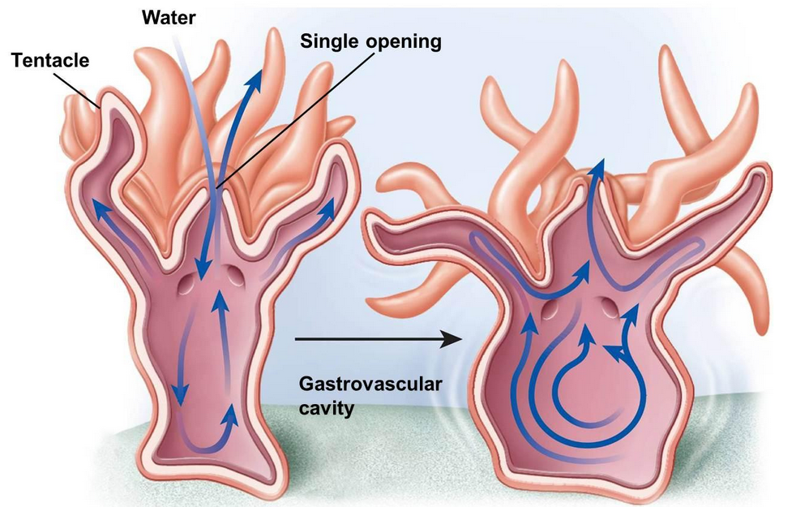

Slide 20
Worms, WORMS, WORMS
Yes, there are three phyla of them!

Slide 21
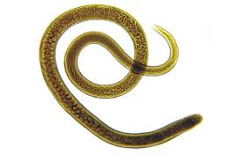
Worms
Bilateral symmetry
Has a basic nervous system that responds to stimulus through sensory receptors
Has a digestive system with intestines, excretory tubes and pores
Breathes through its skin
Can reproduce sexually or asexually through splitting; regeneration

Slide 22
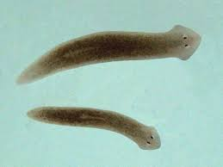
Flatworms
Phlyum Platyhelmithes—flat
Most are parasitic, live in hosts
Has a simple nervous system with head, “brain,” and nerve throughout the body that responds to touch, chemicals, light
Planaria is the most common example—the “cross-eyed worm” with eyespots
Tapeworms

Slide 23
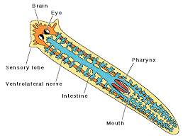
Planaria Diagram

Slide 24
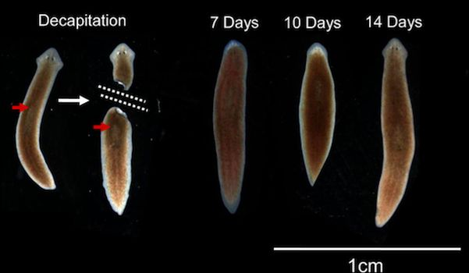
Regeneration

Slide 25
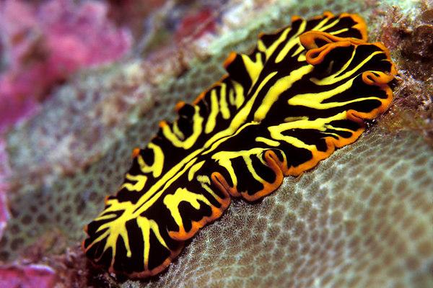
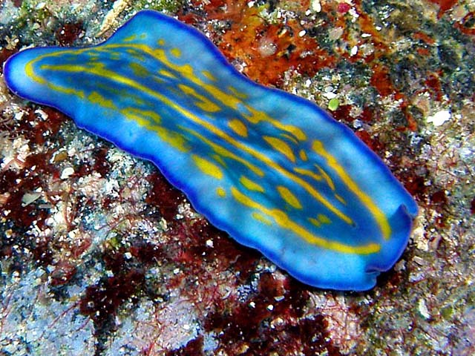
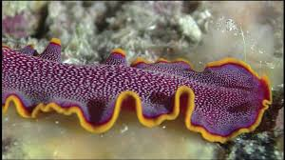
Not all are gross!

Slide 26
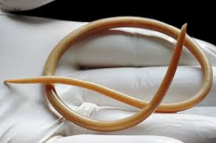
Roundworms
Phylum Nematoda--round
Almost all are parasitic and live in animals’ intestines, but can travel to bloodstream, other parts of the animal by thrashing its muscles
Is killed with thorough cooking (no pink)
Trichinosis was a problem in pig/pork for many years but has been almost entirely eliminated from the USA by tightening standards
More likely in wild animals—bear, rabbit, etc.

Slide 27
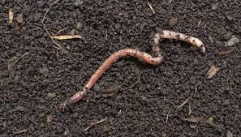
Segmented worms
Phylum Annelida— segmented skin pattern
Also segmented in its organs and tissues inside!
Movement is by a series of complex muscle movements and contractions which pull the worm
Has a more complex nervous system with receptors in its skin and down its tail—responds to light, touch, temperature, chemicals
The earthworm is the most common example
Leeches, tubeworms, fireworms, sandworms

Slide 28
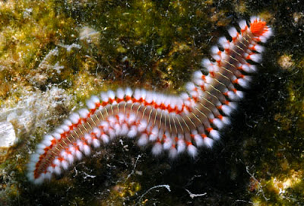
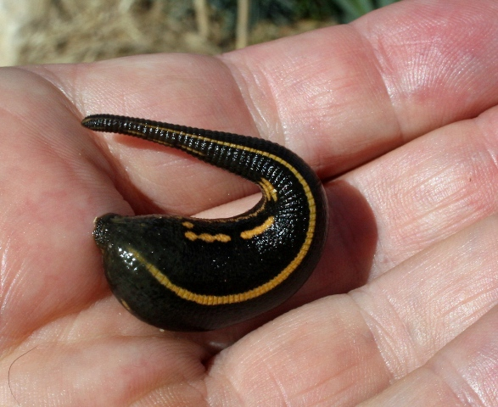
More segmented worms
Notes:
Bristleworm, leech

Slide 29
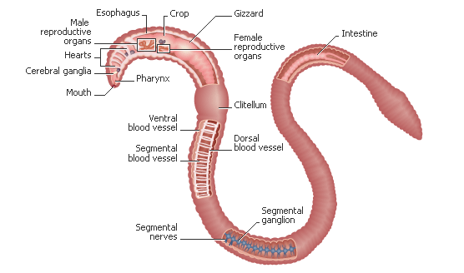
Earthworms
Has a pretty standard digestive system that runs from tip to tail, organs on the way
Has a pretty complex circulatory system that is closed. Has arteries that transport blood away from the heart and veins that pick up blood to carry it back toward the heart. Has blood pressure.

Slide 30
Value of earthworms
Swallows the soil and “digests” it with enzymes
Returns nutrients and fertilizer to soil
Its paths/burrows loosen the soil so the soil gets oxygenated; more air and water is available for plant roots to pick up
Breathes through its skin which is why it rises to the surface after a rain—it cannot breathe when it is submerged

Slide 31
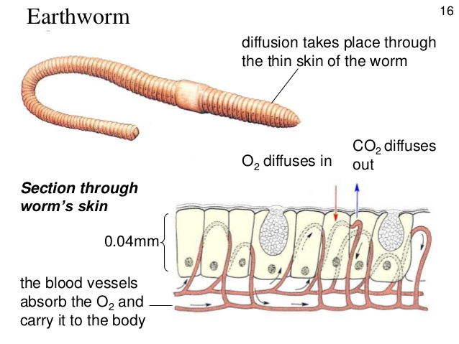
Respiration through Skin

Slide 32
Mollusks & echinoderms

Slide 33
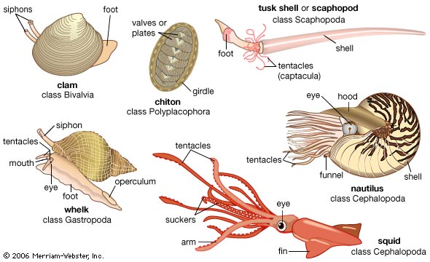
Mollusks
Phylum Mollusca
One shelled (snail), Two shelled (clam), no shelled (octopus)
Known for their defenses and protections
Snails, slugs, clams, octopuses, squids, oysters…

Slide 34
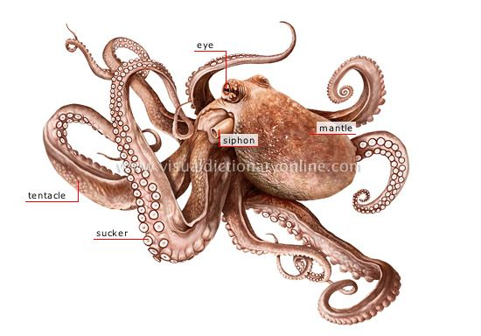
Mollusk--Cephalopod
An octopus has tentacles with suction disks to capture food
Shoots water out of its siphon to move
Soft bodied; can squeeze its body down with muscles
Can regenerate lost limbs
May have poison or ink
Many have camouflage; can change color with fright, anger, or attack
Very complex eyes

Slide 35
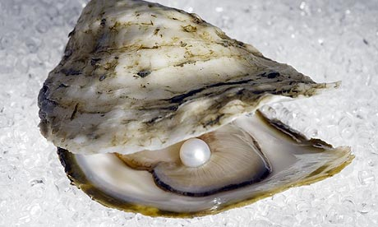
Mollusk—Bivalves
Soft bodied
Mantle: Upper layer of skin produces a coiled shell for protection, which grows a layer each year and slowly thicken (like tree rings)
Moves using a muscular “foot” that can poke, bury itself
Eats or drinks through its siphon
filter feeder
Clams, oysters, mussels

Slide 36
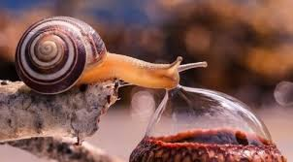
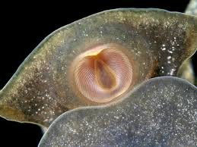
Mollusk--Gastropods
May live in water or land
Leaves a trail of slime
One or no shell
Antennae
Radula which holds its teeth

Slide 37
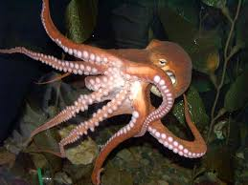
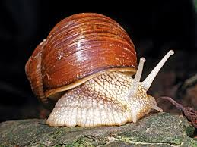
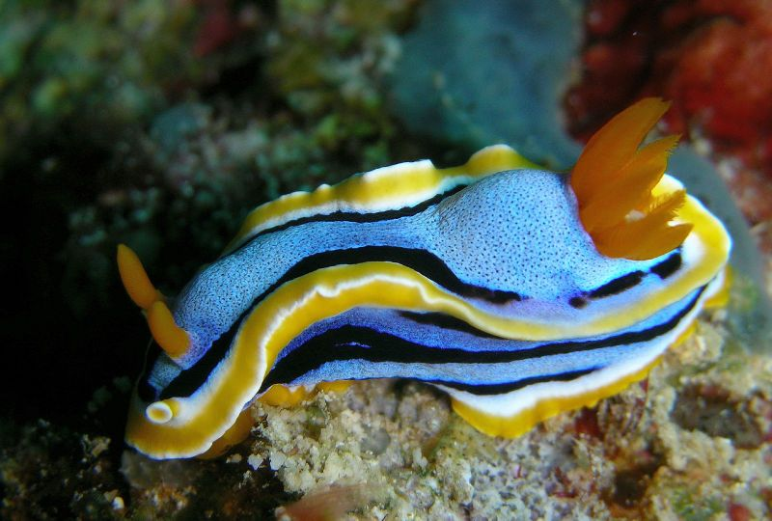
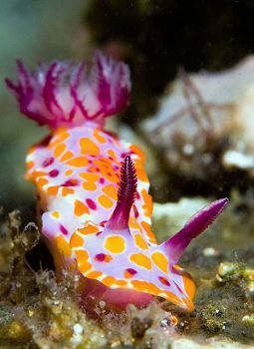
Mollusks
Notes:
Snail, octopus, 2 sea slugs

Slide 38
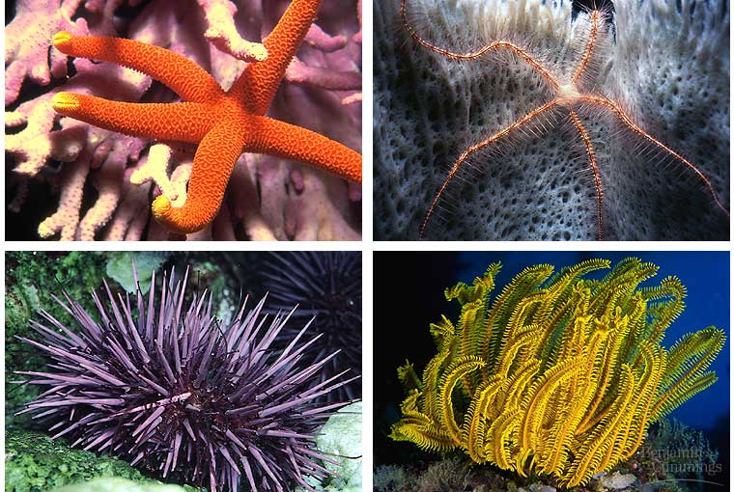
Echinoderms
Phylum Echinodermata
“spiny skin”
Starfish, urchins, sand dollars, sea cucumbers
Extremely tough tissues and muscle fibers, sometimes scales, plates, or spines
Have radial symmetry

Slide 39
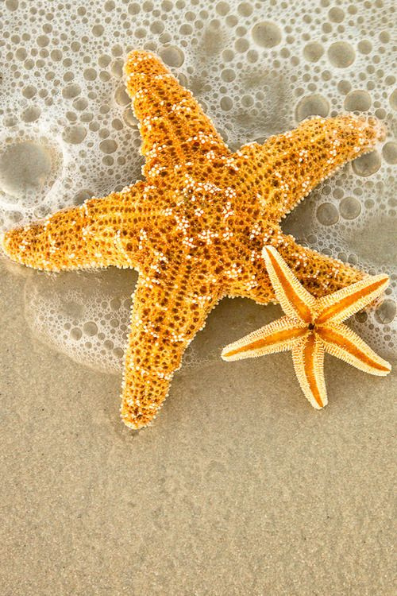
Starfish
The starfish has a water-vascular system that causes its movement.
Tiny tube feet act like suction cups which can pry its food apart.
Can eat outside of its body by protruding its stomach.
Notes:
Brittle Star

Slide 40
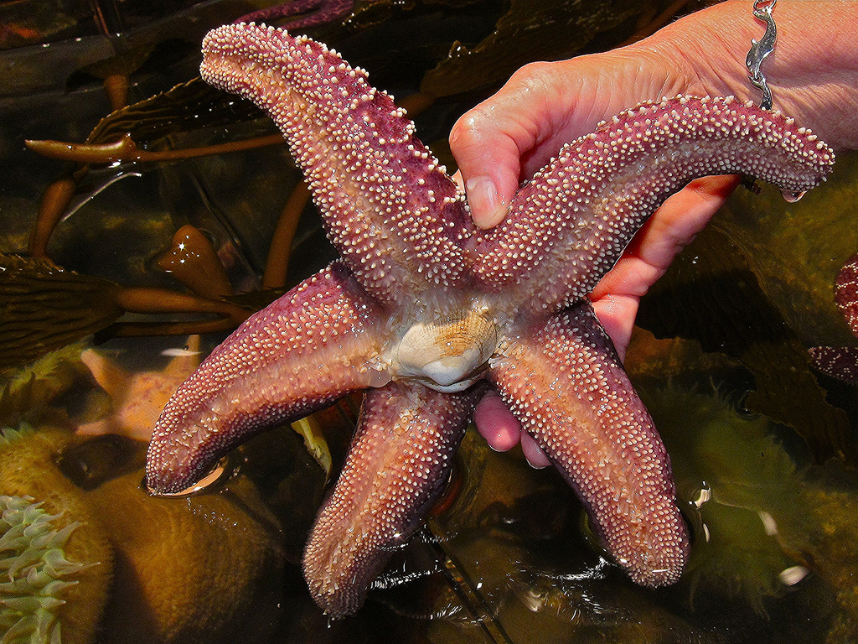
Starfish: Eating
Pushes one of its two stomachs outside its body through its mouth
Then into the clam’s shell which it has pried open with its feet
Then its stomach swallows the soft clam body and begins to digest it before pulling the stomach back in and completing the digestion process

Slide 41
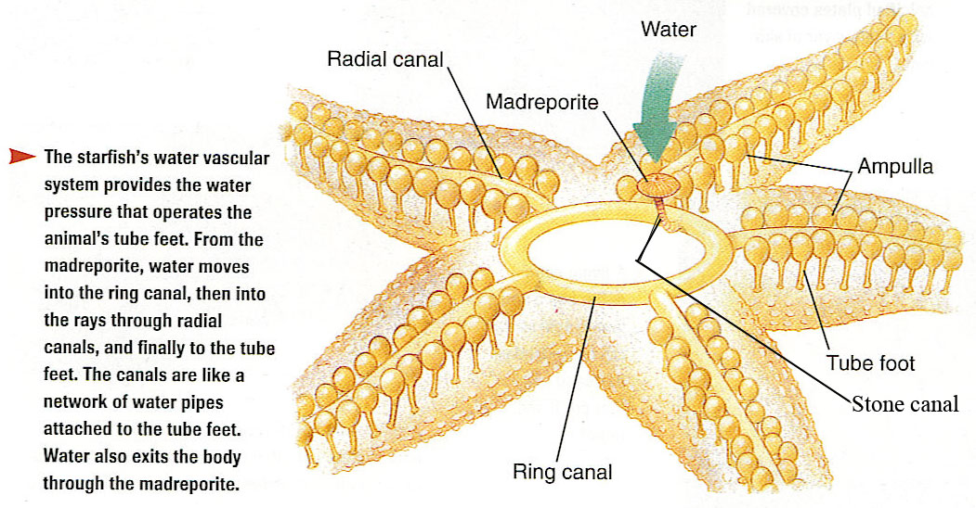
Water-Vascular System

Slide 42
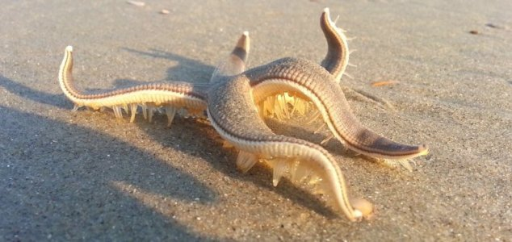
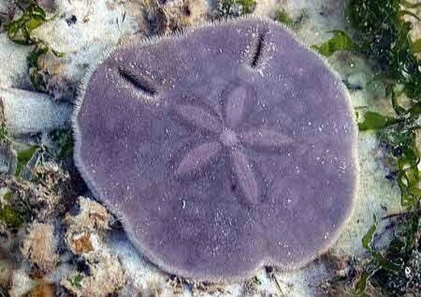
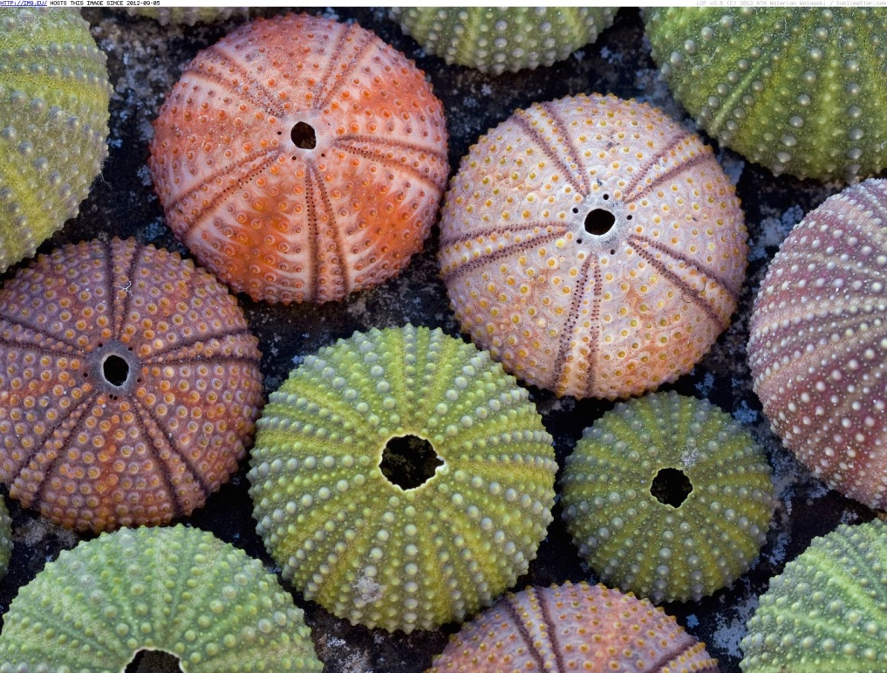
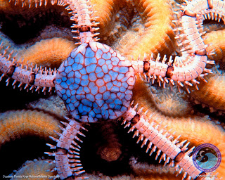
Notes:
Starfish “walking” on beach, sand dollar, brittle star, sea urchins

