Slide 1
Ch16: Arthropods
(Bugs!! Yikes!!)

Slide 2
Insects and More
Phylum Arthropoda-- The largest animal phylum
Crayfish, lobsters, crabs, shrimp, bugs, centipedes, spiders, scorpions, butterflies, ticks, etc.
Have exoskeletons and jointed legs made of proteins
Many have 3 main body parts— head, thorax, abdomen
Often six legs, compound eyes, wings, antennae
Have an open circulatory system (blood flows out over organs with no veins to pickup)
Have relatively normal digestive systems with intestines
Breathe through tracheae (tubes) and spiracles (pores) which pump the air in and out

Slide 3
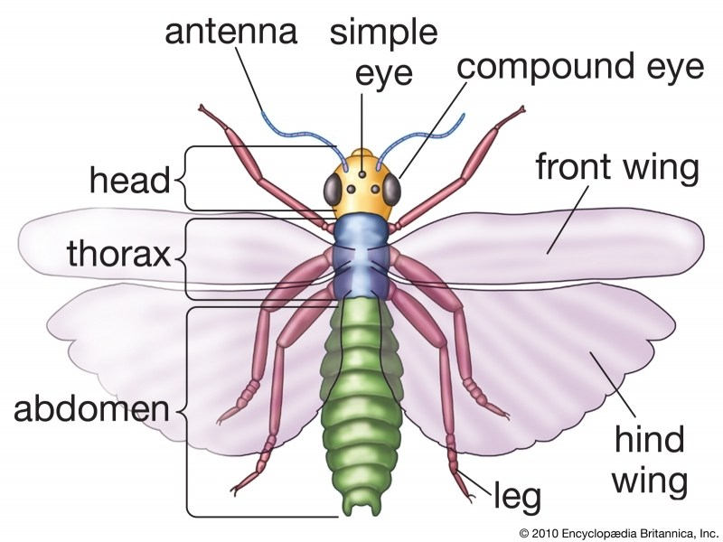
Insect body

Slide 4
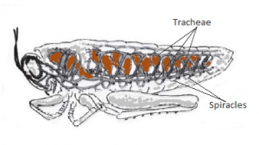
Respiration through Skin
Tracheae are the tubule network
Spiracles are the pores or openings for O2/CO2

Slide 5
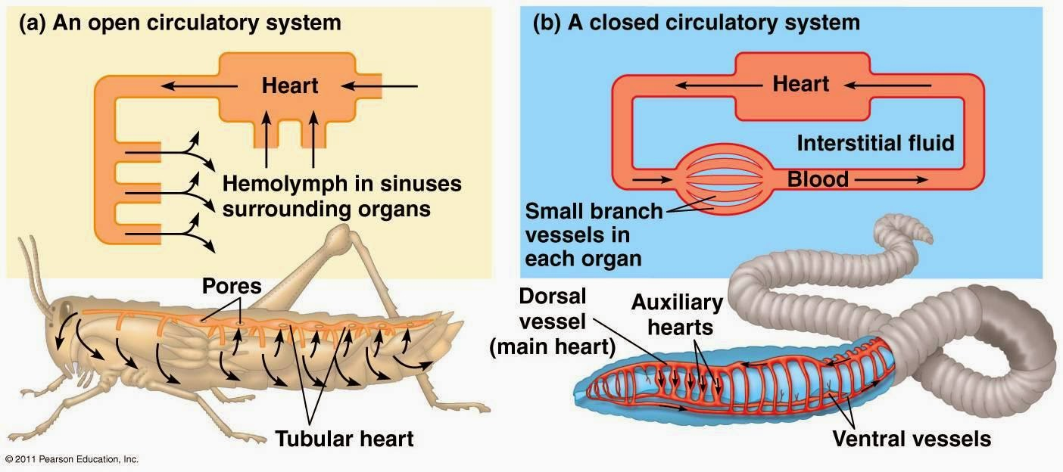
Open v. Closed Circulatory System
Vessels (veins and arteries) to the organs are missing in open systems.

Slide 6
Metamorphosis
Egg
Larvae or “grub” stage (growth)
Pupa/pupate--Cocoon or chrysalis (rest)
Adult
Complete Metamorphosis
Butterflies, moths, beetles, flies…
Incomplete Metamorphosis skip the pupa stage
Grasshoppers, praying mantises
Nymphs look like small versions of the adults

Slide 7
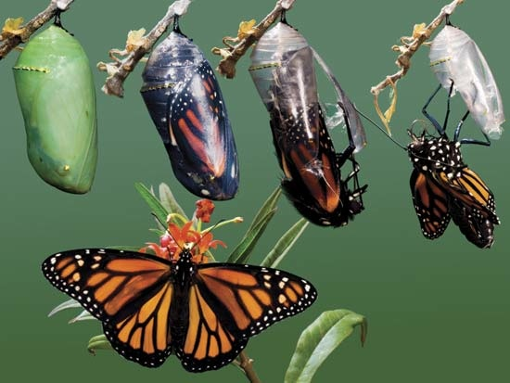
Complete Metamorphosis

Slide 8
Exoskeletons
Normally made of chitin, a strong waterproof protein
Gives a lot of toughness and support to the insect
Very durable
Proteins hard to make, last longer
The insect must molt when it grows because the exoskeleton is not flexible
Molting is when the exoskeleton is shed and grows a new one
A whole series of molting stages may occur within metamorphosis because each exoskeleton is specific and only somewhat flexible

Slide 9
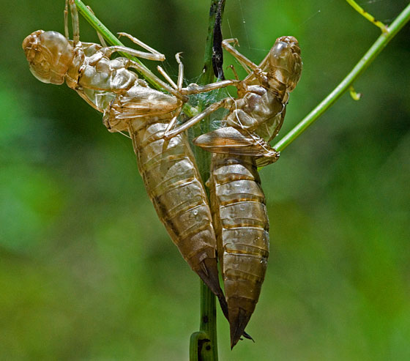
Nymphs shed Exoskeletons
Exoskeletons restrict movement and growth quite a bit
Quite a lot of work to molt!
Triggered by change in hormones

Slide 10
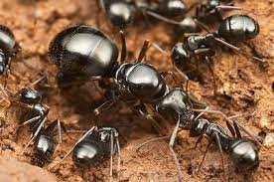
Social Insects
Bees, flies, ants, termites are social—they live in colonies with a strict differentiation of labor (caste system)
They live in a “hive” or collective space which they protect
Most have a “queen” which lays the eggs
“workers “are infertile, usually female
“drones” are male and serve the queen inside the hive

Slide 11
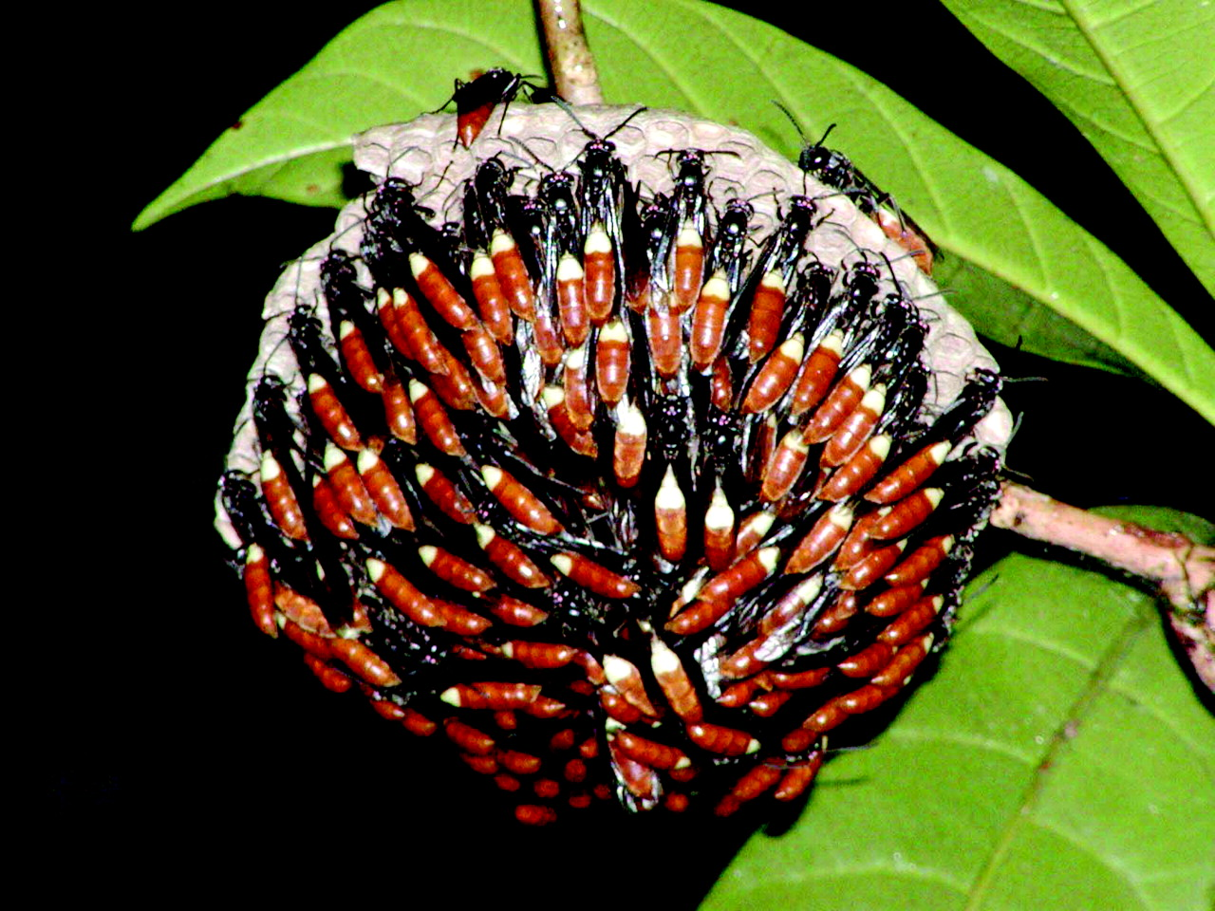
Protecting the Hive
Notes:
Red throated caracara wasp

Slide 12
Different Arthropod Classes
Insecta (insects)
Crustaceans (water dwelling)
Arachnids (spiders)
Chilopoda (centipedes, millipedes)
Differences about legs, antennae, body divisions, wings, etc.

Slide 13
Insecta Orders
Coleoptera- ladybug, Japanese beetle
Diptera- housefly, mosquito
Hymenoptera- bees, ants
Lepidoptera- butterflies, moths
Odonata- dragonfly, damselfly
Orthoptera- grasshopper, roaches
Generally differentiated by number and type of wings (“optera” means “over the land” or “wings”)
Sometimes mouth parts, metamorphosis, or other characteristics

Slide 14
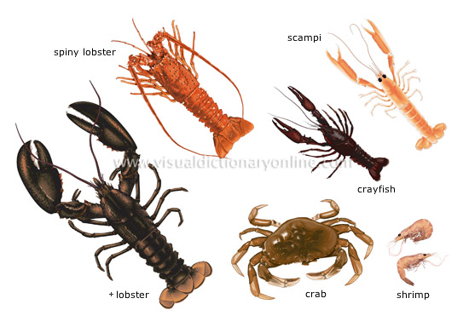
Crustaceans
2 body parts
2 sets of antennae
2 sets of gills
Very interesting respiration systems
Lobsters, shrimp, crabs, barnacles…

Slide 15
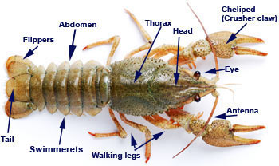
(You Will See This Up Close!)

Slide 16
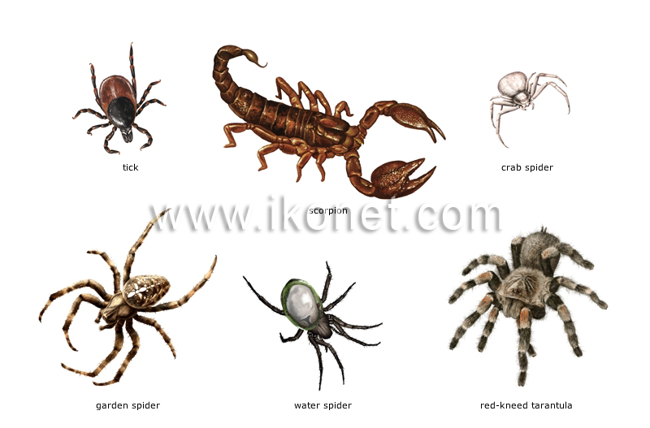
Arachnids
Spiders , ticks, mites, and scorpions!
Eight legs; no wings, mandibles, or antennae (land)
Most spiders spin webs with spinnerets
Very interesting digestive systems

Slide 17
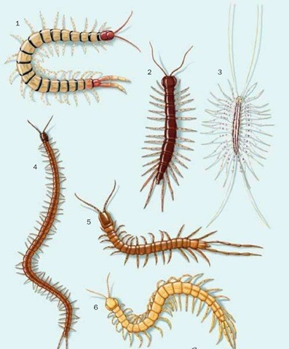
Chilopoda
Centipedes, millipedes
“pod” is “foot”
Still segmented body
Many are venomous, carnivorous

