Slide 1
The HUMAN BODY!!!
The Last Unit… ☺

Slide 2
List of systems
Integumentary (skin)
Skeletal
Muscular
Circulatory
Immune
Excretory
Respiratory
Digestive
Nervous
Endocrine
Reproductive
Protection, defense
Support, movement
Movement
Blood transport
Disease-fighting
Eliminating chemical wastes
Getting oxygen to blood
Absorb nutrients, eliminate wastes
Movement, sensory information
Regulating bodily functions
Producing offspring

Slide 3
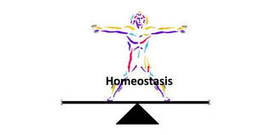
homeostasis
“Homeostasis” means “balance.”
The Human Body needs to stay in balance.
It must respond to stresses, sensations, germs, and other things it encounters every day—and attempt to go back to normal.

Slide 4
homeostasis
Much of homeostasis relies on temperature, hormones, and blood.
If these things are stable, other things usually are. If these things are unstable, it shows the body is experiencing stress/changes and trying to get back on track.
*The circulatory, immune, and endocrine systems work hard in this area.

Slide 5
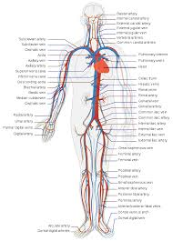
Circulatory system
Pumping oxygen & Nutrients Around the Body

Slide 6
blood
God said, “Life is in the blood.”
For the life of the flesh is in the blood… Leviticus 17:11
Blood is indeed the substance of life.
It carries oxygen, which keeps all living cells alive.
Cells need oxygen for all their processes. Without it, they die. If too many cells die, the tissue/organ also starts to die.
An animal or plant cannot withstand the death of any major organ.

Slide 7
Blood
The circulatory system pumps oxygenated blood through arteries, all throughout the body. It returns through veins to be re-oxygenated.
It is a great recycling system.
Blood also carries vitamins, sugar, hormones, white blood cells, and other important things throughout the body.
Capillaries are tiny blood vessels that reach all the cells of the body. When you cut yourself, blood comes out from the capillaries.

Slide 8
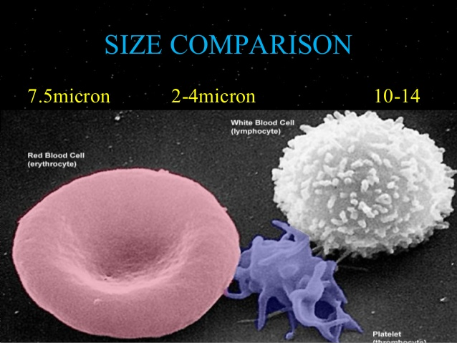
Blood composition
Blood is made of four things:
Plasma (55%)
90-95% water
Vitamins, minerals, proteins, dissolved oxygen and CO2, wastes
Platelets
Clotting agents
Erythrocytes (red blood cells)
Leukocytes (white blood cells)

Slide 9
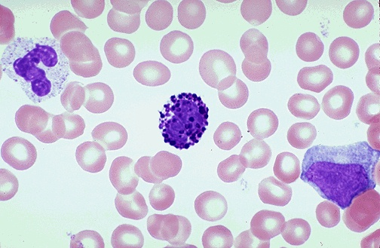
RBC’s and WBC’s

Slide 10
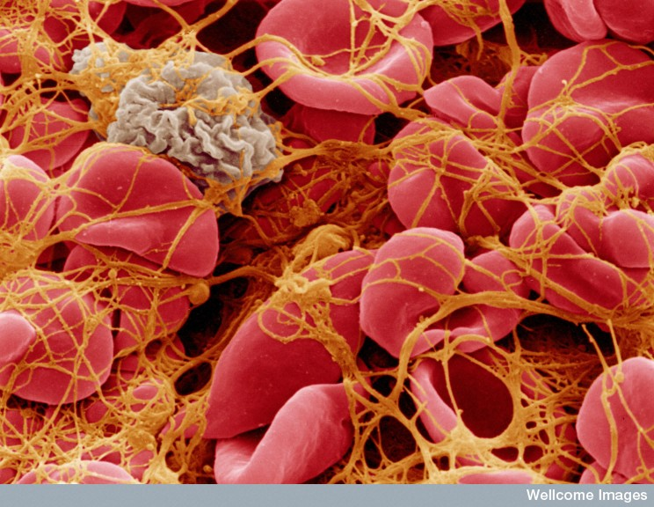
platelets
Platelets are responsible for clotting.
They also constrict the blood vessels to reduce blood flow.
Small, disc-shaped cells
Begin to stick to the blood vessel opening, to plug the hole of a wound
Then create a cell that stimulates a fibrous net to patch the wound
Blood cells catch in the net and hold until new skin cells are formed
Vitamin K is essential for platelet production

Slide 11
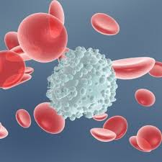
Red blood cells
Erythrocytes:
Red, donut-shaped, carries oxygen
Made in bone marrow
Hemoglobin—protein that binds/carries the oxygen on the RBC (red in color)

Slide 12
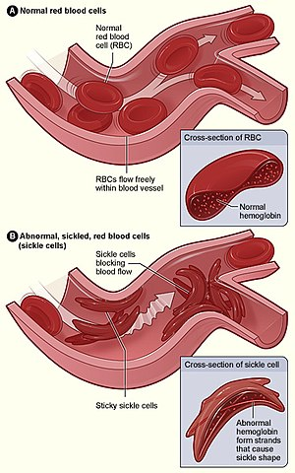
anemia
Anemia—lack of iron, causes low red blood cell count, decreased oxygen in the blood which makes you feel tired all the time
Sickle Cell Anemia—red blood cells are not inflated or well-formed so they don’t carry oxygen; often fatal

Slide 13
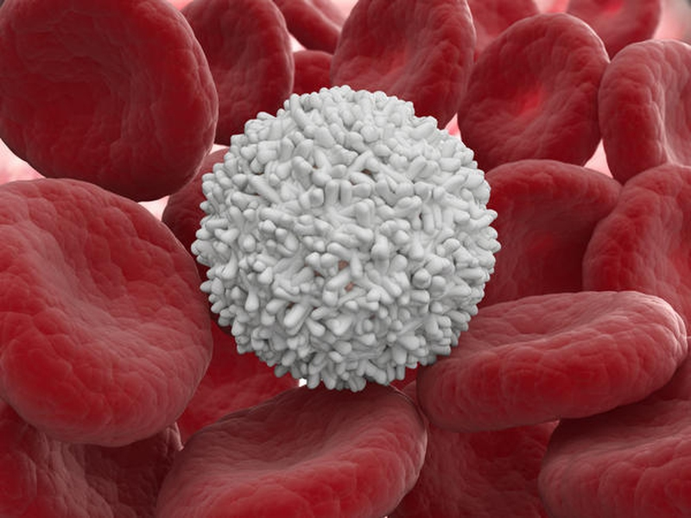
White blood cells
Leukocytes: Different kinds of white blood cells
Provide immunity.
Usually large, circular, different shapes
Some are manufactured in bone marrow
Many are matured in thymus, spleen, tonsils
Leukemia causes
overproduction of immature
white blood cells which fill
the bloodstream

Slide 14
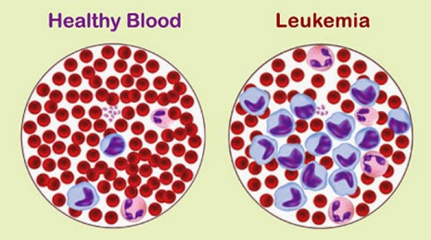
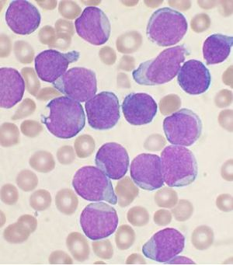

Slide 15
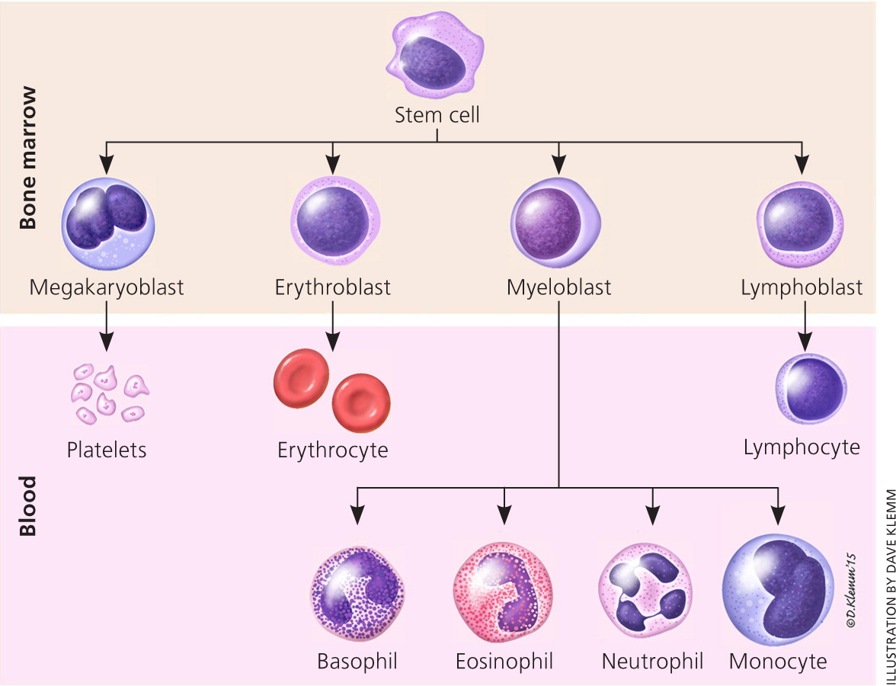

Slide 16
Blood type
Four major kinds: A, B, AB, O
Each type can be positive/negative depending on the Rh factor
This makes a total of EIGHT different types of blood.
One A, B, or O is contributed by each parent, to create six different alleles: AA, AO, AB, BB, BO, OO (multiple alleles)
TRIVIA!!
Blood type O NEG is considered the “universal donor” blood because you can give blood to anyone.
Blood type AB POS can receive blood from anyone!
(Yet, O NEG must receive blood from only O NEG patients, and AB POS can only give blood to other AB POS patients.)

Slide 17
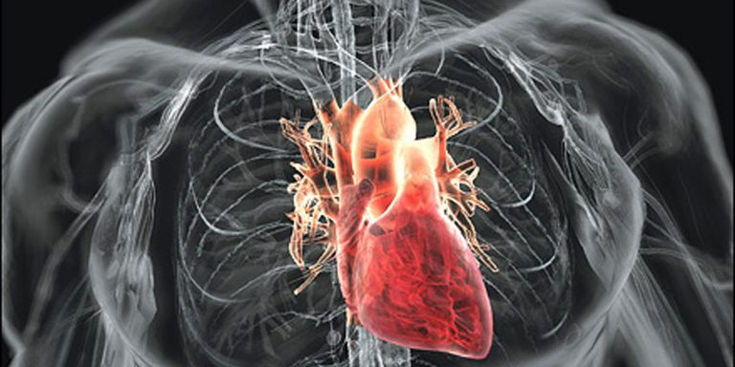
The heart
Center of circulation

Slide 18
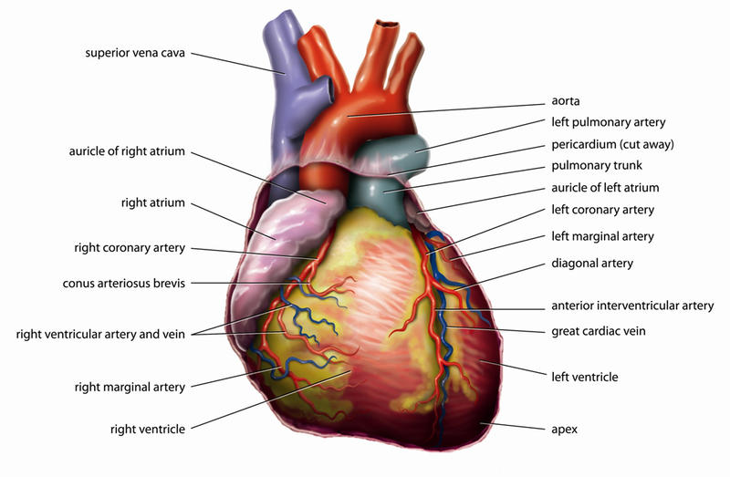
The heart
Striated, involuntary muscle; made of tough fibers
Beats according to electrical impulses, sent through nervous system
Pumps blood out through arteries, in through veins

Slide 19
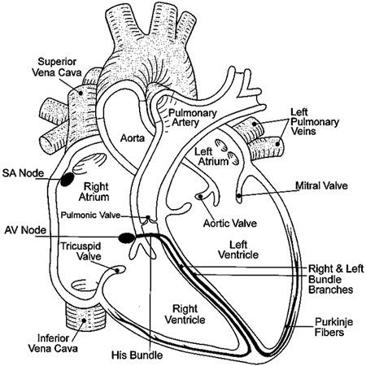
Parts of the heart
Pericardium: the sac
Aorta/Vena Cava (main artery/vein through the trunk)
R/L ventricles
R/L atria
Pulmonary veins, arteries

Slide 20
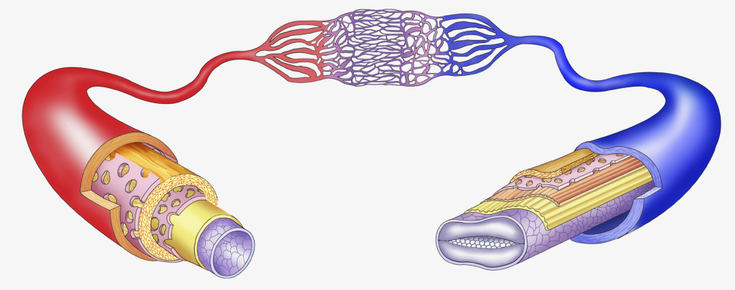
*Arteries v. veins
Arteries are thicker, stronger, and retain their shape (RED)
they receive the push or flow of blood straight from the heart
They are like fortified tunnels or channels
Veins are thinner and collapse as they conduct blood (BLUE)
They are flexible to release blood flow back (i.e. like a turkey baster)
They may have valves or muscles next to them which help direct blood flow back to the heart

Slide 21
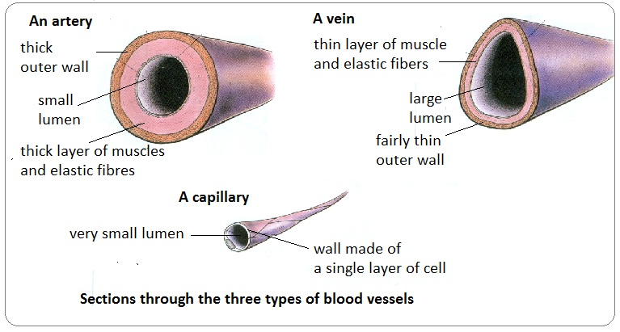
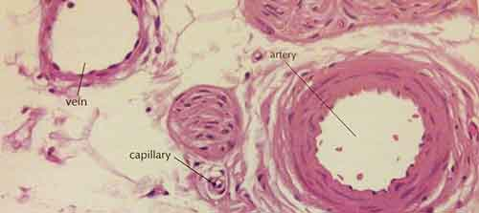

Slide 22
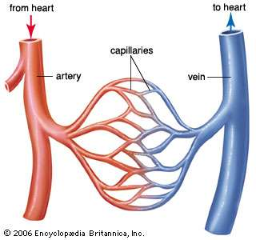

Slide 23
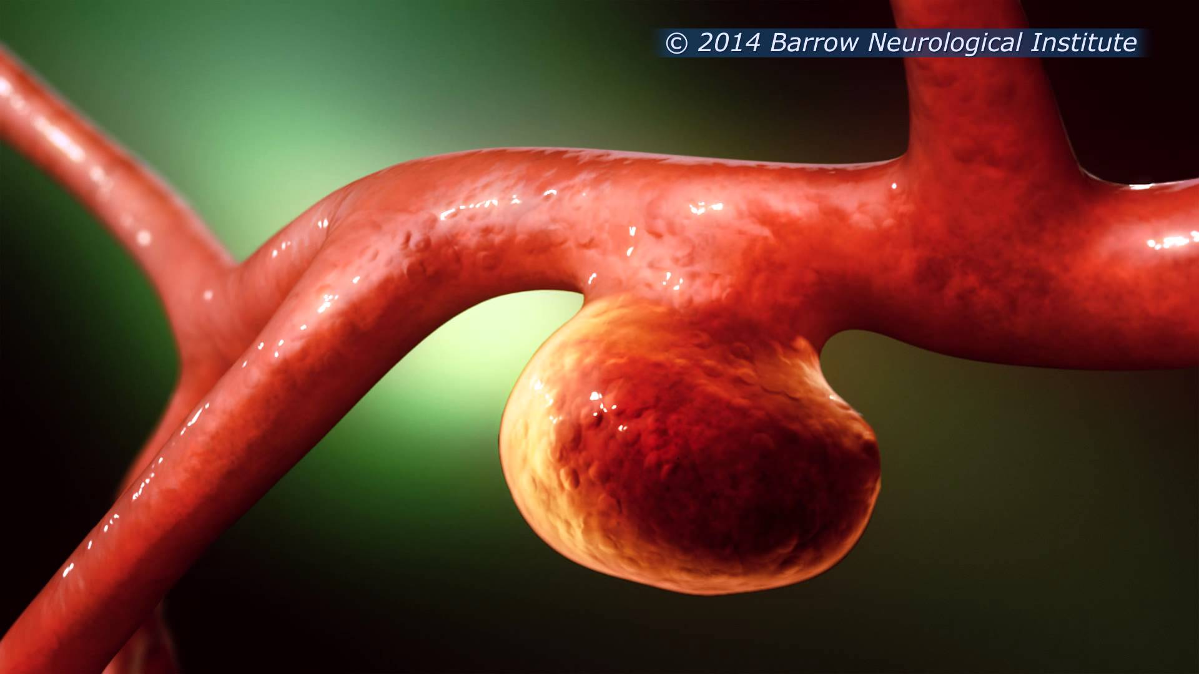
aneurysm
Aneurysm: a bulged out artery wall or heart chamber, caused by high blood pressure

Slide 24
*The heartbeat
Pulse: the number of heartbeats per minute
Pulsating feeling comes from the dilating and rebounding of an artery as blood is pumped through it from the heart
Should be the same, if taken at any major artery
Should be the same as listening to your heartbeat through a stethoscope
Blood Pressure: the amount of pressure (force, push) on the artery walls as blood circulates through
High blood pressure means there may be blockages, artery constriction, or other factors hindering the blood flow/volume
Low blood pressure may mean blood volume is low (dehydration), or a sign of excellent health

Slide 25
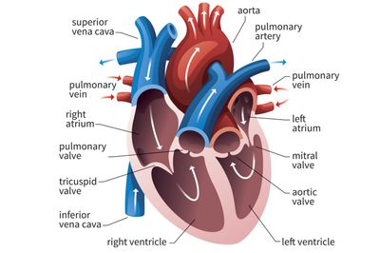
*the cardiac cycle
The “Lubb-Dubb”
The ventricles contract (Lubb)—mitral/tricuspid valves snap closed
The atria contract (Dubb)—the aortic/pulmonary valves close

Slide 26
*Cardiac cycle
Cardiac Cycle: one complete heartbeat, or complete contraction/relaxation of the heart
Nodes start and end the contraction
The sinoatrial node starts the cycle and sets the pace.
The atrioventricular node receives the impulse and causes the heart to briefly pause, letting it empty blood from the atria
Fibrillation: quivering contractions of the heart due to electrical signals overfiring (can be corrected by pacemakers, defibrillators…)

Slide 27
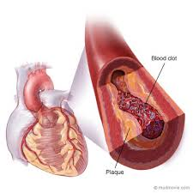
Heart disease
Artherosclerosis: a narrowing of the arteries
Plugged by blood clots (embolis) or fatty deposits (thrombosis)
Narrowing, clogs, plugs restrict the volume of blood getting to the heart—sometimes blocking off the artery entirely
If an embolis breaks free, it can travel around the body’s bloodstream and cause an aneurysm or stroke (if it gets to the brain)

Slide 28
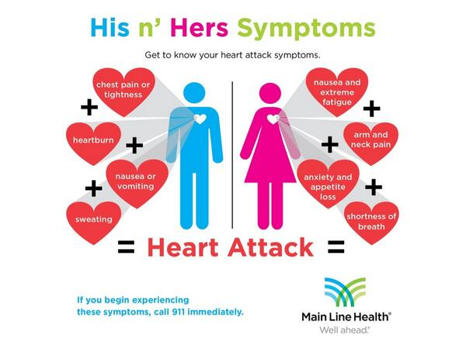
Heart attacks
Extremely common
Number two source of death for women
Symptoms differ between men and women, but can be fatal for both
Symptoms include losing circulation easily (pins and needles), tiring easily, chest pain, trouble breathing
Caused by not enough blood/oxygen getting to the heart

Slide 29
The immune system
Related to bones and blood

Slide 30
First line of defense
Skin
Mucous membranes
Both protect body from internalizing many toxins, germs, allergens
As well as pressures, punctures, infections, etc.
Stomach can kill many things swallowed, through hydrochloric acid

Slide 31
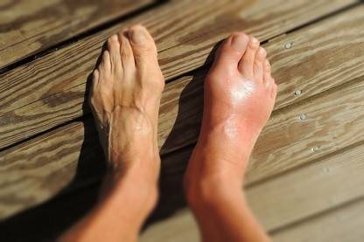
Immune response
Second Line of Defense:
Inflammation- swelling of area due to increased flow of blood and lymph (which carries white blood cells)
Fever- raising of body temperature to burn off germs

Slide 32
*lymphatic system
Lymph: Clear fluid, carries lymphocytes: T and B cells
Carried through lymph vessels, often through lymph nodes
Returns to bloodstream through ducts near the shoulder region
Nodes filter and clean
May swell if sick because toxins accumulate there
Under throat, armpits
Lymphoma is cancer of the lymph nodes.

Slide 33
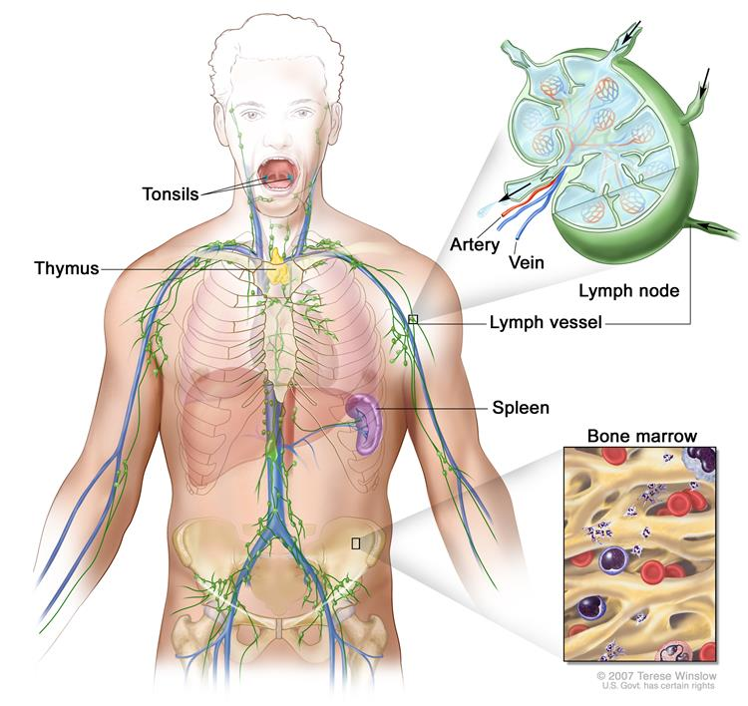

Slide 34
*lymphocytes
B cells: mature in red bone marrow; humoral immunity
- produce chemical antibodies dissolved in blood plasma
T cells: mature in thymus gland; cell-mediated immunity
- fight antigens directly, through engulfing or otherwise
Both have memory cells which remember germs and toxins.
There are over 200 different kinds of cold viruses!!
Multiple Myeloma- a cancer of white blood cells which accumulates in the bone marrow ; malignant cells do not produce antibodies

Slide 35
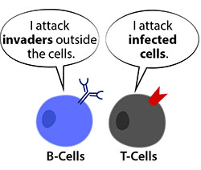

Slide 36
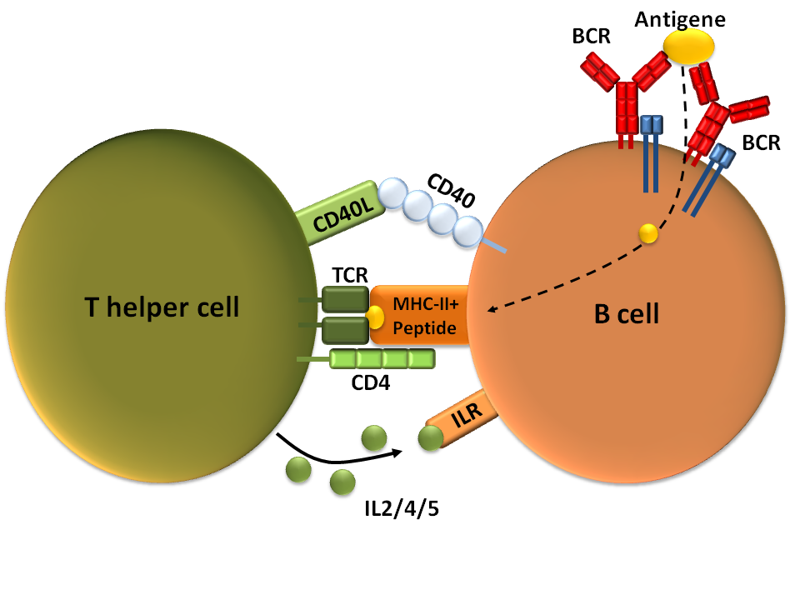

Slide 37
Antibodies and antigens
White blood cells (B cells) produce antibodies which fight antigens
- through making chemicals in blood
Very specific, fights only one toxin
Is stimulated by the toxins themselves
- a vaccine introduces a weakened amount of toxin to get the antibodies to produce themselves (active immunity)
- the body will eventually make its own and remember them for the future (active immunity)
Passive immunity is conferred from mother to child; through pregnancy/nursing, but is not foolproof, does not last as long as active immunity

Slide 38
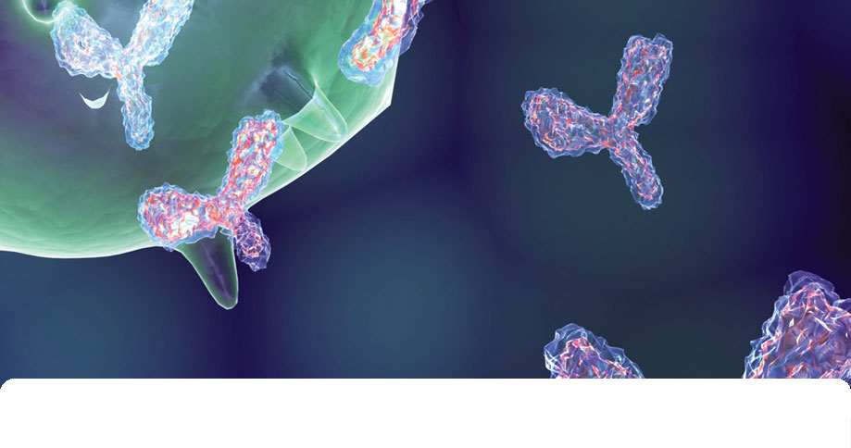
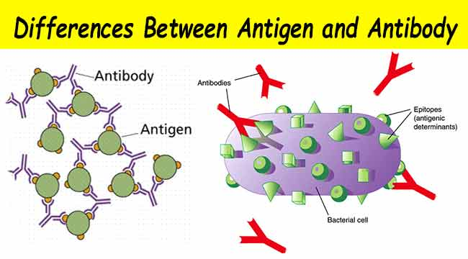

Slide 39
*How Antibodies fight
Antibodies are specific chemicals that fight germs, pathogens.
Neutralization: antibody binds itself to the virus and prevents it from entering a cell
Precipitation: causes antigens to bind together in large clumps
Agglutinization: causes infected cells to clump together
Immobilization: antibody can freeze flagellated bacteria cells to stop moving so they can be dealt with

Slide 40
allergies
Allergies are immune responses to things which are not toxins
Body attacks something it feels is bad, but its attack can make it worse for the body
Body will go into shock if the reaction is bad enough
Epinephrine (epi pens) can restart the heart
Antihistamines (like Benadryl) can counteract the allergen response reaction

Slide 41
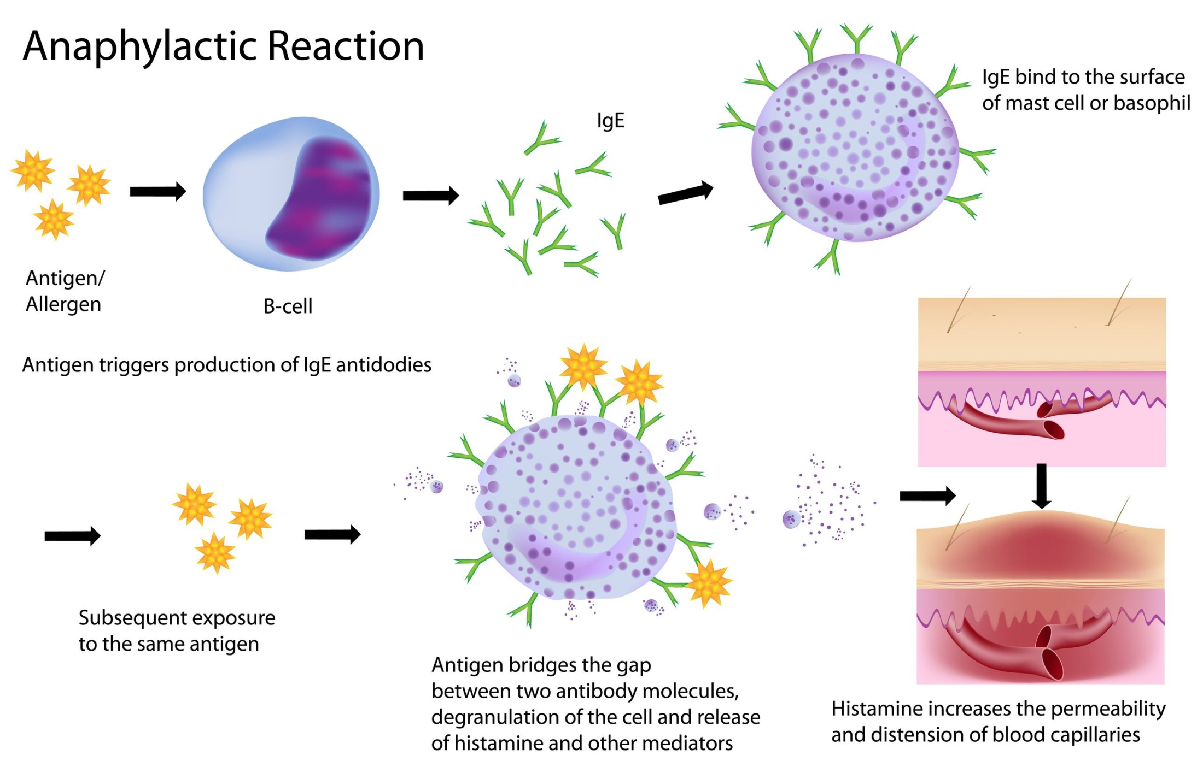

Slide 42
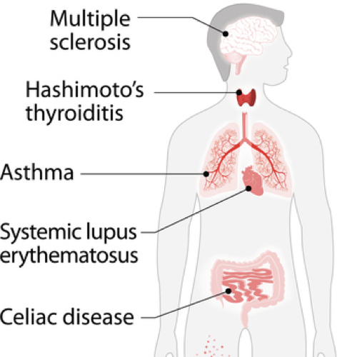
Autoimmune diseases
The body attacks itself, sees its own cells or tissues as harmful.
Antibodies and T-cells attack the body causing pain, inflammation, damage to joints, organs…
Lupus
Diabetes (Type I)
Multiple Sclerosis (MS)
Rheumatoid Arthritis
Hashimotos Disease
Celiac Disease or IBD

Slide 43
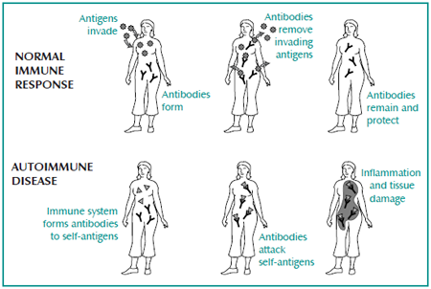

Slide 44
YOUTUBE
https://www.youtube.com/watch?v=oHMmtqKgs50 (lubb dub)
https://www.youtube.com/watch?v=HNP1EAYLhOs (killer T cells)
https://www.youtube.com/watch?v=qKGm3CXBCGU (immune/lymph)

