Slide 2
Last Week:
Marxism is about uprooting those who have historically had power, and replacing them with those who have historically not had power.
Socialism is an economic way of doing this, since money is an obvious source of power.
Forceful redistribution of money (land, resources) is called “Communism.”
Gentle redistribution of money is called “Democratic Socialism” (or “Social Democracy”).
Both make a nation poorer, less productive.

Slide 3
Other Sources of Power
Money is one source of power, but not the only one.
Social power, or Status/Favor is also important.
Cultural Marxists argue that this precedes economic power:
Certain traits make some people groups prosper and others fail. Institutions that transmit those traits hold ultimate power and need to be radically transformed.

Slide 4
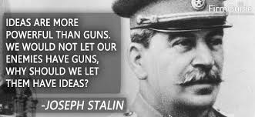

Slide 5
Cultural Marxism
Values need to change so that social power will shift away from those who currently have favor towards those who don’t.
Redistributive processes of attention and favor will shift current power trends.
Schools, experts, news, lawmakers
art, music, TV, celebrities, products, fads
Policies need to be created that keep that new power there and prevent old powers from re-acquiring it.

Slide 6
It’s a Re-Balancing Act!
Economic and Cultural Power
Marxist Economics: Socialist economics will make everything equal!
Cultural Marxism: Culture war is how to get the Desirables to switch with the Undesirables, and offload those who resist.
We “subsidize” (or reward) what we want to see more of, and “tax” (punish) what we want to see less of.
Oppressed/Oppressor Narratives: Who or What have had power in the past?
Christianity
Capitalism
Democracies of Europe/USA

Slide 7
It’s About Groups
Old favored groups
New favored groups
Male
Christian
White
Heterosexual
“Normal”
American
Rich/Capitalist
Employed
The upright citizen
Female
Non-Christian
Non-white
Non-Heterosexual
Alternative
Non-American
Poor/Socialist
Unemployed
The imprisoned, deviants, disenfranchised, rebels, unwanted, illegal resident

Slide 8
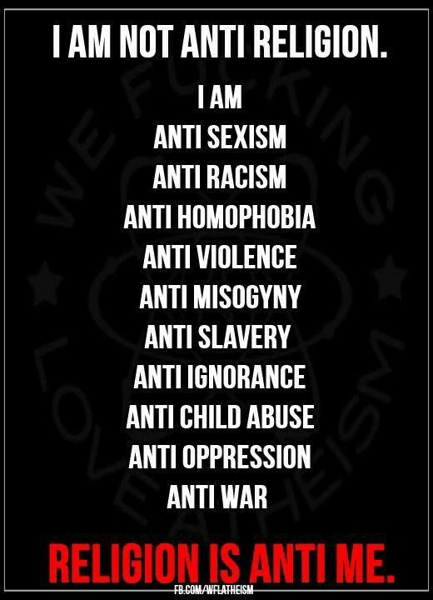

Slide 9
Cultural Marxism Principles
Reversal: The Desirables of this world will be the Undesirables of the next.
Revenge: Hate is permitted until reversal occurs
Progress IS reversal: We cheer when reversal happens, no matter the cause/cost. We cannot celebrate any example of normalcy.
Social justice vs. injustice
Censorship, the Volume Knob
Spin
Identity Politics, United in Hate

Slide 11
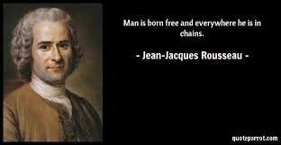

Slide 13
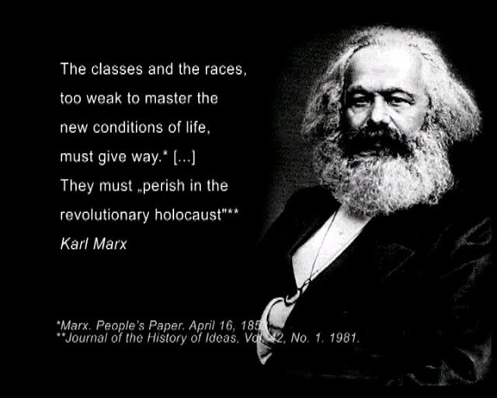

Slide 14
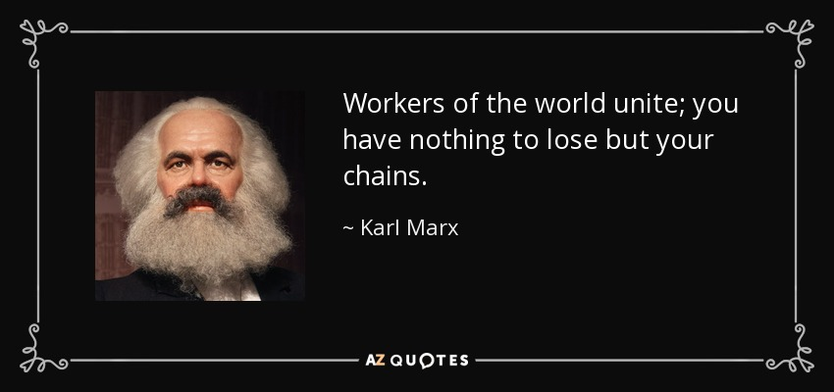
Darwinian struggle of the poor against the rich, the Have Nots against the Haves
Need to swarm: bloody revolution to win the future; ends justify the means

Slide 15
For though we live in the flesh, we do not wage war according to the flesh. The weapons of our warfare are not the weapons of the world. (2 Cor. 10:3-4)
Why not say, “Let us do evil
that good may result?”
Their condemnation is deserved! (Rom. 3:8)

Slide 17
Dominant Worldview of Today
The basis of all problems across the globe are struggles over limited resources between the more and less powerful
The more powerful people in the world exploit resources and oppress the poor so they can’t get at them
Those who are exploited respond to their oppression and cause other social problems they get blamed for (crime, etc.).
Most of us have been indoctrinated into this worldview instead of into a Biblical one.
Notes:
This is called “Conflict Theory” in the literature.

Slide 18
Schools, media, and educational outlets are seen as maintaining existing evil power structures.
They are seen as funded by the rich and favored to maintain inequality. Need to be reversed or eliminated completely.
Society’s basic problem is a bunch of power struggles. (i.e. not individual sin).
Good socialist institutions/governments will help resolve these power struggles in the PC way.
Culture War on Christianity is a great starting point since it launched the whole of Western Civilization (the sickness we’re fighting).

Slide 19
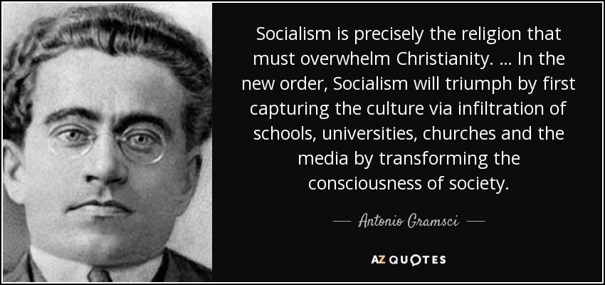
Churches?

Slide 21
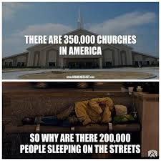

Slide 22
Mt. 26:10-11
Aware of this, Jesus asked,
“Why are you bothering this woman?
She has done a beautiful deed to Me.
The poor you will always have with you,
but you will not always have Me.*
Notes:
Again, attention and favor are off, in the Marxist worldview, not the identiication of poverty as an important issue. Also worldview of how to solve is off. Jesus knew that a bag of silver given to the poor would not ultimately solve that problem.

Slide 23
Psalm 25:1-3
To You, O LORD, I lift up my soul.
O my God, in You I trust, Do not let me be ashamed; Do not let my enemies exult over me.
Indeed, none of those who wait for You
will be ashamed; Those who deal treacherously without cause will be ashamed.

Slide 24
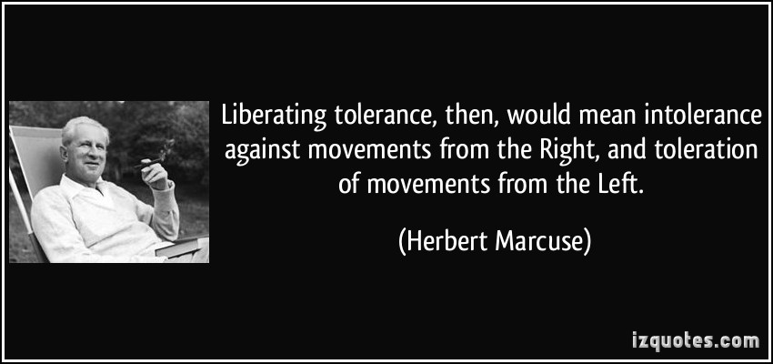

Slide 25
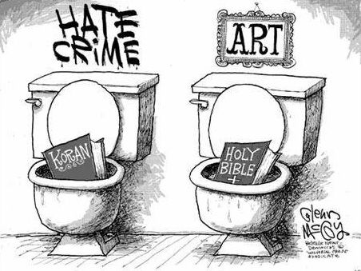

Slide 27
Gramsci: “Everything is political.”
All the “free” choices you make everyday… everything you buy (don’t buy), eat (don’t eat)…
You won’t freely choose Revolution.
You won’t freely choose the Collective.
You won’t freely choose the Correct options.
Sooo… we help you.

Slide 28
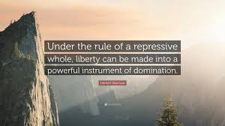
Marcuse

Slide 29
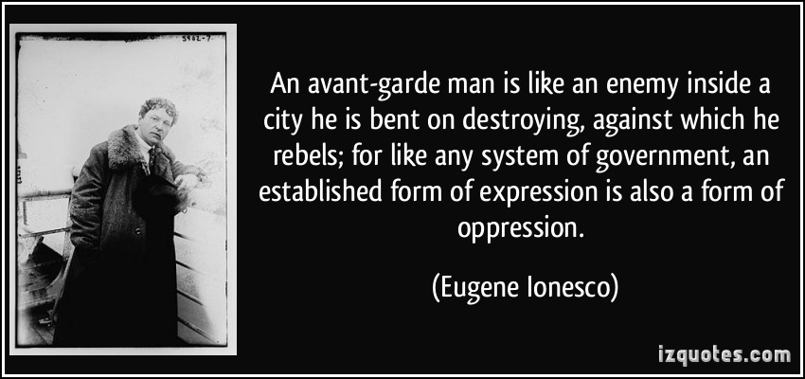

Slide 30
Psalm 2:1-3
“Why do the nations rage and the peoples plot in vain? The kings of the earth set themselves, and the rulers take counsel together, against the LORD and against his Anointed, saying, “Let us burst their bonds apart and cast away their cords from us.”

Slide 31
Romans 7:7
Well then, is the law of God is sinful?
Of course not!
In fact, it was the Law that showed me my sin.
I would never have known that coveting is wrong if the Law had not said,
"You must not covet."

Slide 32
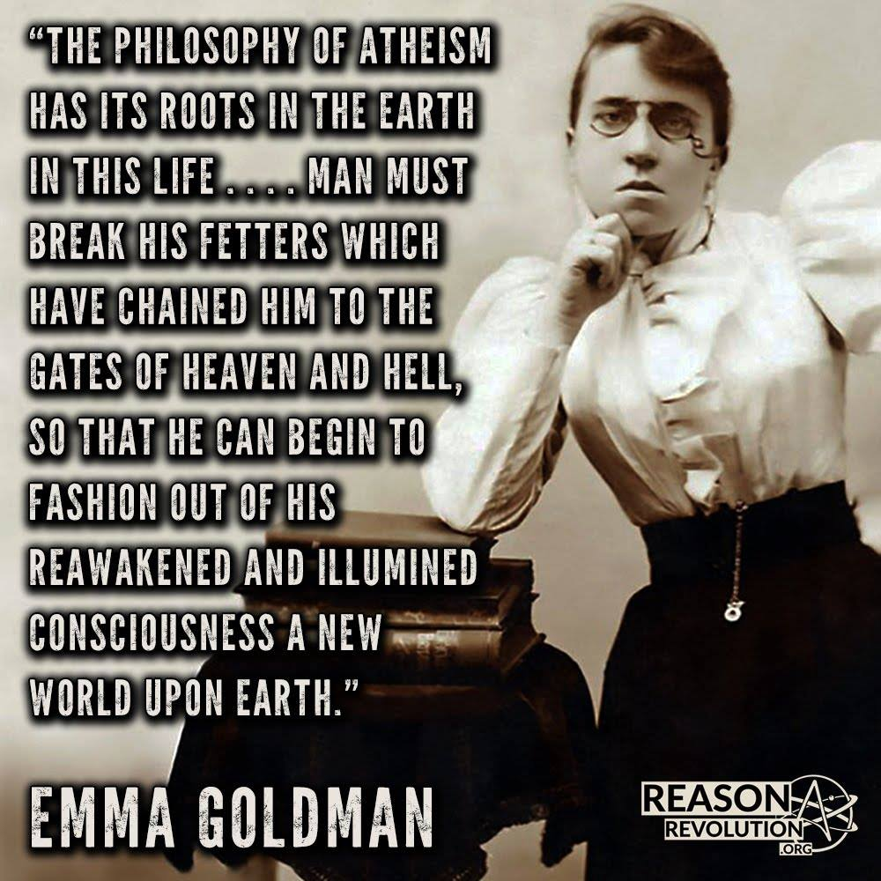

Slide 33
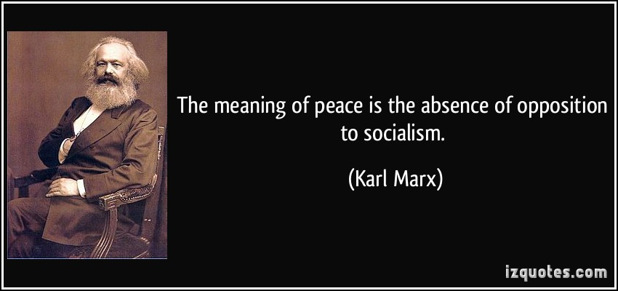

Slide 35
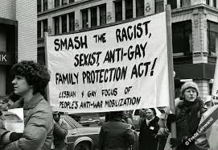
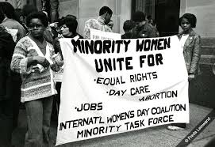

Slide 38
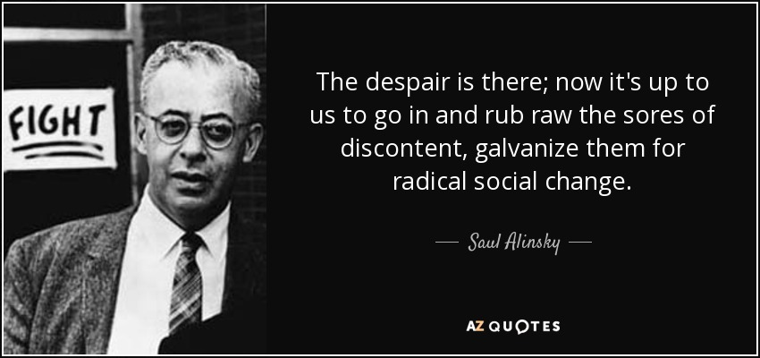

Slide 39
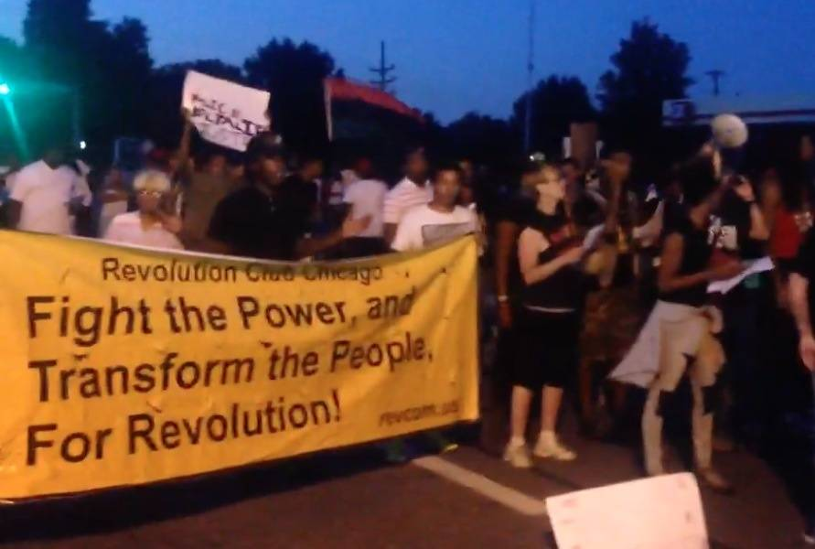

Slide 40
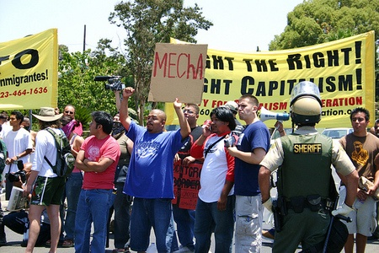

Slide 41
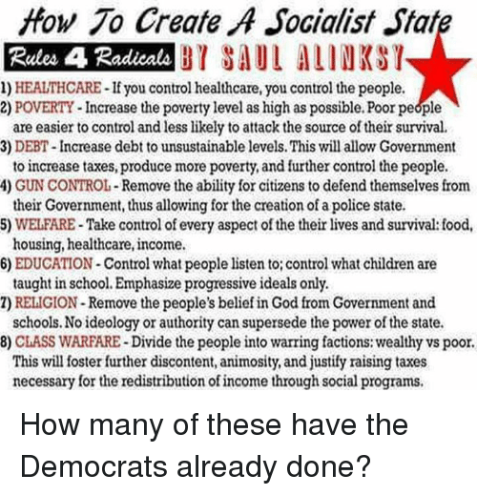

Slide 42
Huffington Post

Slide 43
If the world hates you,
understand that it hated Me first.
If you were of the world,
it would love you as its own.
Instead, the world hates you,
because you are not of the world,
but I have chosen you out of the world.…

Slide 47
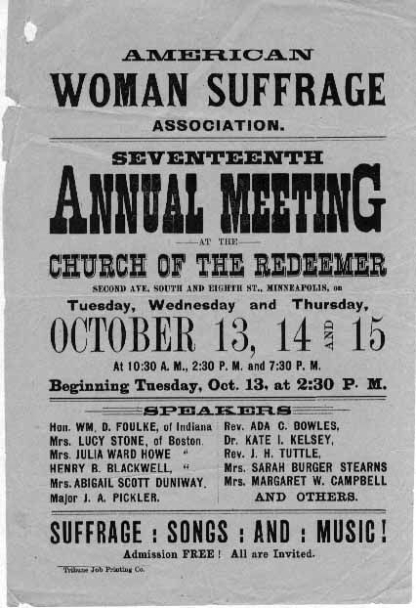
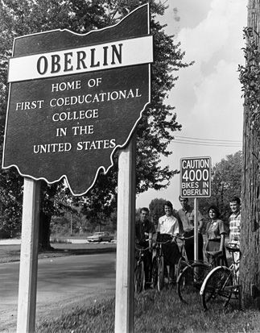
Notes:
1833 Oberlin

Slide 48
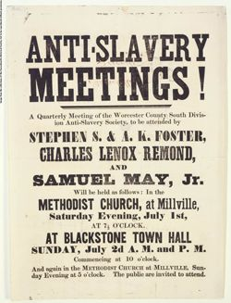
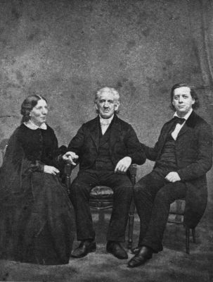
Notes:
1830s-50s

Slide 49
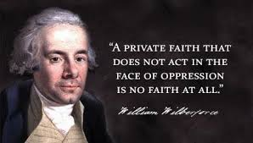

Slide 50
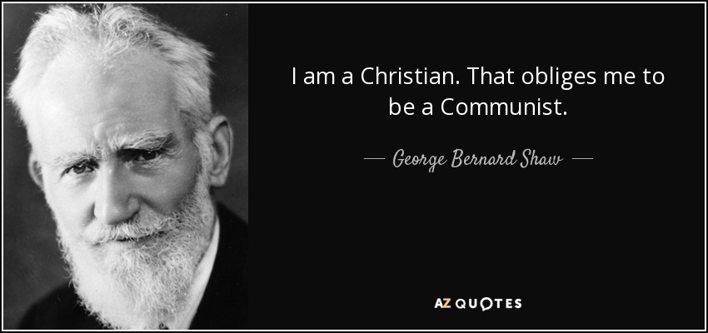

Slide 53
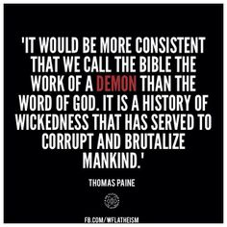

Slide 55
1Tim. 1:9-11
We realize that the Law is not enacted for the righteous, but for the lawless and rebellious, for the ungodly and sinful, for the unholy and profane, for killers of father or mother and for murderers, for the sexually immoral and homosexuals, for slave traders, liars and perjurers, and for anyone else who is averse to sound teaching that agrees with the glorious gospel of the blessed God, with which I have been entrusted.…

Slide 56
Matthew 5:16-18
In the same way, let your light shine before men, that they may see your good deeds and glorify your Father in heaven.
Do not think that I have come to abolish the Law or the Prophets; I have not come to abolish them, but to fulfill them.
For I tell you truly, until heaven and earth pass away, not a single jot, not a stroke of a pen, will disappear from the Law until everything is accomplished.…

Slide 57
What does LOVE mean?
Acceptance?
Aid?
Finding solutions?
What did Jesus mean, by LOVE?

Slide 58
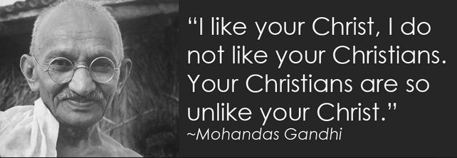
Notes:
Does anyone ever say, “I like your atheism, but I do not like your atheists. Your atheists are so unlike their atheist founders?” Or, “I like your Hindu yogis, but not your Hindus. Your Hindus are so unlike your bodhisatvas.”

Slide 61
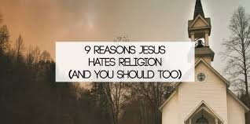

Slide 65
Not Doing Church Right?

Slide 66
Not Likeable?

Slide 67
Similar Message?

Slide 69
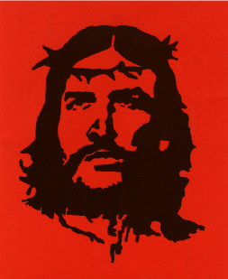

Slide 70
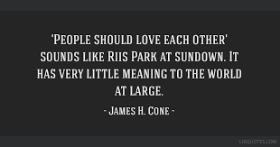
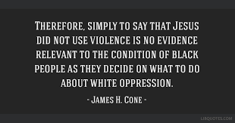

Slide 71
2 Cor. 10:3-5, 18
For though we live in the flesh, we do not wage war according to the flesh. The weapons of our warfare are not the weapons of the world. Instead, they have divine power to demolish strongholds.
We tear down arguments, and every presumption set up against the knowledge of God; and we take captive every thought to make it obedient to Christ…
For it is not the one who commends himself who is approved, but the one whom the Lord commends.

Slide 72
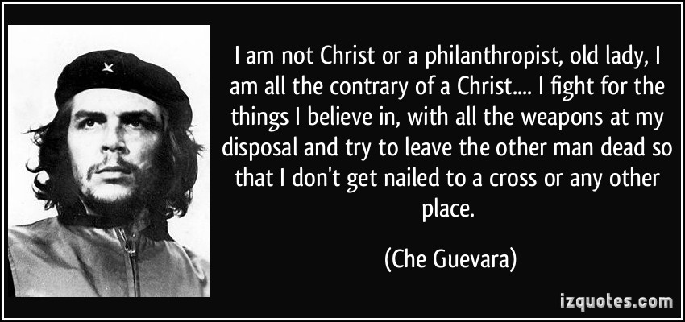

Slide 73
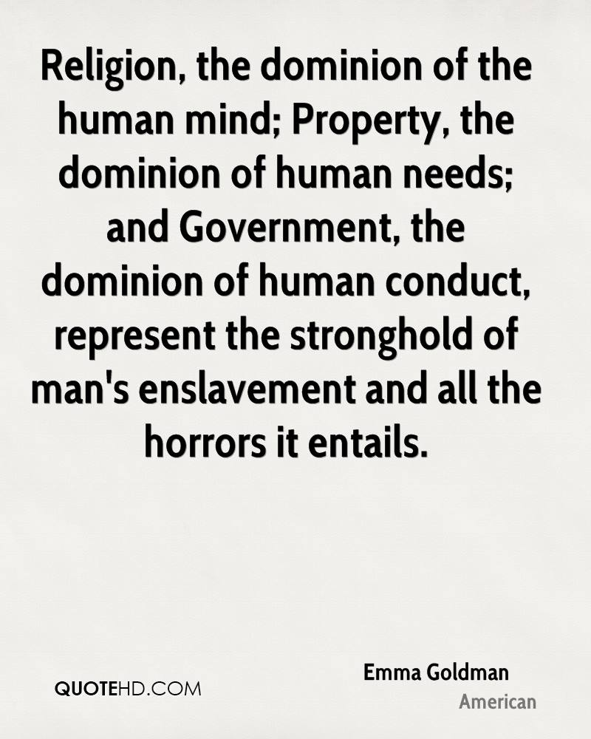

Slide 74
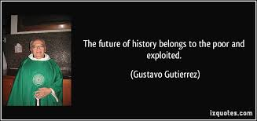

Slide 77
2 Tim.4:2-5
Preach the word; be prepared in season and out of season; reprove, rebuke, and encourage with every form of patient instruction.
For the time will come when men will not tolerate sound doctrine, but with itching ears they will gather around themselves teachers to suit their own desires.
So they will turn their ears away from the truth and turn aside to myths.
But you, be sober in all things, endure hardship, do the work of an evangelist, fulfill your ministry.

