Slide 1
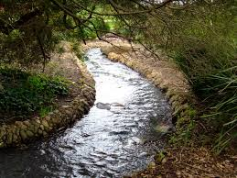
Streams, Lakes, and Ponds
Chapter 16

Slide 2
Study of Bodies of Water
LIMNOLOGY: the study of surface and groundwater, including streams, rivers, lakes
Limnologists have to have broad scientific knowledge because surface and ground waters are intricately connected to the local weather, geology, biology, and chemistry of a region

Slide 3
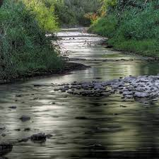
Streams

Slide 4
What is a stream?
Streams are any flow of fresh surface water that is confined to a channel.
They can be very small creeks or larger rivers
They may have tributaries
A tributary may have more water length and volume than the river itself (i.e. the Missouri is a tributary of the Mississippi, but is longer)

Slide 5
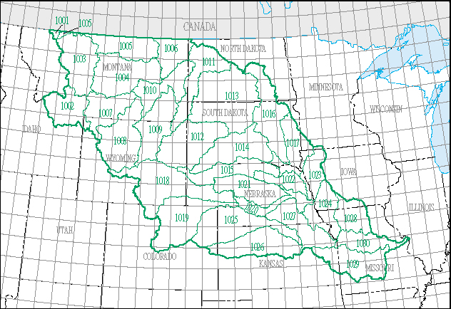
Missouri Watershed

Slide 6
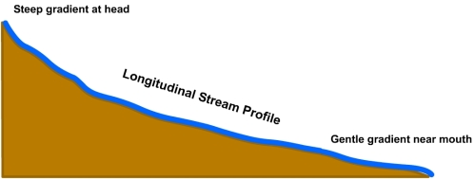
Stream Gradient
They have a gradient, or slope that determines the speed of flow
The flow is usually highest and fastest near the source, and slowest as the path becomes flatter

Slide 7
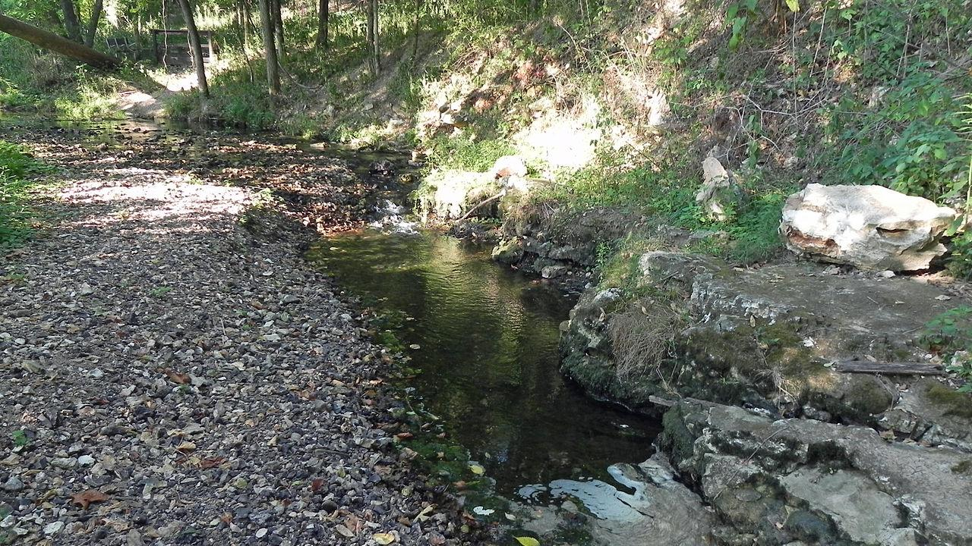
Intermittent or Perennial
Streams that are intermittent, occasionally appearing or drying up
These can fill suddenly and cause flash flooding
They may only fill during the wet season
Other streams
are perennial
which means they
are there all the
time

Slide 8
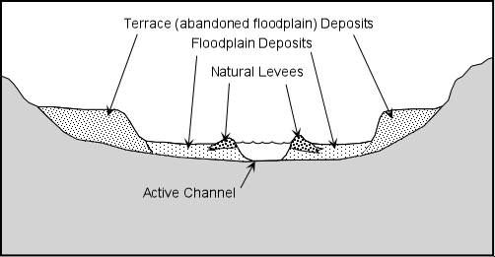
Stream Cross-Section
Related to its gradient and erosional power
Steepness depends on the kind of rock it flows over, the kind of sediments it carries, and the difference in height between the source and base level

Slide 9
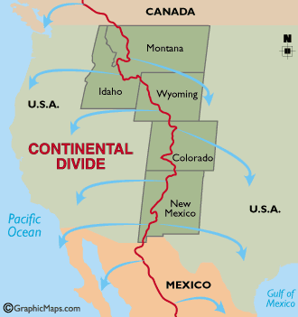
Stream Systems
Streams and their tributaries drain water from a drainage basin
It must contain the source of the stream
A divide separates one stream system from other stream system drainage basins
The Continental Divide separates the drainage basins in North America

Slide 10
Stream Diversity
Streams can have rapids, waterfalls, meanders, and deltas
Meanders: where streams erode sideways instead of downwards
Deltas: where the mouth of a river opens up to the ocean, usually sloping downwards and full of sediments
Many stream systems have been modified for shipping, electricity, and irrigation projects
Some have had levees built to hold water back from the city edge or coastal strip

Slide 11
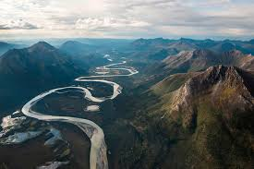
Meanders

Slide 12
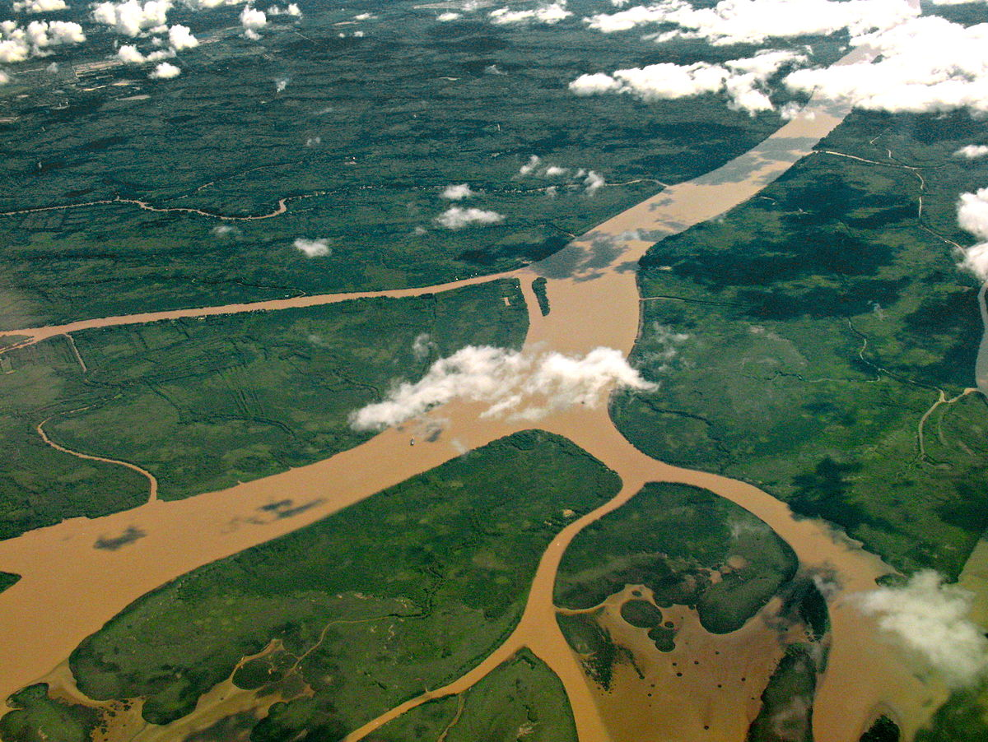
Delta (mouth of a river)

Slide 13
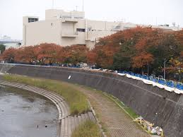
Levee

Slide 14
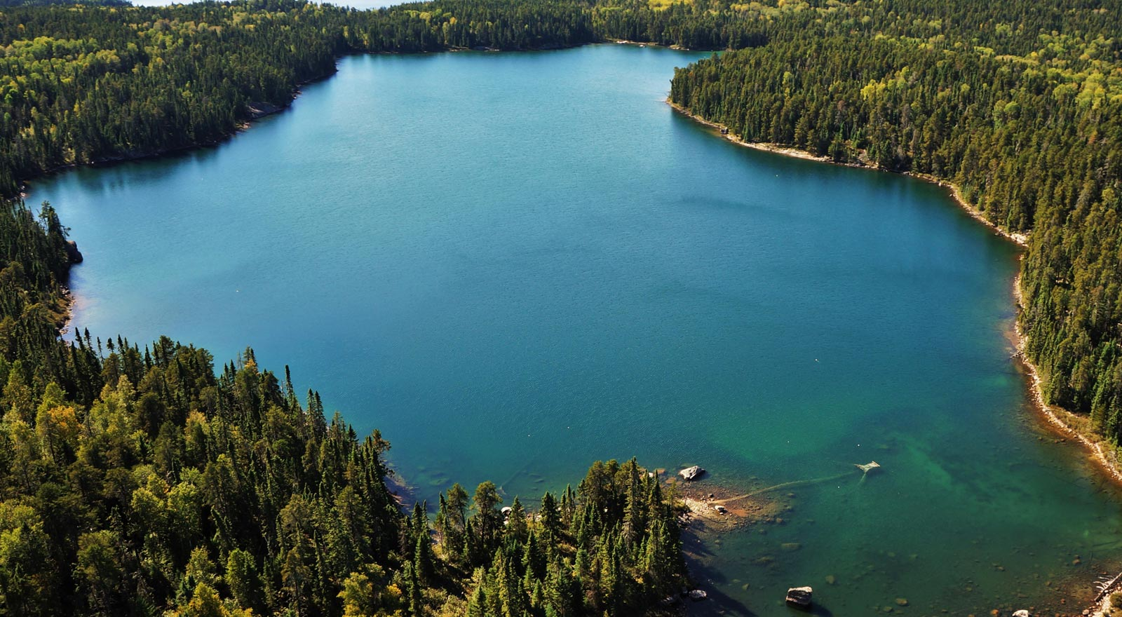
Lakes

Slide 15
Lakes
Lakes are bodies of water entirely surrounded by land and cut off from the ocean
They are usually fresh water and hold most of the fresh water on the earth’s surface
They are considered geologically young, some even “new”

Slide 16
Lake Diversity
There are many unusual lakes across the world
Some are salty, especially if they have no outlet
Evaporation makes them saltier
Some are in the middle of volcanic and meteor craters
These can be cooler if filled by rain, but very hot if filled from hydrothermal vents below
Some are intermittent lakes that form broad salt flats

Slide 17
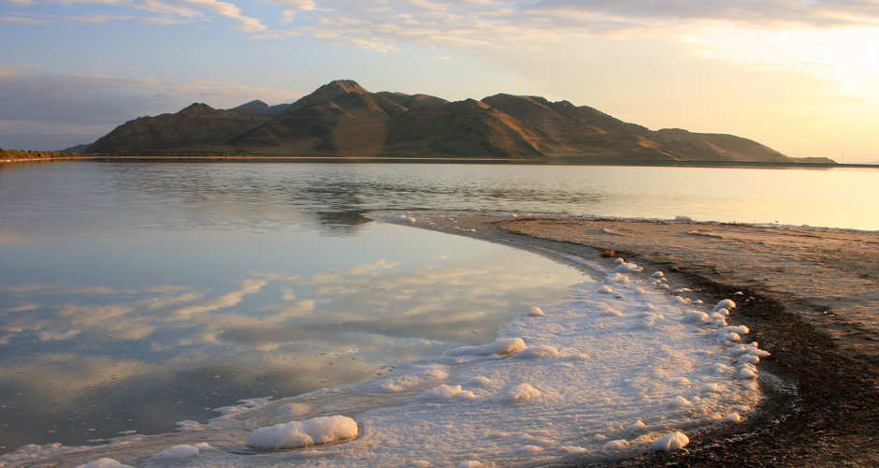
Salt Lake, UT

Slide 18
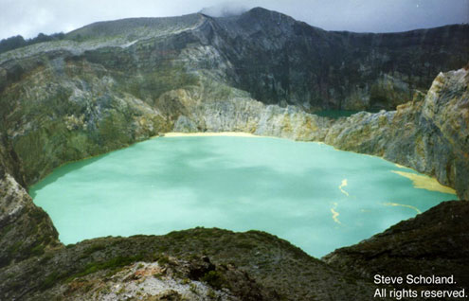
Volcanic Lake

Slide 19
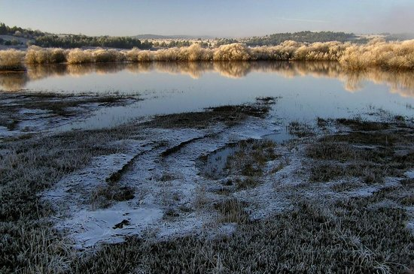
Intermittent Lake

Slide 20
Lake Phases
Lakes and ponds go through a series of phases
They form quickly then gradually fill in with soil or sediment
Sediments collecting on the bottom and plants along the shoreline shrink the diameter of the pond
They shrink to become a bog or marsh.
Plants grow more, leaving only a small stream running through the land.
This process is sped up by 4 things:
warming temperatures,
land development
lack of rain
eutrophication—the adding of excess nutrients which cause algae and turbidity to take over

Slide 21
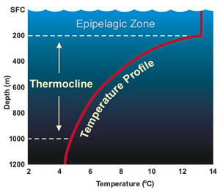
Lake & Pond Features
Seasonal turnovers
Winter: Downwelling water current is caused by temperature sinking as it nears its freezing point (then rising when it freezes)
The summertime thermocline: Waves from wind mix warm surface waters with cooler waters deeper down. A thermal layer develops at the depth of the wave base.

Slide 22
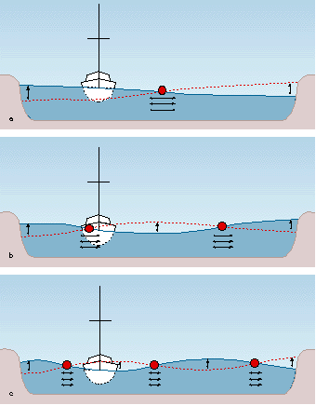
Lake Features
Seiches- a standing wave that oscillates in a lake as a result of strong wind or changes in atmospheric pressure; The standing waves slosh back, creating huge fluctuations of water levels in a few seconds.

Slide 23
Pollution Concerns
Eutrophication occurs when extra nutrients are dumped into a lake from fertilizers, sewage, or dumping.
Algal blooms can build up chemical poisons, decrease the light available for life down below, reduce dissolved oxygen

Slide 24
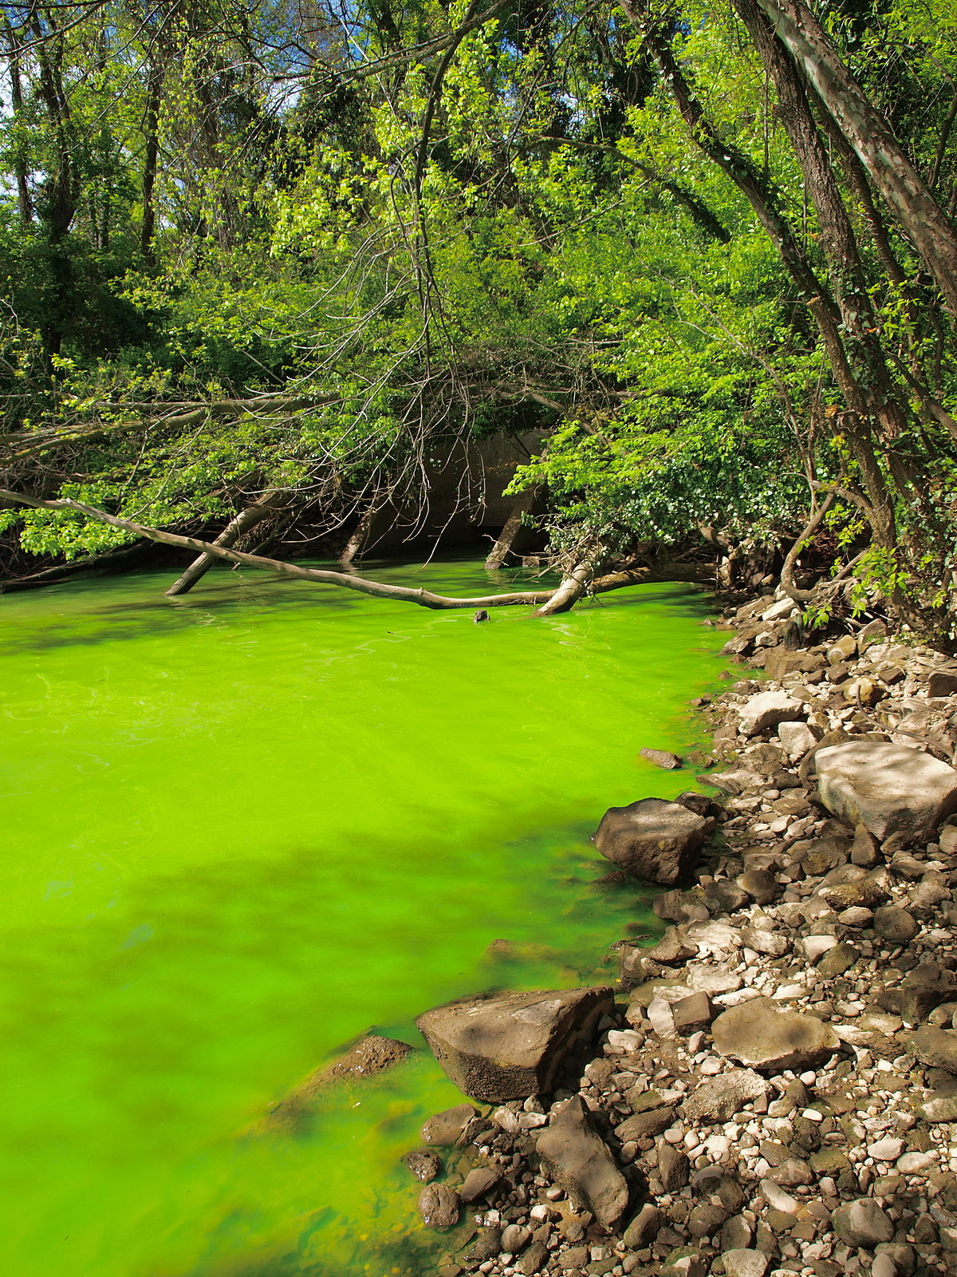
Eutrophication

Slide 25
Groundwater: (Water stored in/underground)
Chapter 17

Slide 26
Source of Fresh Water
Fresh water accounts for only a tiny percentage of water on the earth.
Yet, most plants and animals need fresh water
Fresh water comes from rain/water cycle
10-20 liters of precipitation daily!

Slide 27
Groundwater
Almost all fresh water on land is either trapped in glacial ice or in groundwater
Groundwater percolates down through soil and rock, and fills up all available spaces between the particles of sediment.
The permeability and arrangement of rock strata control the direction and rate of groundwater flow
The upper surface of this zone of saturation forms the water table.

Slide 28
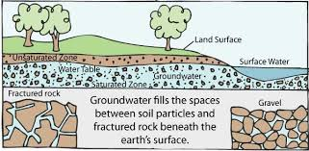
Groundwater Diagram

Slide 29
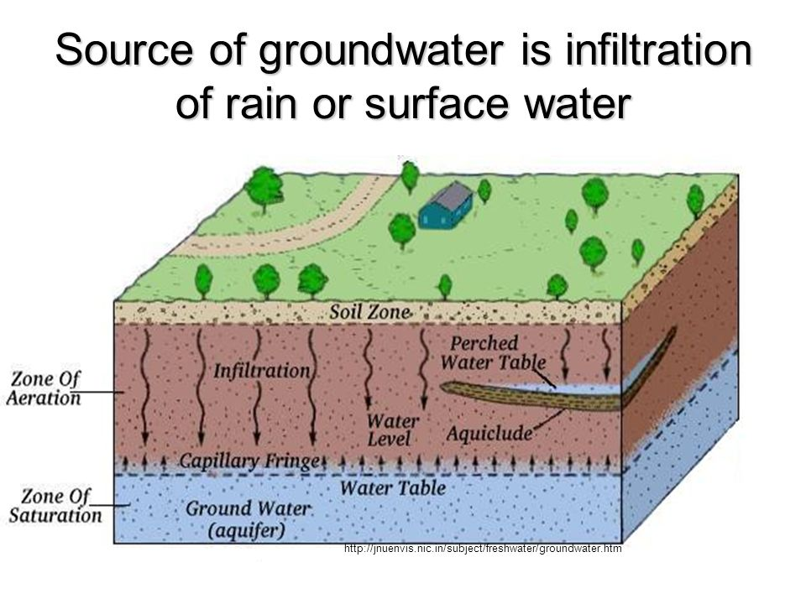
Water Table

Slide 31
Aquifers
An aquifer is an underground layer of saturated rock through which water can easily move. Above it is the water table.
It can store a huge amount of water
Aquifers must be both permeable and porous; often made of sandstone, fractured limestone, sand and/or gravel.
When a water-bearing rock readily transmits water to wells and springs, it is called an aquifer.

Slide 32
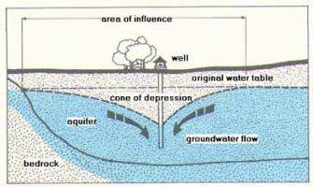
Wells
Drawing water from a well always forms a cone of depression in the water table
If water is pumped at too high a rate, a cone of depression can form or the well can go dry
Overpumping can also change the direction of groundwater flow, deplete nearby wells, or draw in pollutants
An Artesian Well goes all the way down to the aquifer

Slide 33
Replenishment
Groundwater can be replenished naturally or by artificially recharging
Natural: precipitation, glacier, lake or river flow
Unnatural: through wells pumping treated wastewater

Slide 34
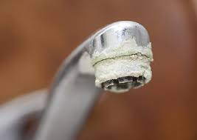
Groundwater Chemistry
Water with large amounts of dissolved minerals in it is “hard” water
Water without those minerals is “soft” water
Water softeners filter out dissolved minerals for better drinking and showering
pipes can get clogged with minerals from water
Requires more soap/detergents to get things clean

Slide 35
Water as a Resource
The value of water increases as it becomes more scarce, as demand increases
Demand increases by population growth, and by irrigation and associated development projects
Water conservation is based on the idea that we should only use what we need.
Proper development helps us search for ways to:
reduce the amount of water we waste
recycle it
replenish it faster/better
find water new sources

Slide 36
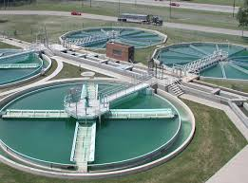
Water Treatment
Water treatment plants help to remove pollutants such as soaps and detergents, heat, germs, soil, substances.

Slide 37
Groundwater Landforms
Caves and cave systems
Speleothems
Karst Topography

Slide 38
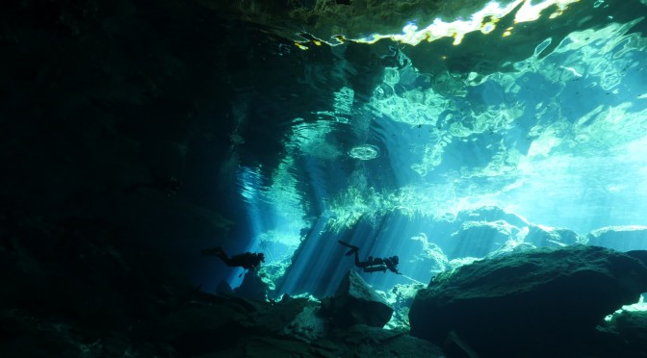
Underwater Caves
Many caves have been formed (eroded) by flowing groundwater
Young-earth scientists dispute the old age of many caves by appealing to a changing rate of erosion/formation, and the type or age of groundwater that formed it

Slide 39
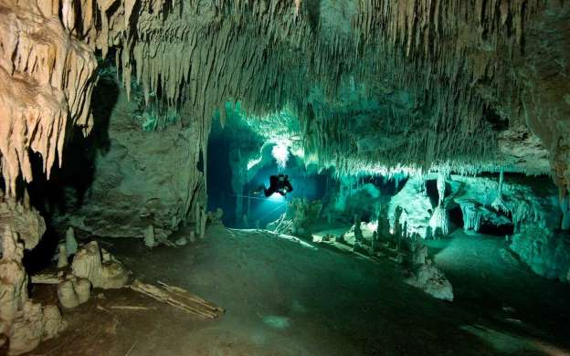
Underwater Caves

Slide 40
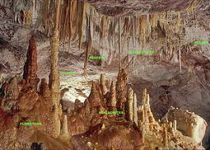
Speleothems
Precipitated minerals from evaporation
Stalactites, Stalagmites
Dripstone
Flowstone
Do not take thousands of years

Slide 41
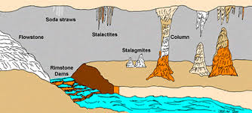
Speleothems

Slide 42
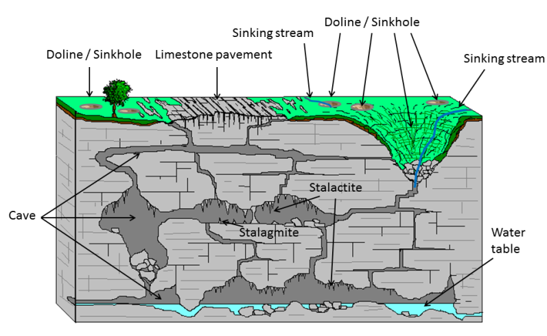
Karst Landforms

Slide 43
Karst Topography
A kind of landscape formed from the collapse or erosion of highly soluble rocks-- such as limestone, gypsum, other carbonates.
Forms underground drainage systems, streams
Has sinkholes, caves, sinking streams, springs
25% of the world gets their water from karst aquifers!

Slide 44
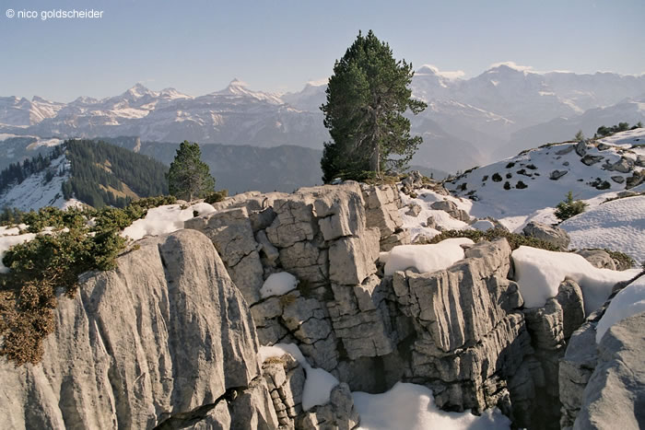
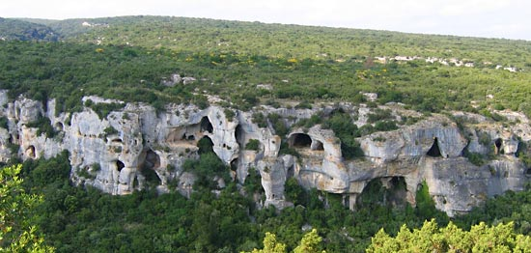
Karst

Slide 45
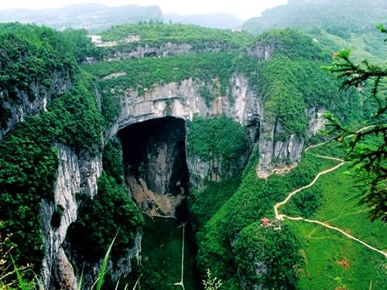
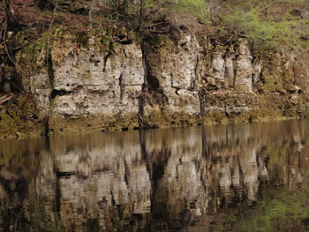

Slide 46
Ozarks

