Slide 1
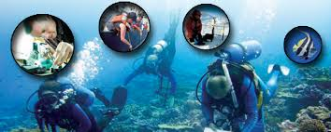
oceanography
Ch 15

Slide 2
History

Slide 3
Ancient History
Early peoples were skilled in shipbuilding, both before and after Noah’s time—this intelligence did not “evolve” or develop during modern times
Exploration of oceans and seas led to “sea peoples” of various kinds that invaded others, from ancient times
Many ancient cultures including Egypt, Chinese, Greeks, Phoenicians, Slavs, Caribs, and Polynesians had livelihoods and religious cults based completely on the sea, sea gods, and forces
Many of these prompted people to see the sea as divine, fickle, and ominous, not a natural, scientific object to be explored or studied

Slide 4
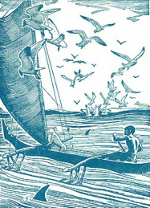
Ancient Polynesia, Sea and Monster

Slide 5
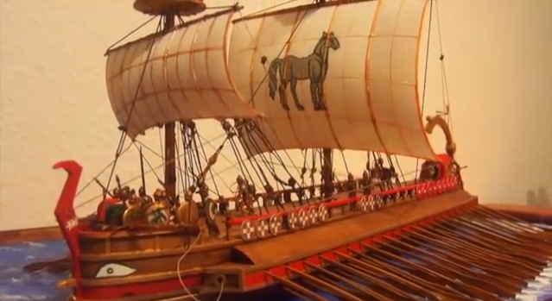
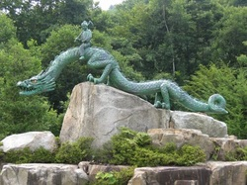
Phoenicia boat and Japanese Sea God

Slide 6
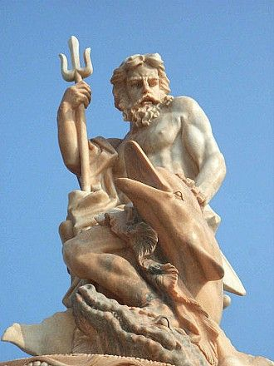
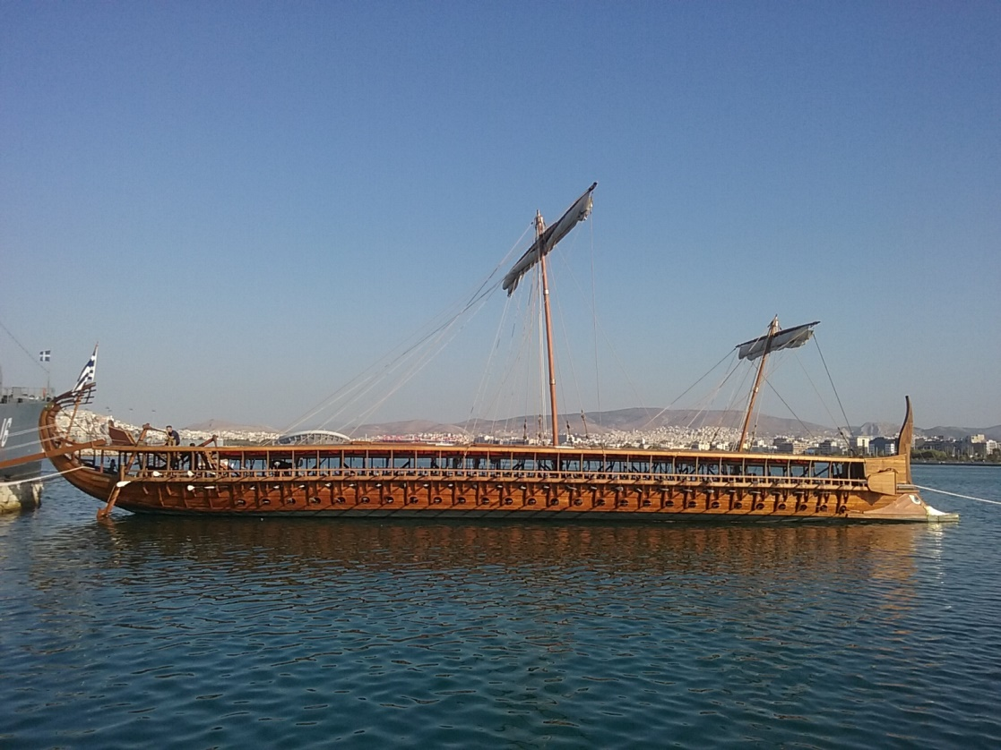
Poseidon and Trireme (500BC)

Slide 7
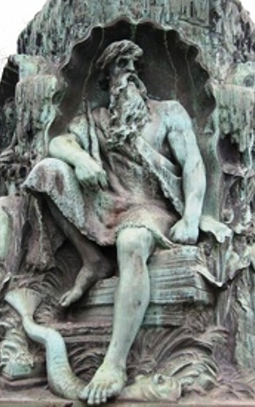
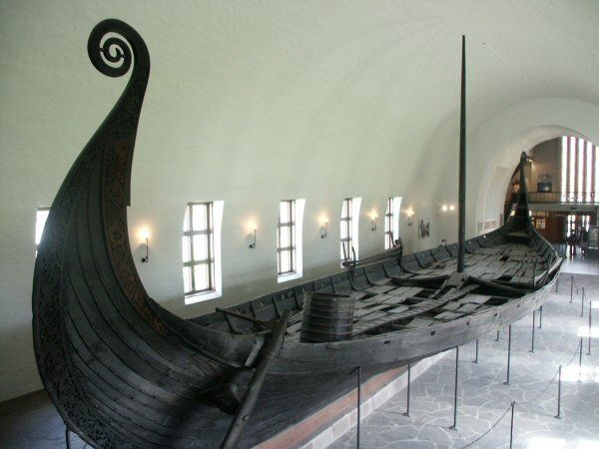
Viking Drakkar and Aegir, 500AD

Slide 8
History
Catholics in the Middle Ages were quite interested with astronomy and earth science—got into astronomy, geometry, the mathematics of the earth, geology, as well as agronomy and soil study
Chinese invent the magnetic compass around 1000AD
The Age of Discovery began in the mid-1400s with Portuguese ships being able to navigate and explore more thoroughly
Angola and slavery
Da Gama and Henry the Navigator
Indonesia and Spice Islands
Columbus
Ships began with just a few scientists and scientifically trained friars but grew to carry more as trade and colonialism heated up.

Slide 9
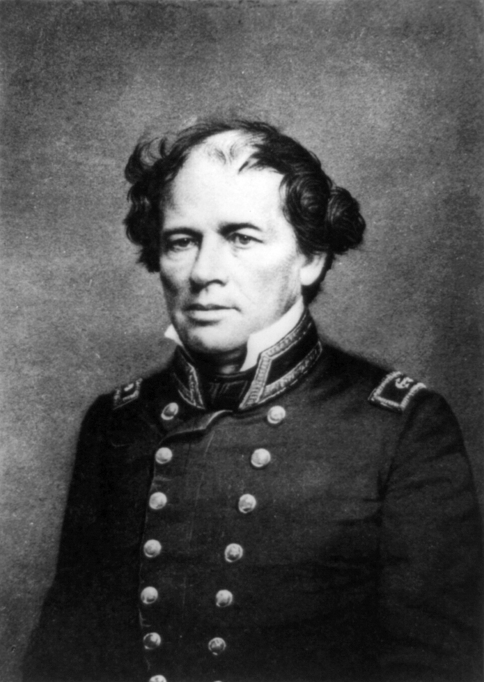
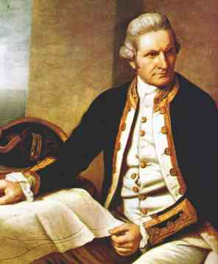
Modern History
Expeditions of the ocean became more naturalistic, for scientific investigation of animals, currents, landforms, climate, etc.
James Cook, late 1700s Pacific
The Wilkes Expedition crosses the world, 1838-1842
Matthew Maury, US Navy; father of Oceanography 1855 textbook on winds, currents, and the sea

Slide 10
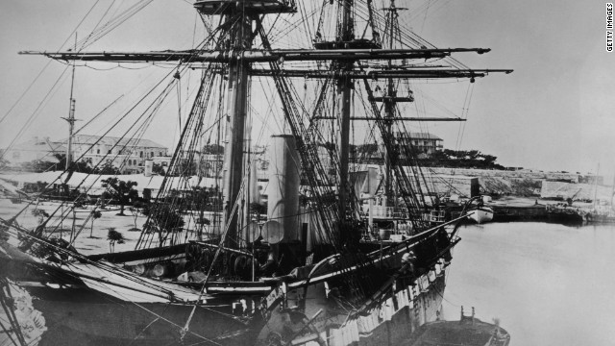
Challenger Voyage
The Challenger expedition (1872-1876) was the first global deep-sea scientific voyage that focused on the ocean and marine life
NASA Challenger was named after it!
Discovered almost 5000 new marine species, most in the depths

Slide 11
Modern History
The industrial revolution and ensuing technological breakthroughs in the WW period permitted more tools, vessels, instruments, and supplies to help scientific study be safe, accurate, and repeatable.
The Cold War also accelerated funding and interest in water/space research. Breakthroughs in one area helped other areas.
Challenger II found the deepest part of the ocean in the Marianas Trench (1951)
The digital revolution has continued this trajectory, along with increasing interest in environmentalism.

Slide 12
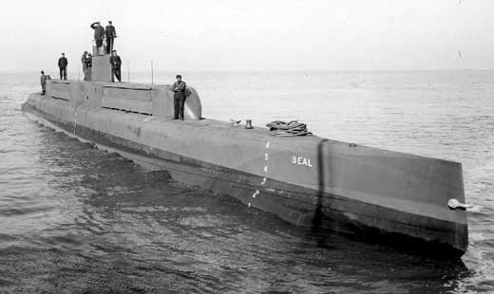
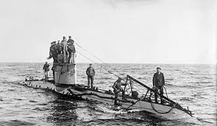
WWI subs

Slide 13
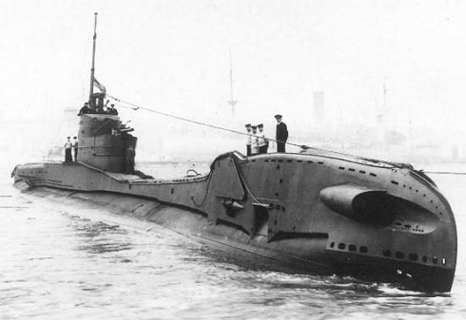
WWII Sub

Slide 14
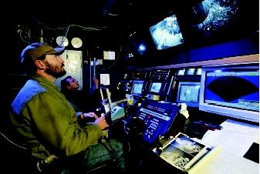
Technology

Slide 15
First observations
Water depths
Seawater chemistry
Temperature
Clarity
Samples of water from the floor
Samples of marine life sighted, caught, grabbed, or washed up on shore

Slide 16
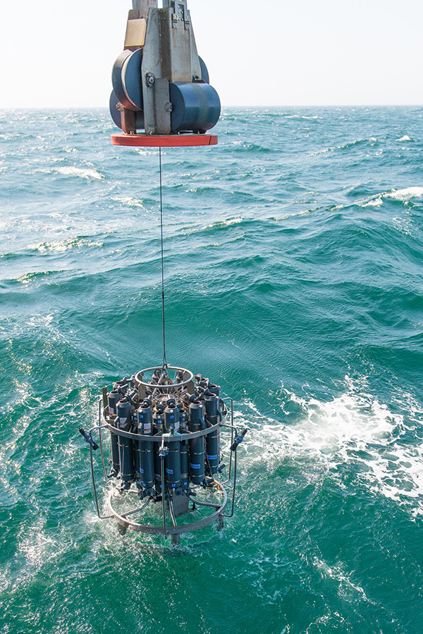
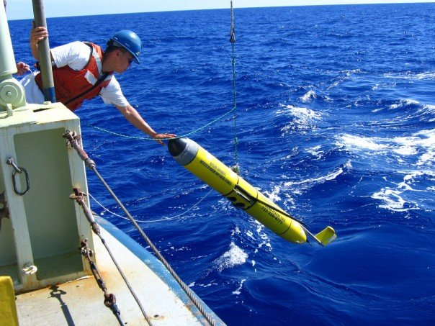
Advanced observations
Sonar bottom profiling
Satellite surface observations
Daily reports from data-collection buoys/stations

Slide 17
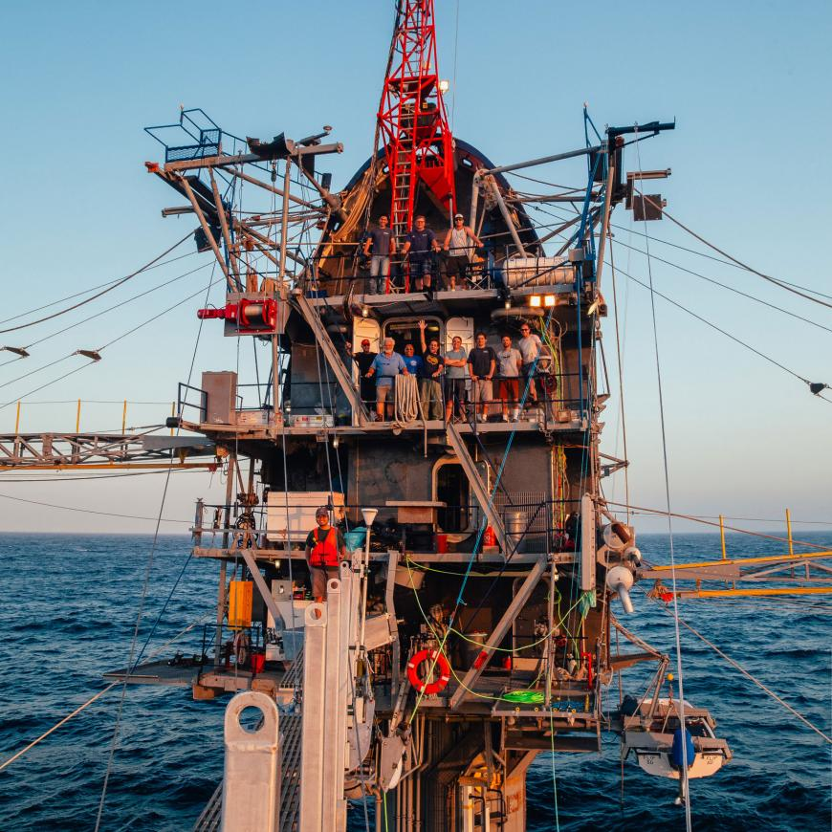
Research & Monitoring Stations

Slide 18
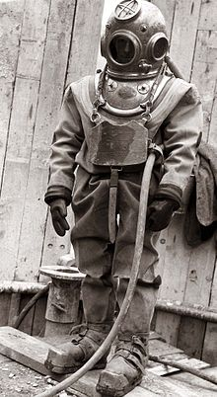
First Divers
Helmet divers permitted some underwater observation and excavation
Limited amount of oxygen
Lack of air supply and pressure-resistant tools/clothes limited most explorations
Expense
No recording abilities
Water technology advanced slowly through the late eighteen hundred with Franco-Prussian wars (first submarine and torpedo)
Then amazing breakthroughs in WWI

Slide 19
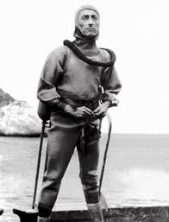
Advanced Diving
Scuba divers and Mixed-gas hardsuits
Jacques Cousteau perfected the first suit in 1943
Better water-proofing and pressure-proofing tools and vessels
Sonar and better location finding
Recording and communication devices
Cages, other things for protection
Manned submersibles, underwater habitats

Slide 20
Diving Today
GPS
Unmanned vehicles, robots, or drones now popular
ROV used to explore the wreck of the Titanic
More of the world now has money, time, and agendas that promote exploration/research

Slide 21
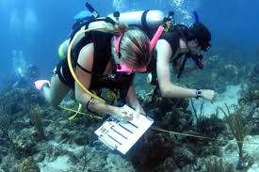
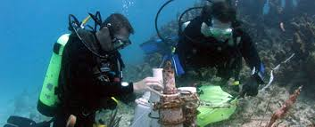
Scuba Diving

Slide 22
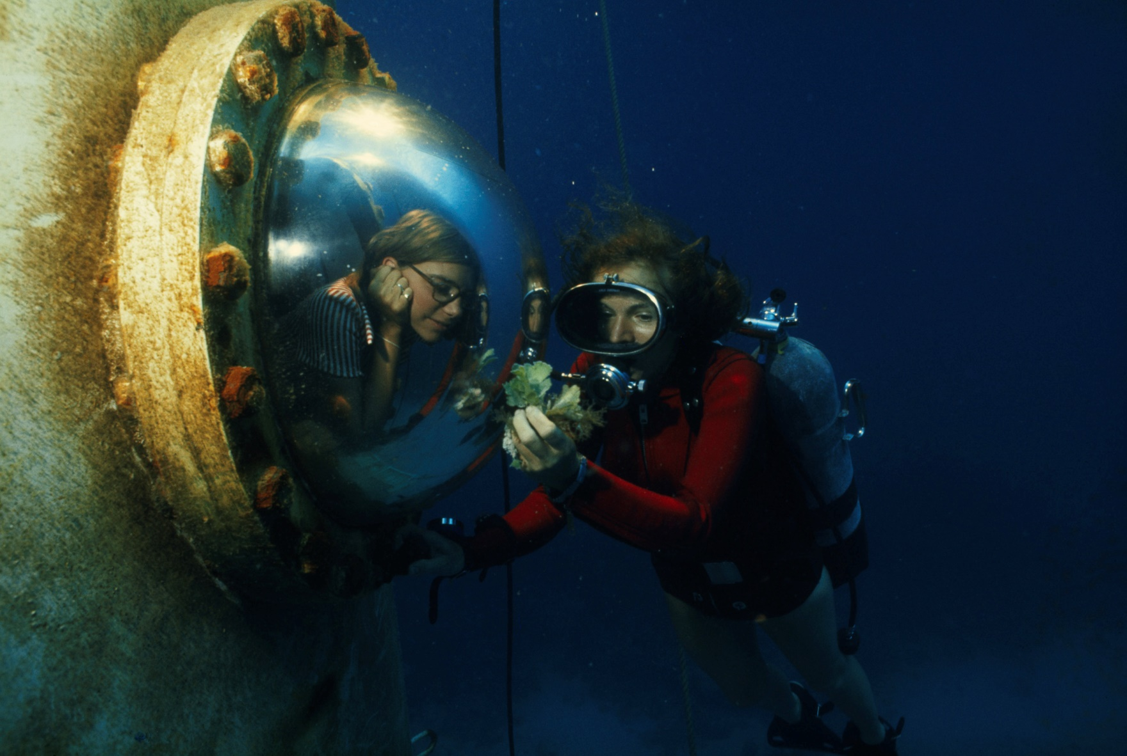
First diver to walk on the ocean floor

Slide 23
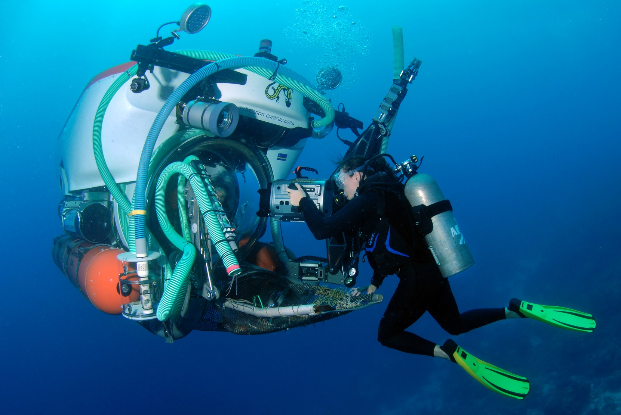
The “Ocean Doctor”

Slide 24
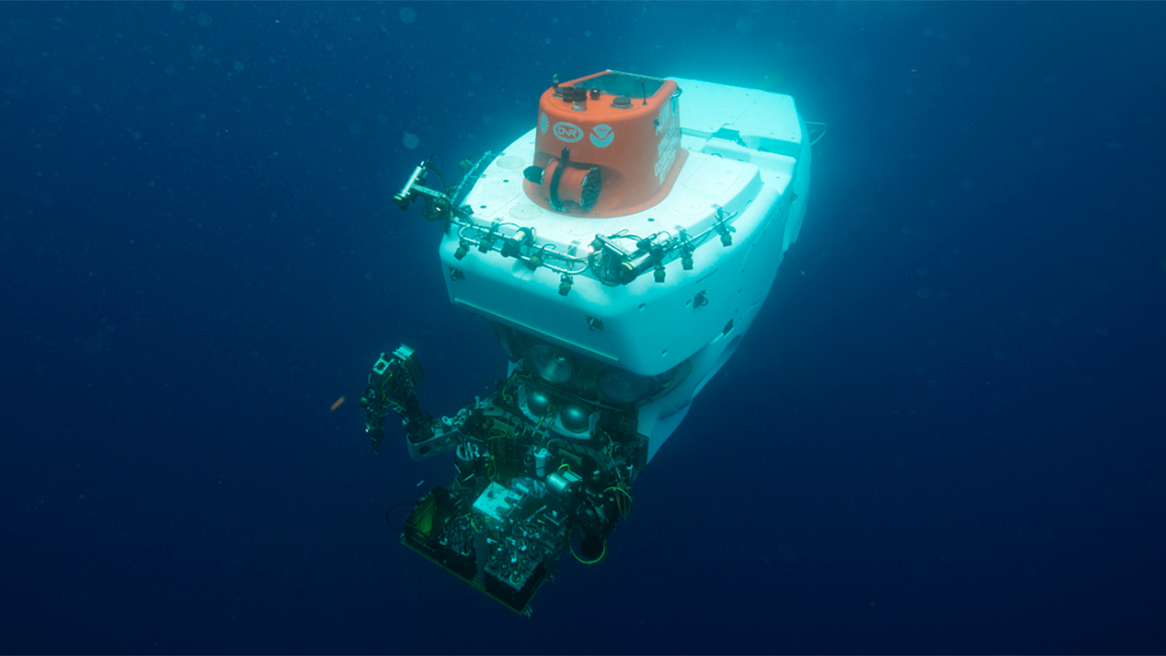
HOV- the Alvin

Slide 25
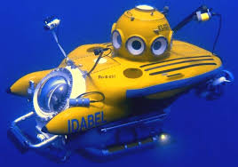
HOV

Slide 26
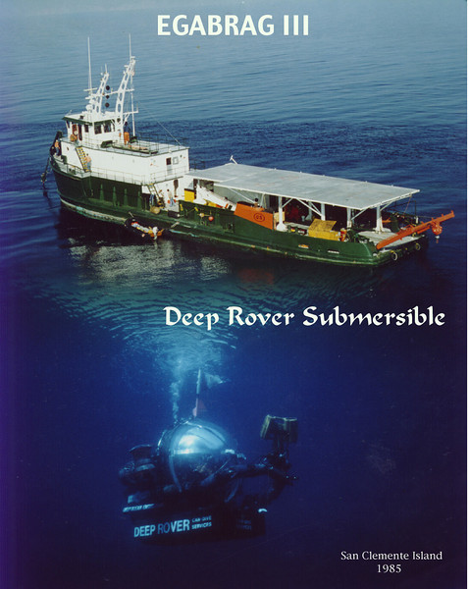

Slide 27
The unmanned frontier!
Exploring the depths of the ocean is more dangerous than outer space!
Predators, life
Toxins, bacteria
Volcanoes, activity
Complete darkness, limited observability
Pressure requires even better construction than spacecraft
Communication with the bottom is harder; interference

Slide 28
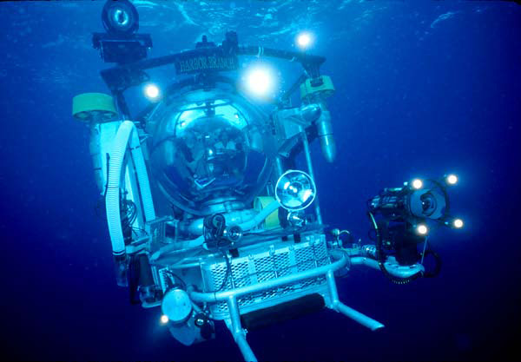
The Johnson-Sea-Link Robot

Slide 29
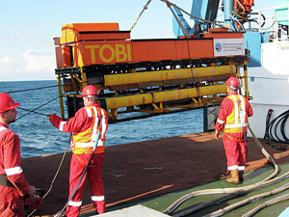
Seafloor Mapping Instrument

Slide 30
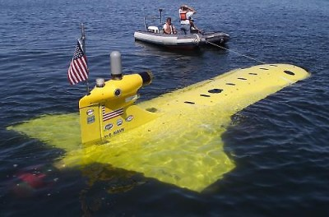
US Navy Drone

Slide 32
http://slideplayer.com/slide/10803595/
For more information and review

