Slide 1
Intro to animals

Slide 2
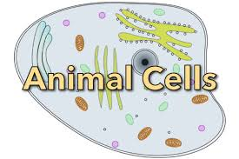
What is an animal?
Eukaryotic cells
Multicellular
Organized tissues, organs
Consumers—have to eat!
Move

Slide 4
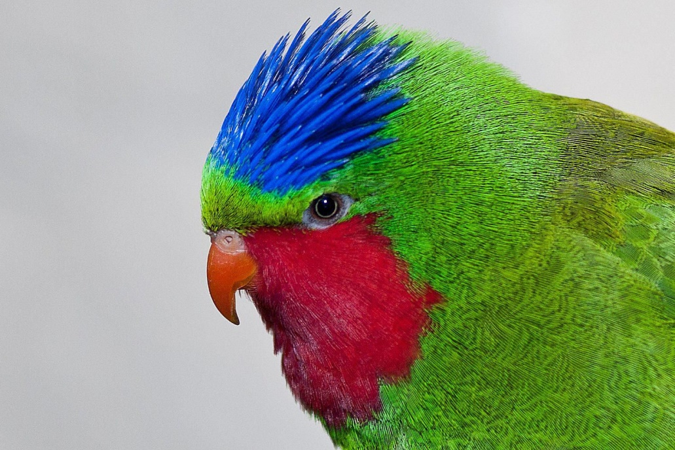
Birds

Slide 5
Birds
Endothermic
Wings and feathers—not all fly! Some only walk or swim.
Most do a lot of preening; some molt (lose flight feathers)
Feathers themselves are specially designed for perfect function, and feathers differ widely across species
Lay eggs, usually build nests, and incubate eggs to keep them warm and moving on the inside

Slide 6
Types of Birds
Most birds are herbivores although some eat insects
Raptors are predators, birds of prey (owls, hawks, falcons)—help control the rodent population
Scavengers eat decaying things (crows, vultures)

Slide 7
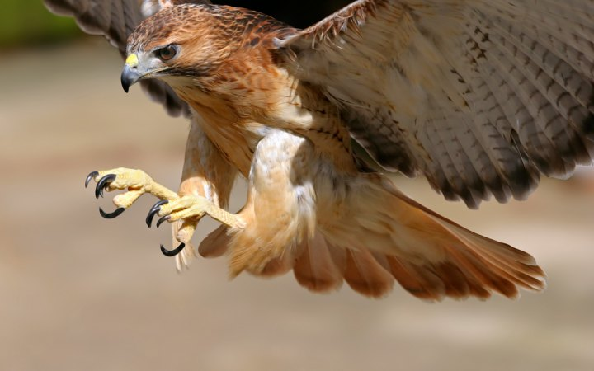
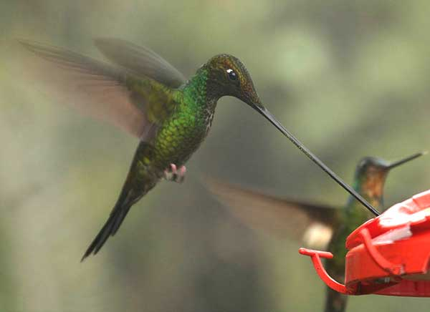
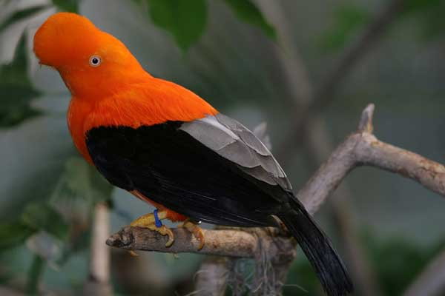
Diversity
Notes:
Golden Hawk, andean cock of the rock, swordbellied hummingbird

Slide 8
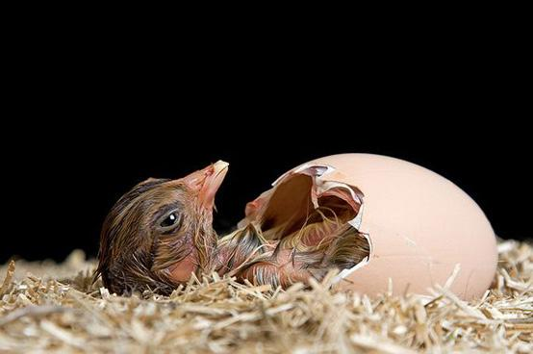
Bird Hatching

Slide 9
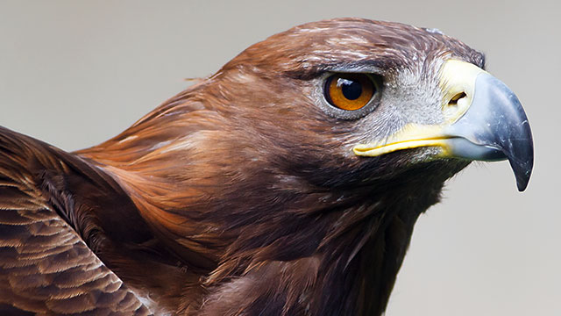
Flying Birds
Designed specially for flight
Air hollows in their bones; lightweight skeletons
Air sacs around their lungs
Flight feathers are designed for protection, streamlining, temperature/waterproof
Designed to eat a lot and digest it quickly to supply all the energy they need for flight
Eyes are usually very good
Beaks very diverse

Slide 10
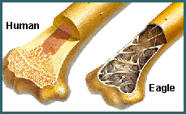
Designed for flight
Bird bones are hollow, lightweight for flying; have air spaces

Slide 11
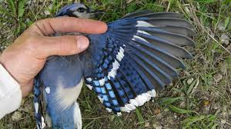
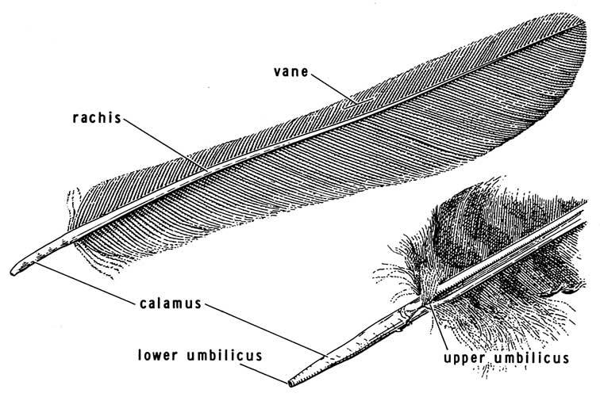
Flight v. Down Feathers

Slide 12
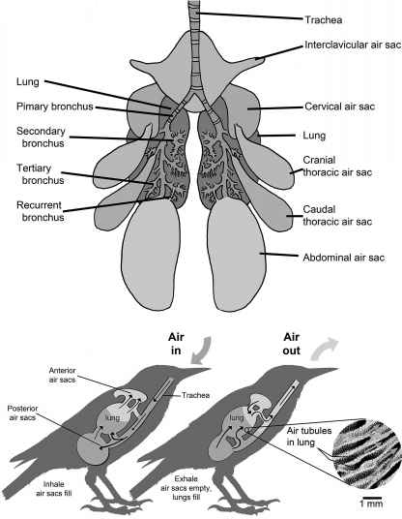
Air sacs
Allow them to receive oxygen while both inhaling and exhaling—to provide all the energy they need during flight

Slide 13
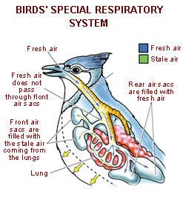

Slide 14
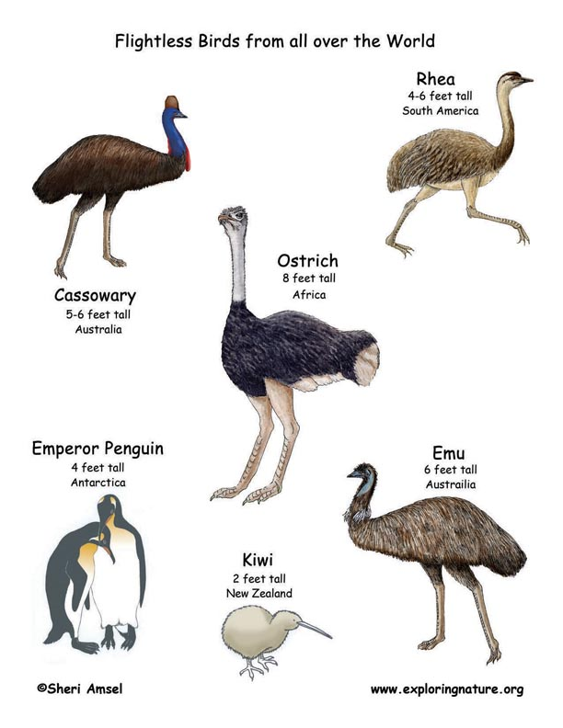
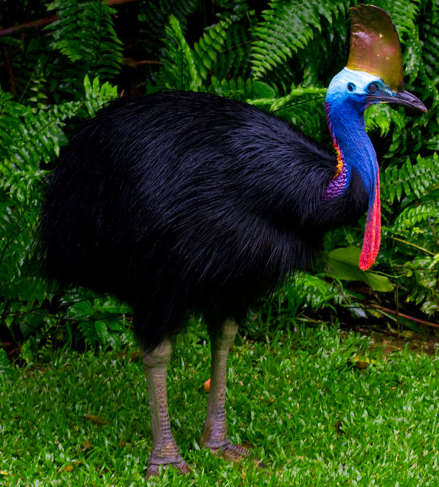
Flightless Birds

Slide 15
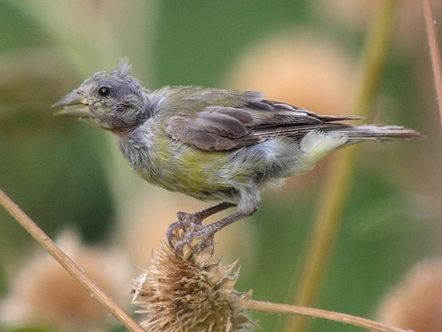
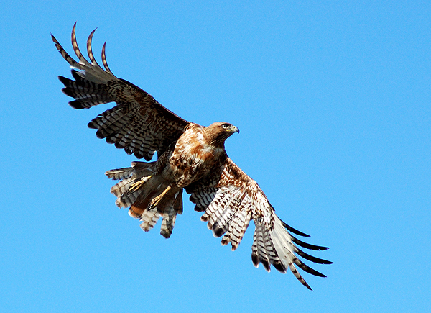
Molting
Losing flight feathers
Can take up to two months to regrow

Slide 16
Mammals

Slide 17
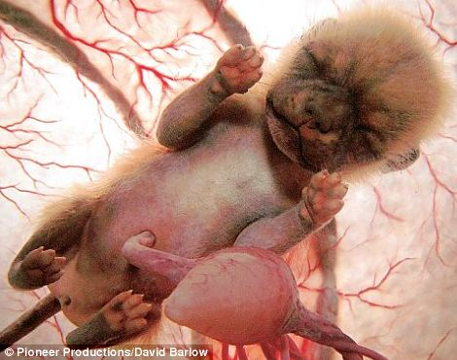
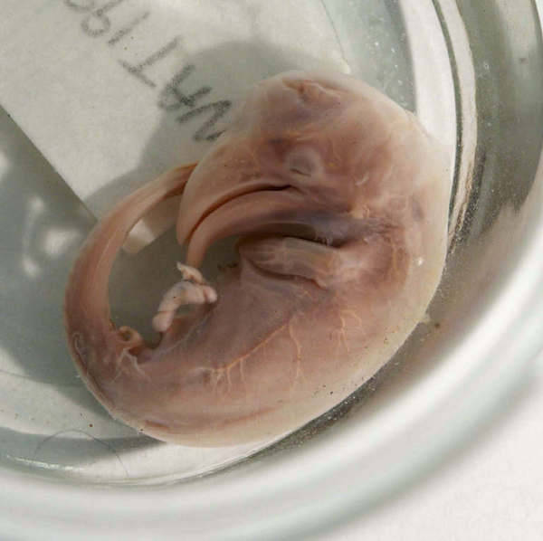
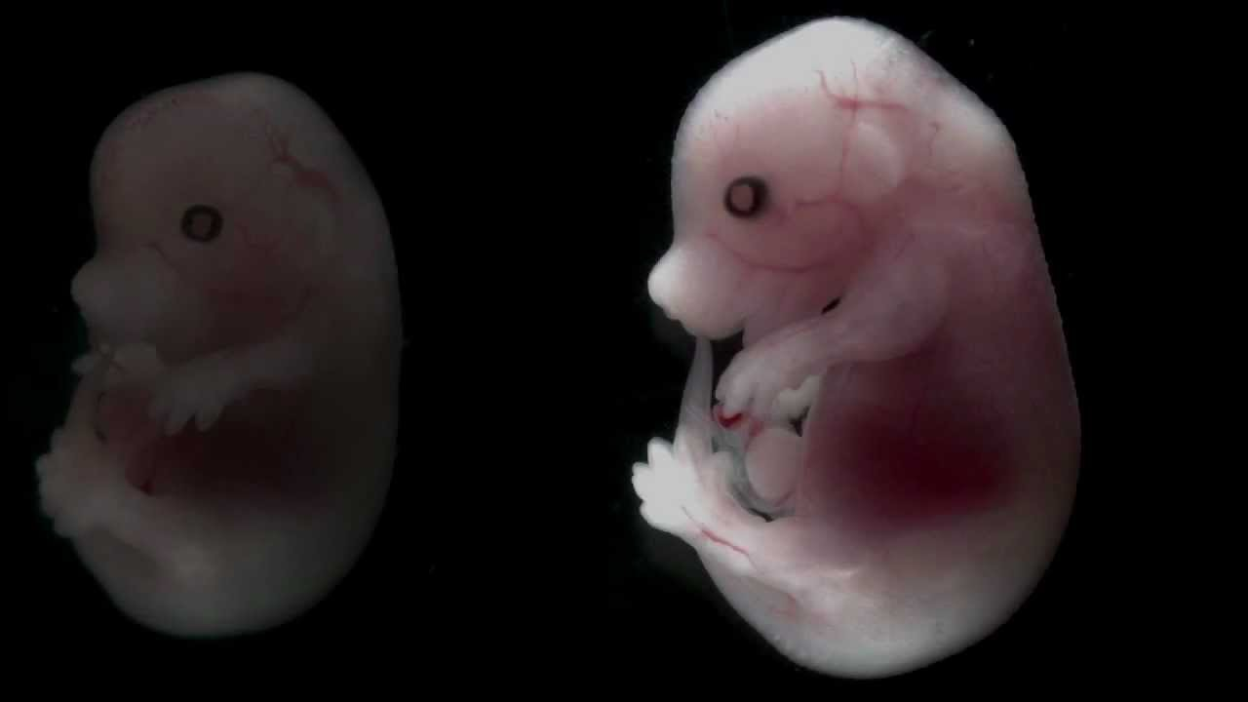
Characteristics of Mammals
Endothermic
Hair or fur (or wool, etc) with keratin in cells (protein)
Mammary glands for milk
Placental reproduction: give birth, bear live young
Have a bellybutton ☺ from the umbilical cord
Diverse kinds of teeth for carnivore, omnivore, herbivore

Slide 18
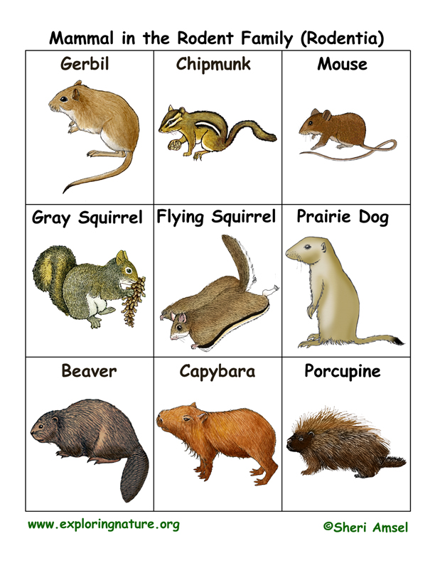
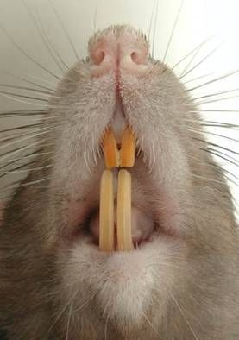
Rodents
Rabbits, mice, rats, beavers, groundhogs
Gnawing mammals
Teeth continue to grow

Slide 19
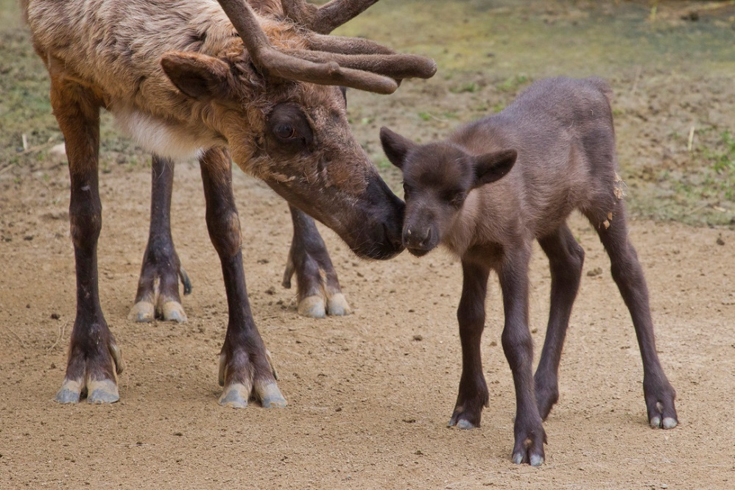
Hoofed Mammals
Deer, cattle, goats, llamas, horses, oxen, pigs, moose, camels
Herd or pack animals
Many can be domesticated
Many chew the cud, have special digestive systems
Some have interesting bone structures for loads, running, strength
Notes:
Reindeer

Slide 21
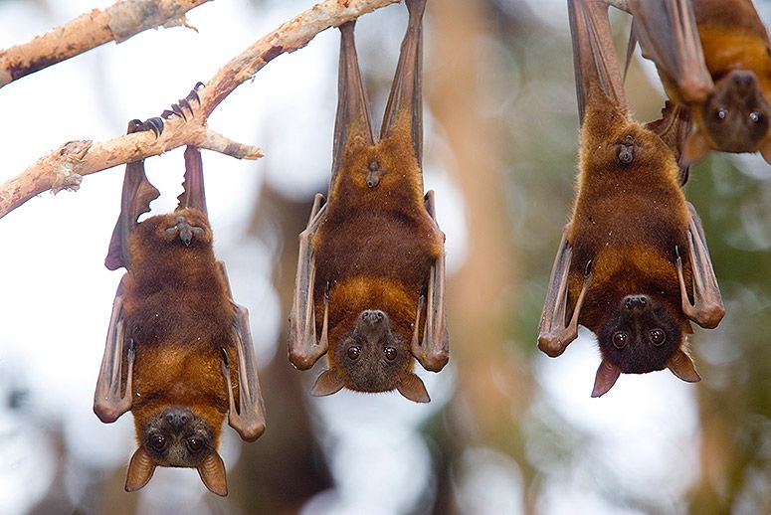
Flying Mammals
Bats, flying squirrels, sugar gliders, flying foxes

Slide 22
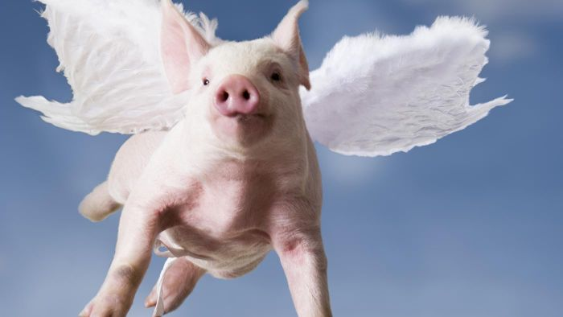
Just kidding ☺

Slide 23
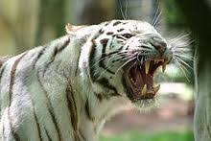
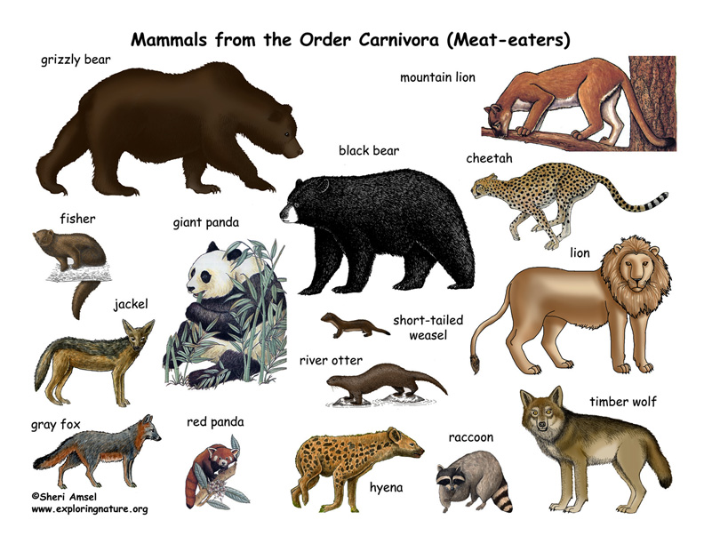
Carnivora
Meat-eating mammals: all wild cats, all wild dogs, foxes, beartters, racoons, weasels,

Slide 24
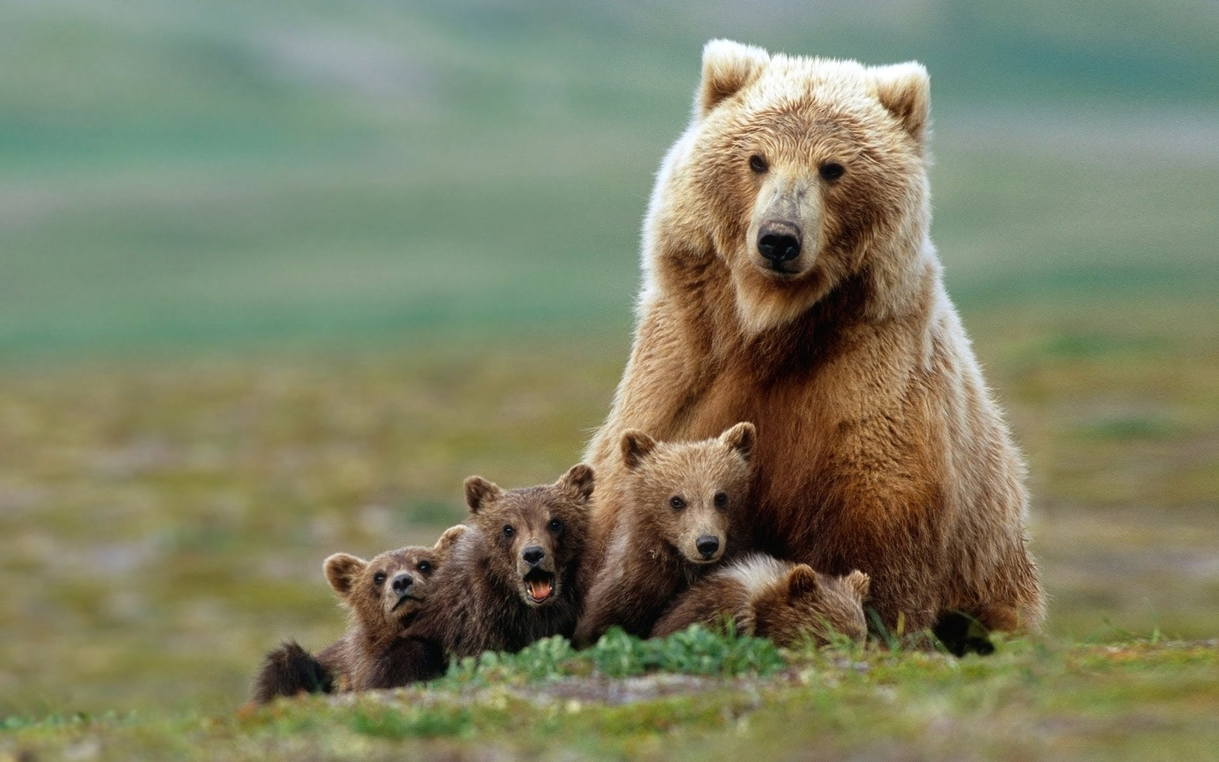

Slide 25
Hibernation
Hibernation is a period of winter inactivity
Estivation is a period of summer inactivity
Heart rate drops, ceasing most body functions except key respiration and circulation
Does not wake to eat until over; lives off of stored fat
May end with giving birth and then going to find food
Dormancy is a wakeable state where many things are slowed

Slide 26
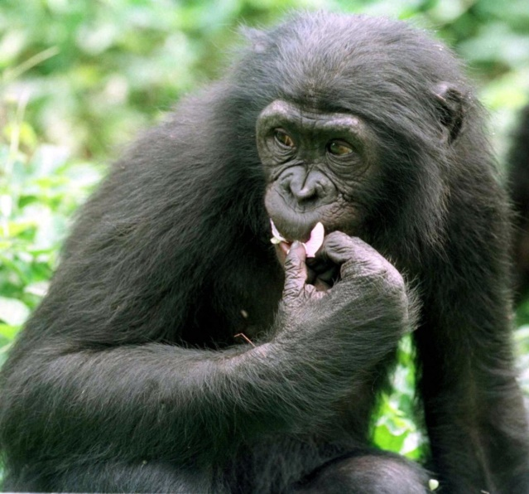
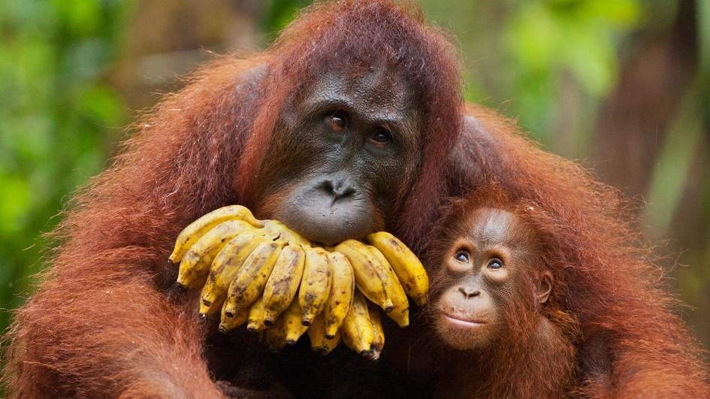
Primates
Monkeys, apes, lemurs
Have thumbs
Can walk upright
Some intelligence, emotion, and teachability
Social organization
Prehensile tails
Eyes face forward

Slide 27
The Outliers!
Monotremes: platypus and echidna lay eggs
Marsupials: are “born” then develop in an external pouch (instead of developing inside, connected to a placenta, then born)
Aquatic mammals like blue whales, dolphins are more like fish that bear live young

Slide 28
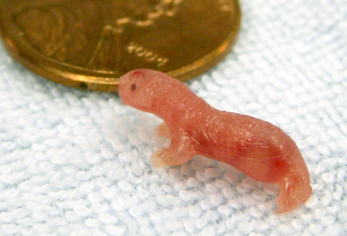
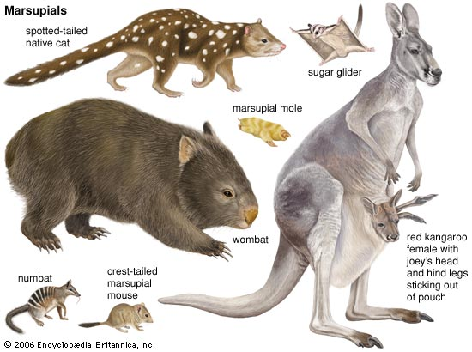
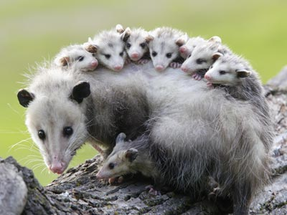
Marsupials
Possums, koala bears, kangas!

Slide 29
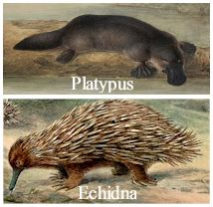
Monotremes

Slide 30
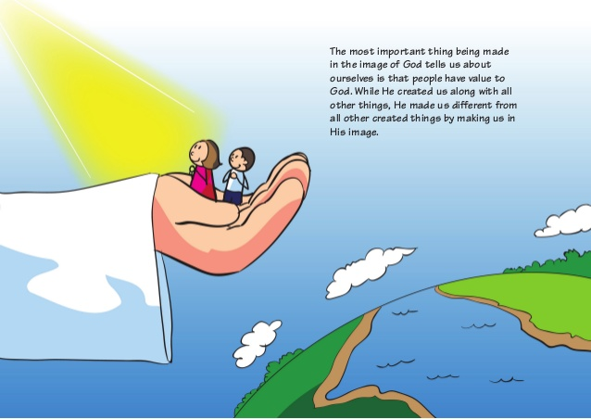
Humans
Have souls, made in God’s image
Intelligence—higher rational thought, abstraction, mathematics
Sense of self; goal-setting
Language—expression, persuasion, development
History—sense of heritage, time, progression
Education: science, engineering, teaching
Economy, Politics/Legislation, societal institutions (business, hospitals, military)
Agriculture
Art, music, architecture, sports; “inspiration”
The ability to think about God, think about God’s thoughts
“The religious impulse”
Charity
Lifelong family
self-sacrifice
Love

