Slide 1
Intro to animals
Chapter 12: Invertebrates

Slide 2
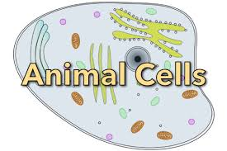
What is an animal?
Eukaryotic cells
Multicellular
Organized tissues, organs
Consumers—have to eat!
Move

Slide 4
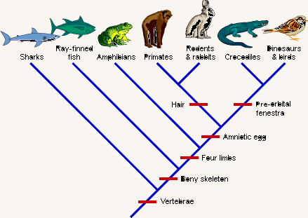
Evolutionary Tree?
Notes:
Cladogram: note warm blooded mammals developing alongside cold-blooded reptiles/warm blooded birds—how do both share a common ancestor?

Slide 5
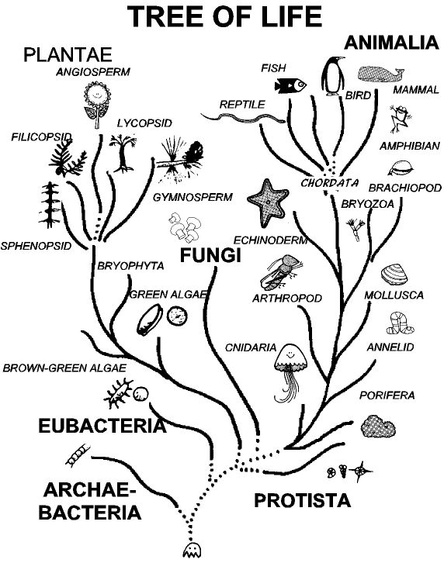

Slide 6
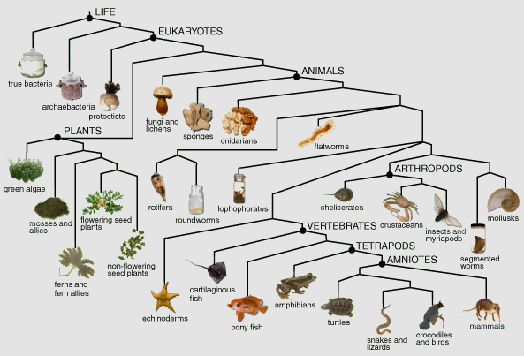

Slide 7
Invertebrates
Chapter 12

Slide 8
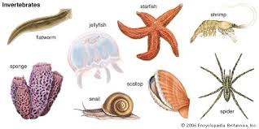
What is an invertebrate?
No backbone
Has an internal or external skeleton made of protein, glass, limestone, water (not bone!)
Usually small
Over 95% of animals are invertebrates!

Slide 9
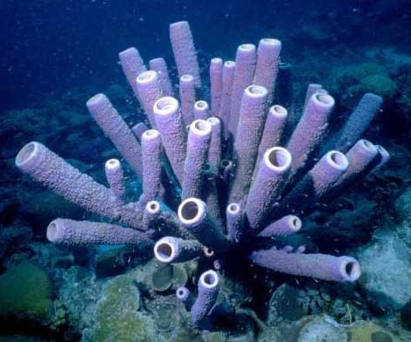
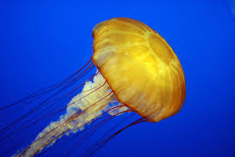
Sponges & jellyfish

Slide 10
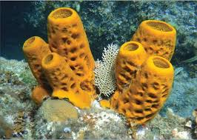
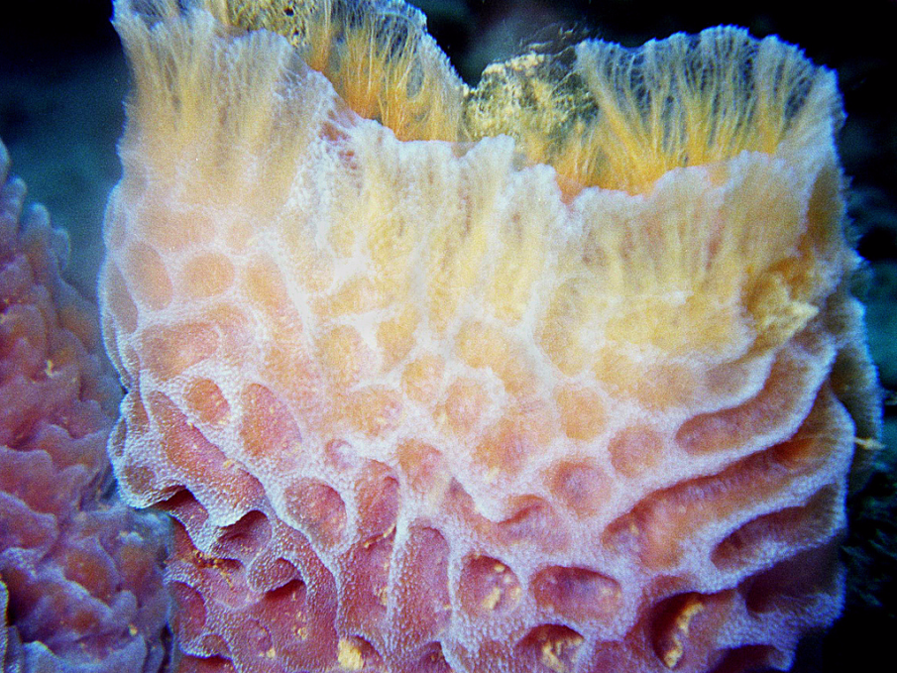
Sponges
Sessile: permanently planted
Filter feeder: filters its food as water passes through it
Pores: small openings for water to enter/exit
Flagella line the body cavity and whip water into a current
Skeletons are made of spongy proteins or spicules (spikes made of rocklike material)
Grow around the cavity
Phylum Porifera

Slide 11
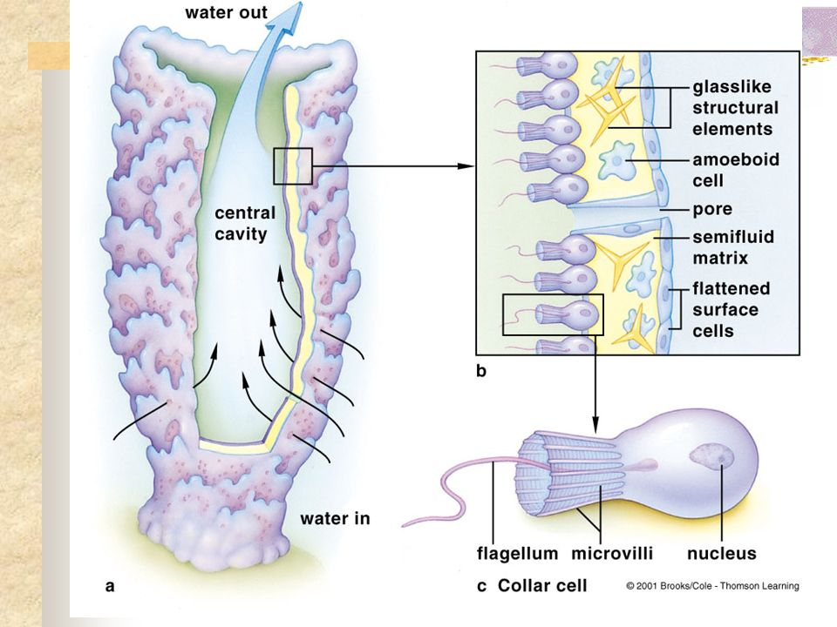
Filter Feeder
Catch algae or particles that flow through the body cavity with the current. Aided by flagella on collar cells that whip the water through.

Slide 12
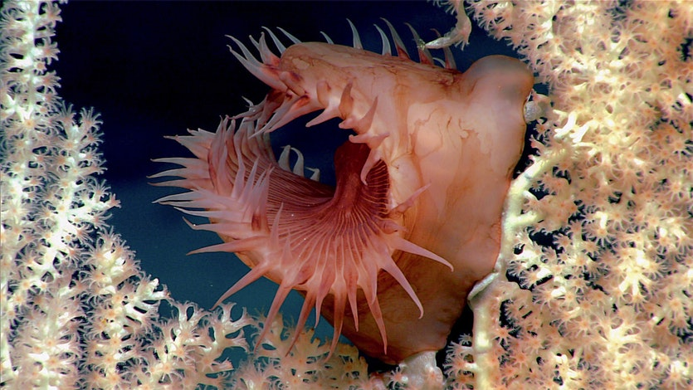

Slide 13
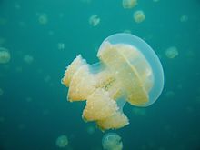
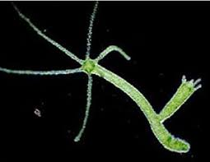
Jellyfish & Hydra
Shaped in tubular or umbrella shapes
Have radial symmetry
Some are sessile, but most move through contraction of water in and out of its body cavity (NOT by tentacles)

Slide 14
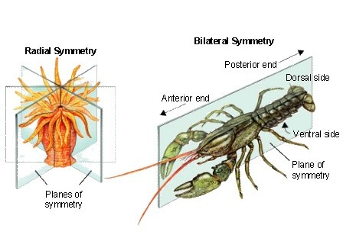
Symmetry

Slide 15
Jellyfish
Jellyfish have hydrostatic skeletons (water)
Has a mouth that leads to a “stomach” called the gastrovascular cavity
Enzymes digest the material which then moves into cells
Has network of nerves and muscle fibers but no brain
Has nematocysts (stinging cells) in their tentacles for defense and to paralyze its food
Drift with the current, no coordinated movement
Phylum Cnidaria

Slide 16
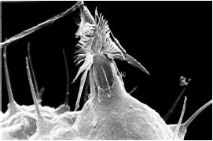
Nematocyst

Slide 17
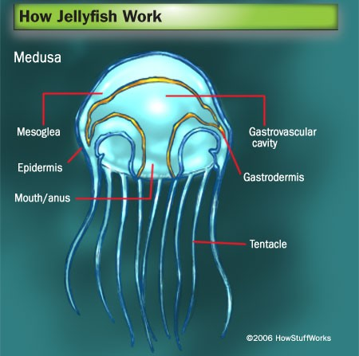

Slide 18
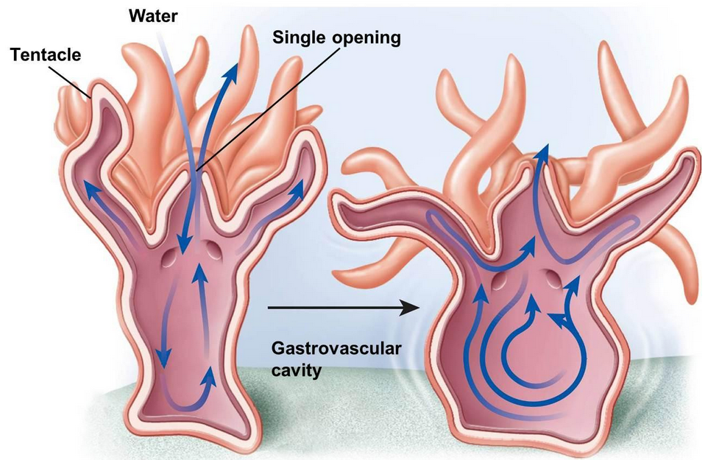

Slide 19
Worms, WORMS, WORMS

Slide 20
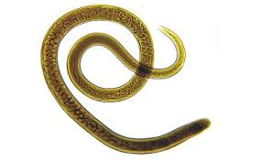
Worms
Bilateral symmetry
Has a basic nervous system that responds to stimulus through sensory receptors
Has a digestive system with intestines, excretory tubes and pores
Breathes through its skin
Can reproduce sexually or asexually through splitting; regeneration

Slide 21
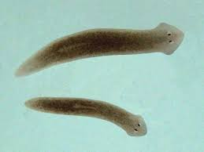
Flatworms
Phlyum Platyhelmithes—flat
Most are parasitic, live in hosts
Has a simple nervous system with head, “brain,” and nerve throughout the body that responds to touch, chemicals, light
Planaria is the most common example—the “cross-eyed worm” with eyespots
Tapeworms

Slide 22
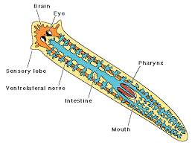
Planaria Diagram

Slide 23
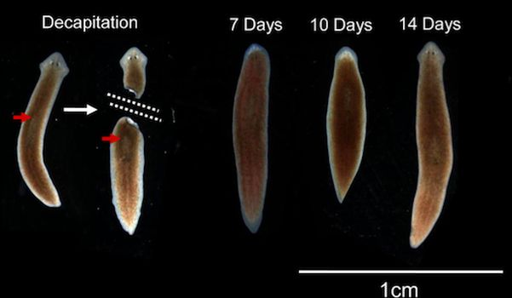
Regeneration

Slide 24
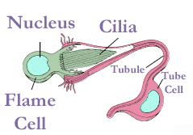
Flame Cells
Special cells in aquatic flatworms, like Planaria
Used in excretion, like kidneys removing wastes from the blood
Have bunches of cilia
Beat wastes into excretory tubules, which connect to pores

Slide 25
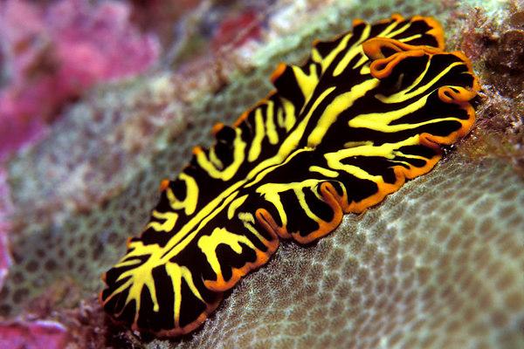
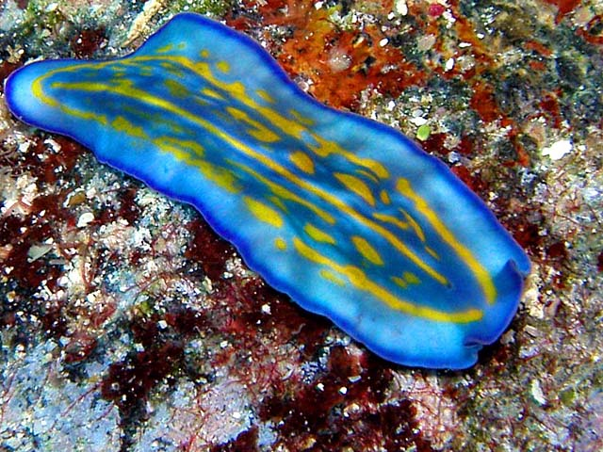
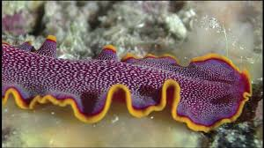
Not all are gross!

Slide 26
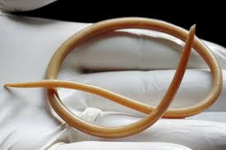
Roundworms
Phylum Nematoda--round
Almost all are parasitic and live in animals’ intestines, but can travel to bloodstream, other parts of the animal
Is killed with thorough cooking (no pink)
Trichinosis was a problem in pig/pork for many years but has been almost entirely eliminated from the USA by tightening standards
More likely in wild animals—bear, rabbit, etc.

Slide 27
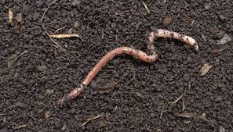
Segmented worms
Phylum Annelida— segmented skin pattern
Movement is by a series of complex muscle movements and contractions which pull the worm
Has a more complex nervous system with receptors in its skin and down its tail—responds to light, touch, temperature, chemicals
The earthworm is the most common example
Leeches, tubeworms, fireworms, sandworms

Slide 28
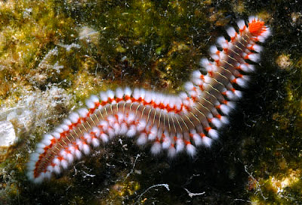
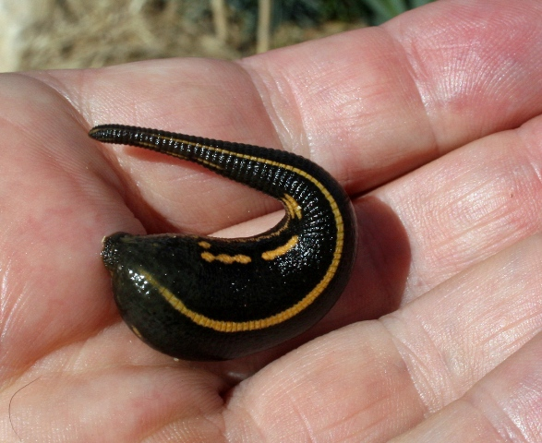
More segmented worms
Notes:
Bristleworm, leech

Slide 29
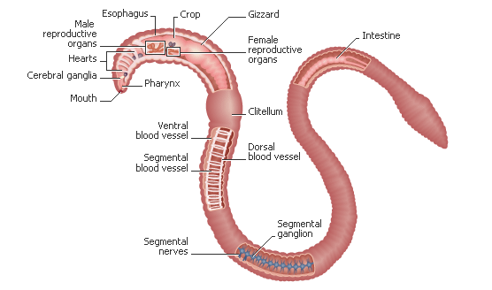
Earthworms
Has a pretty standard digestive system that runs from tip to tail, organs on the way
Has a pretty complex circulatory system that is closed. Has arteries that transport blood away from the heart and veins that pick up blood to carry it back toward the heart. Has blood pressure.

Slide 30
Value of earthworms
Swallows soil and “digests” it with enzymes
Returns nutrients and fertilizer to soil
Its paths/burrows loosen the soil so the soil gets oxygenated; more air and water is available for plant roots to pick up
Breathes through its skin which is why it rises to the surface after a rain—it cannot breathe when it is submerged

Slide 31
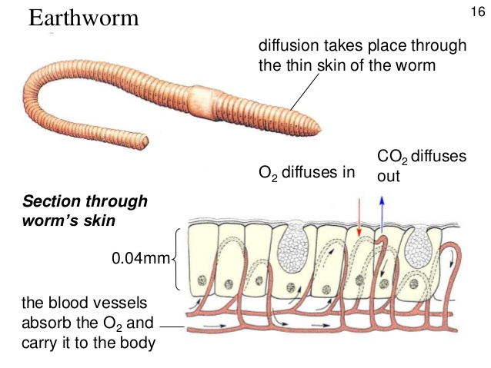
Respiration through Skin

Slide 32
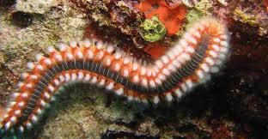
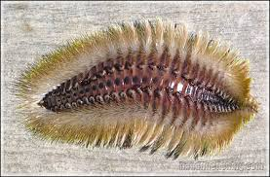
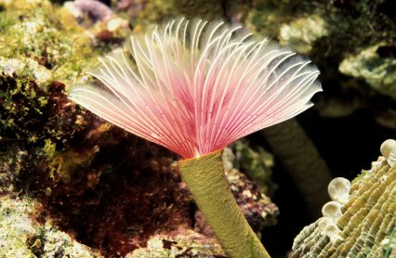
Fireworm/Bristleworm/Fanworm
Notes:
Fireworms and Bristleworms can irritate/sting if handled. Fireworms sting a lot, hence the name!!

Slide 33
Mollusks & echinoderms

Slide 34
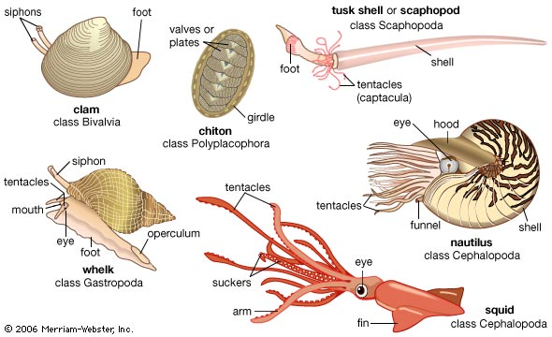
Mollusks
Phylum Mollusca
One shelled (snail), Two shelled (clam), no shelled (octopus)
Known for their defenses and protections
Snails, slugs, clams, octopuses, squids, oysters…

Slide 35
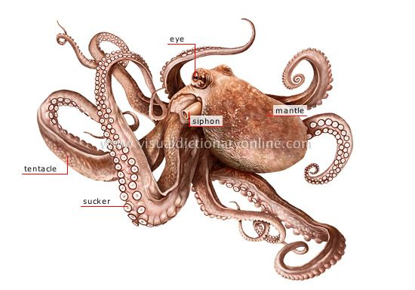
Mollusk--octopus
An octopus has tentacles with suction disks to capture food
Shoots water out of its siphon to move
Soft bodied; can squeeze its body down with muscles
Can regenerate lost limbs
May have poison or ink
Many have camouflage; can change color with fright, anger, or attack
Very complex eyes

Slide 36
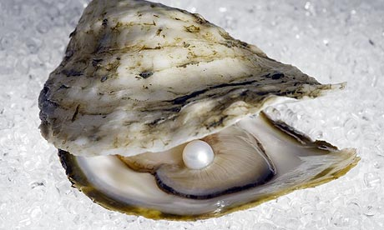
Mollusk—clam, oyster
Soft bodied
Upper layer of skin produces a coiled shell for protection, which grows a layer each year and slowly thicken (like tree rings)
Moves using a muscular “foot”
Eats or drinks through its siphon
filter feeder

Slide 37
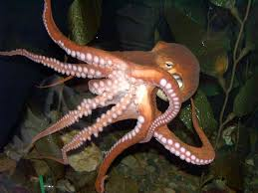
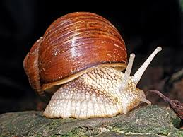
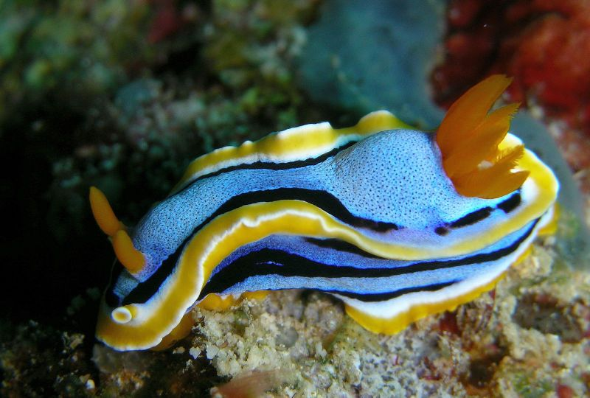
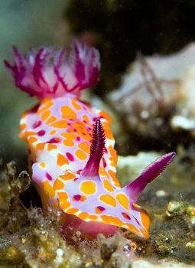
Mollusks
Notes:
Snail, octopus, 2 sea slugs

Slide 38
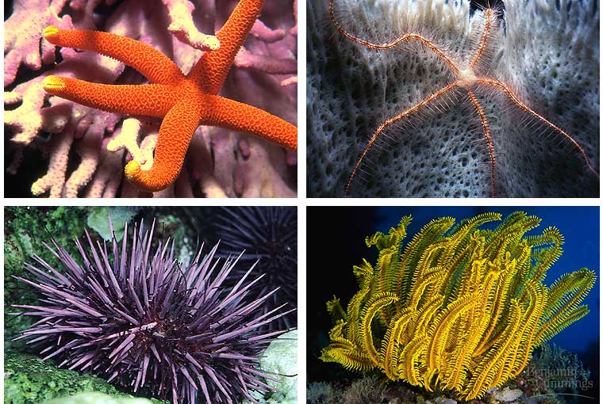
Echinoderms
Phylum Echinodermata
“spiny skin”
Starfish, urchins, sand dollars, sea cucumbers
Extremely tough tissues and muscle fibers, sometimes scales, plates, or spines
Have radial symmetry

Slide 39
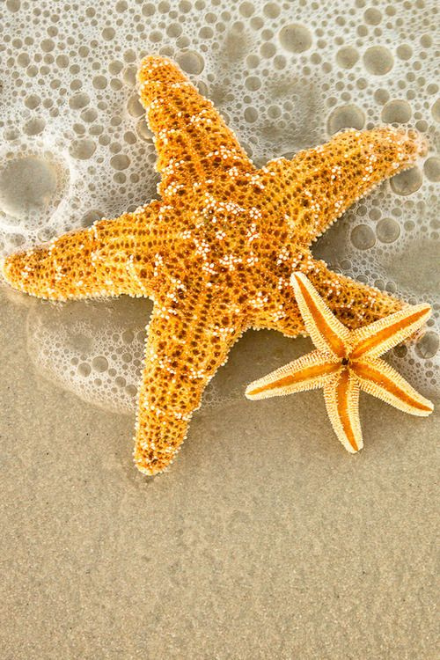
Starfish
The starfish has a water-vascular system that causes its movement.
Tiny tube feet act like suction cups which can pry its food apart.
Can eat outside of its body by protruding its stomach.
Notes:
Brittle Star

Slide 40
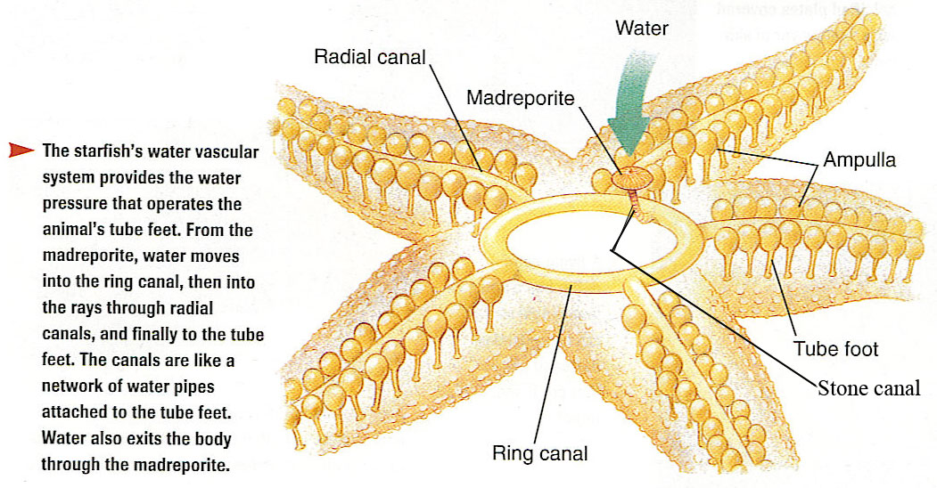
Water-Vascular System

Slide 41
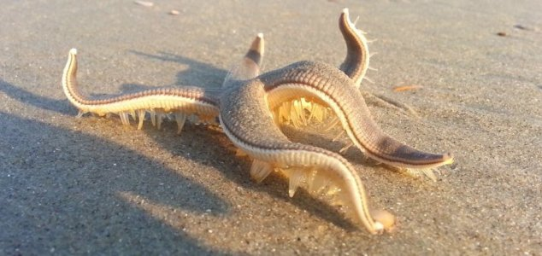
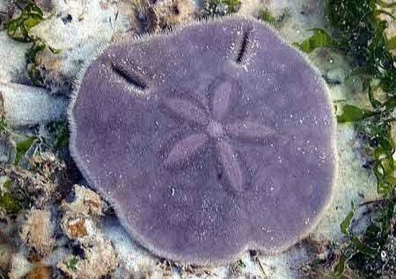
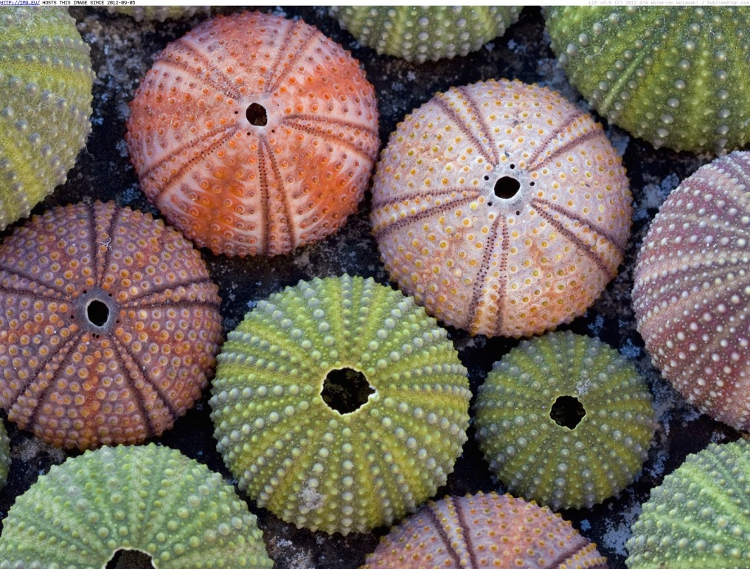
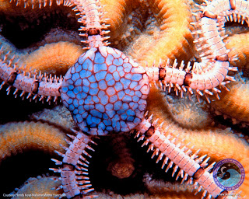
Notes:
Starfish “walking” on beach, sand dollar, brittle star, sea urchins

Slide 42
arthropods
(Bugs!! Yikes!!)

Slide 43
Insects
Phylum Arthropoda-- The largest animal phylum
Crayfish, lobsters, crabs, shrimp, bugs, centipedes, spiders, scorpions, butterflies, ticks, etc.
Have exoskeletons and jointed legs made of proteins
Has 3 main body parts— head, thorax, abdomen
Often six legs, compound eyes, wings, antennae
Have an open circulatory system (blood flows out over organs with no veins to pickup)
Have relatively normal digestive systems with intestines
Breathe through tracheae (tubes) and spiracles which pump the air in and out

Slide 44
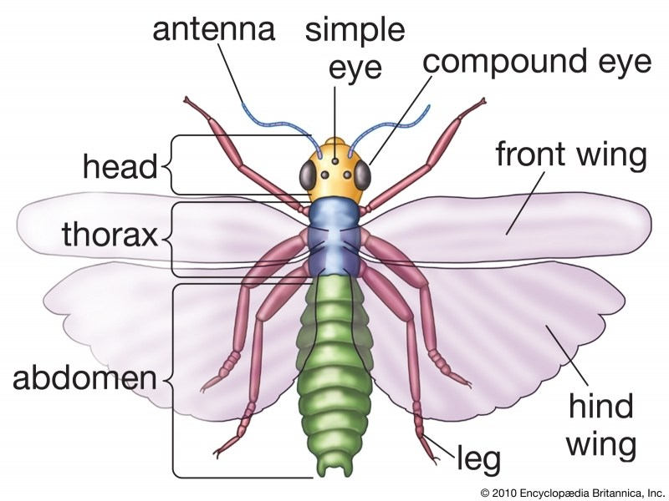
Insect body

Slide 45
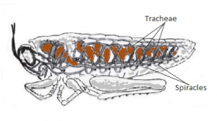
Respiration through Skin

Slide 46
Open v. Closed Circulatory System

Slide 47
Metamorphosis
Egg
Larvae or “grub” stage (growth)
Pupa/pupate--Cocoon or chrysalis (rest)
Adult
Nymphs skip the pupa stage and look like small versions of the adults
Molting is when the exoskeleton is shed and grows a new one; a series of molting stages occurs within metamorphosis because each exoskeleton is specific and only somewhat flexible

Slide 48
Metamorphosis

Slide 49
Nymphs shed Exoskeletons

Slide 50
Social Insects
Bees, flies, ants are social—they live in colonies with differentiation of labor
They live in a “hive” or collective space which they protect
Most have a “queen” which lays the eggs
Not all can reproduce (“workers “are infertile, usually female; while “drones” are male)

Slide 51
Protecting the Hive
Notes:
Red throated caracara wasp

