Slide 1
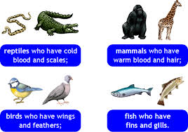
Vertebrates!
What, no amphibians??
Chapter 13

Slide 2
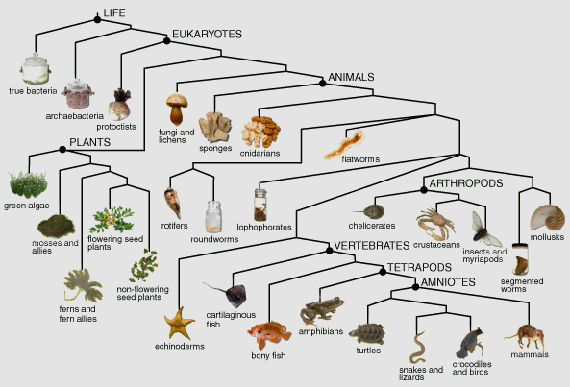
Notes:
WHERE ARE THE BIRDS???

Slide 3
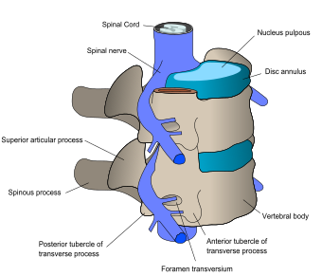
What is a vertebrate?
Has a brain, backbone, with spinal cord inside
Has an endoskeleton made of bone and cartilage (living tissues)
Vertebral column is connected to a skull with nerves that connect to each bone
Many have ribs, limbs/wings—but not all

Slide 4
Warm v Cold Blooded
Cold-blooded (fish, amphibians, reptiles)
Ectothermic: Cannot regulate their own body temp; use sun
Warm-blooded (birds, mammals)
Endothermic: Can regulate/stabilize their own temp (using food)
Note: Birds are not on the evolutionary tree!

Slide 5
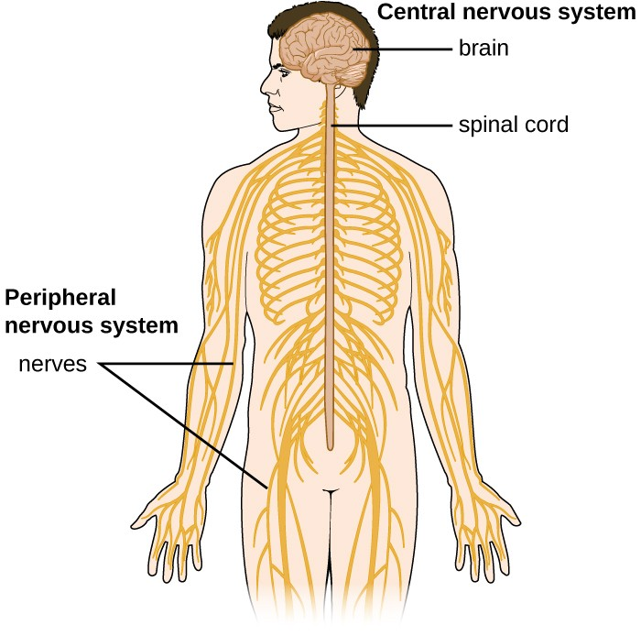
Vertebrate Systems
Nervous System
Made up of a central nervous system and a peripheral nerve system
Nerves branch off to sensory organs (eyes, ears…) and sensory receptors (cells in skin and organ membranes)
Allows an organism to respond to stimulus: the more developed, the more sensitive and complex the response

Slide 6
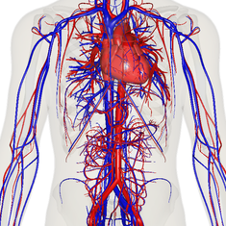
Vertebrate Systems
Circulatory system
Blood carries oxygen and key nutrients throughout the body
Circulates wastes away
Arteries (away) and veins (towards)
Hearts have chambers: 2 for fish, 3 for amphibians and reptiles, 4 for birds, mammals, people
Respiratory system
Gills (water) and lungs (land)
Connected to circulatory system
Provides oxygen and carries away carbon dioxide

Slide 7
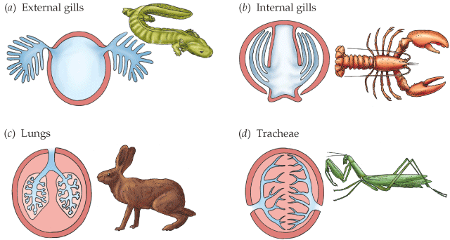
Respiration Types

Slide 8
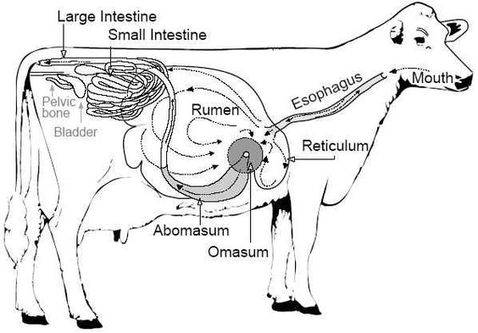
Vertebrate Systems (cont.)
Digestive System
Forms from a digestive tube from mouth to end
Contains enzymes to break down food, and intestines to absorb nutrients from it
Many parts which help: liver, pancreas, gallbladder…

Slide 9
Vertebrate Systems, cont.
Excretory System
Kidneys, bladder to filter out wastes from blood and get rid of it
Reproductive System
Contain organs for maturation, development/birth of offspring
Extremely diverse throughout the animal kingdom
Endocrine System
Manufactures and regulates special chemicals (hormones) for all kinds of processes: growth, maturation, appetite, attention, emotions, calming, fight/flight…

Slide 10
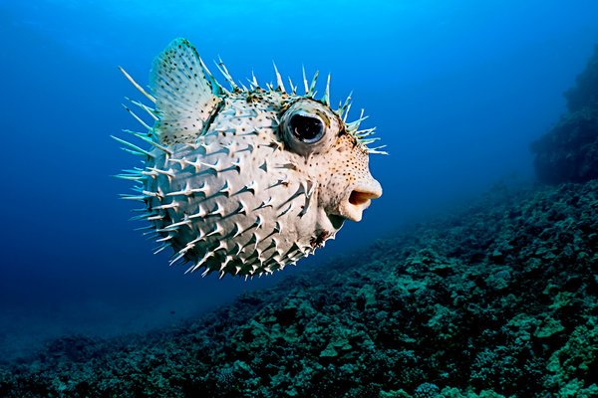
Go Fish!
Chap 13
Notes:
Fugu, pufferfish

Slide 11
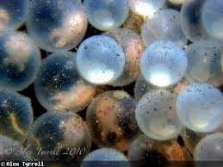
Characteristics of Fish
Ectothermic
Fins, gills, scales
Swim bladder helps many fish float/sink
Lateral line is sensitive to vibrations and pressure changes in water
Two-chambered hearts
Reproduce by spawning
Females lay eggs
Males come along later to fertilize them
Eggs hatch, only some survive

Slide 12
Post-Spawning

Slide 13
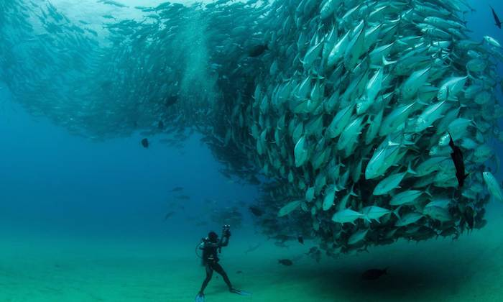
Spawning Behavior

Slide 14
Fish Respiration
Gills help extract breathable oxygen from dissolved oxygen gas in water
Carbon dioxide is “exhaled” producing bubbles

Slide 15
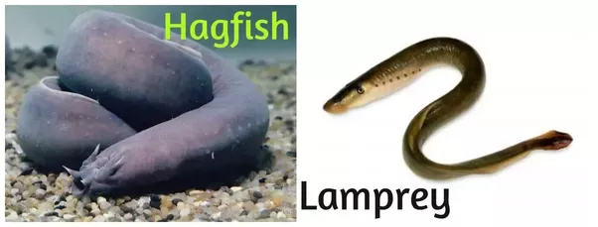
Kinds of Fish
Bony fish have the standard jaws, scales, paired fins, skeletons of bone
The largest group: Nemo and friends
Cartilaginous fish have skeletons made of cartilage
Sharks, rays
Jawless fish do not have jaws, scales, paired fins
Hagfish, lamprey

Slide 17
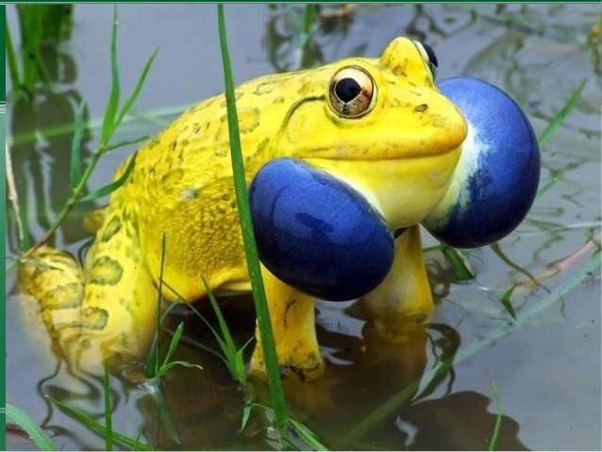
Amphibians

Slide 18
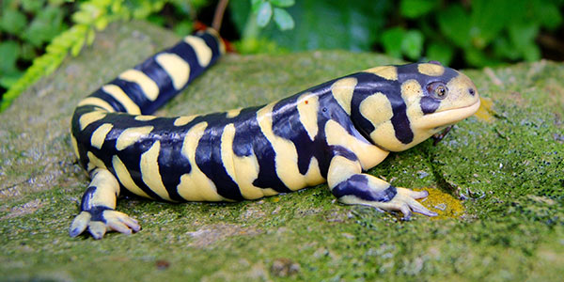
Amphibians
“amph” means both: both land and water
When young, they have gills and live in water
As adults, they breathe through lungs and live on land
Metamorphosis changes from young to adult
They molt their skin
Egg-laying
Cold-blooded
Breathe through skin, similar to insects—skin must be thin, moist, smooth
They often secrete harmful substances; some are toxic
Frogs, toads, salamanders, newts

Slide 19
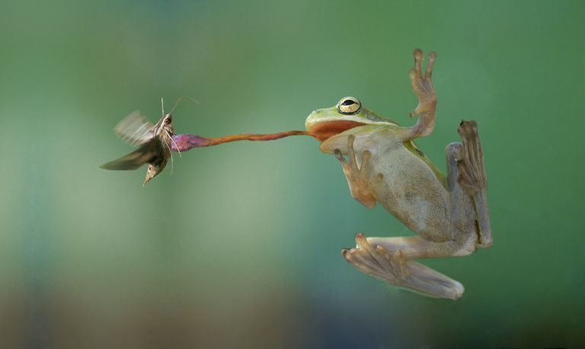
Predation

Slide 20
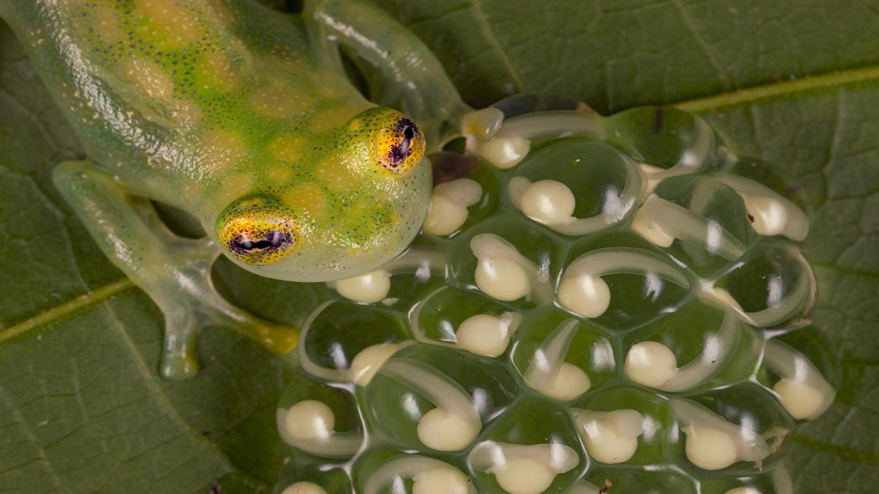
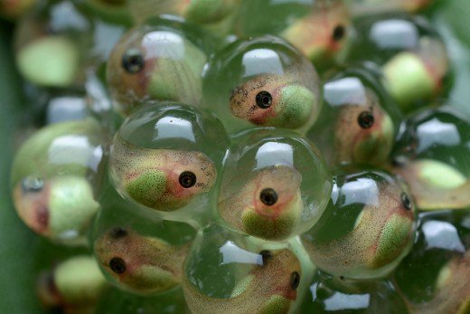
Metamorphosis: tadpoles

Slide 21
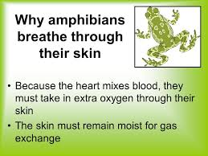
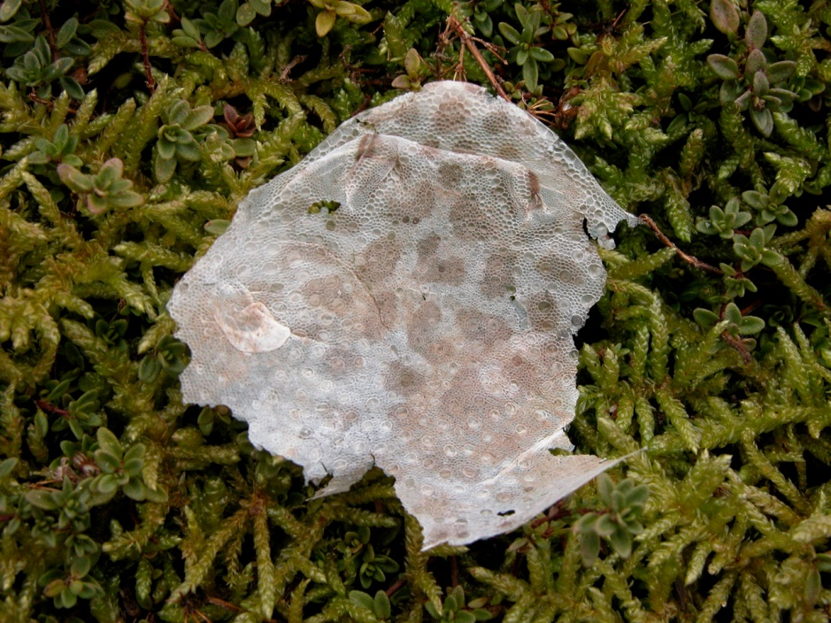
Skin: Breathing/Molting

Slide 22
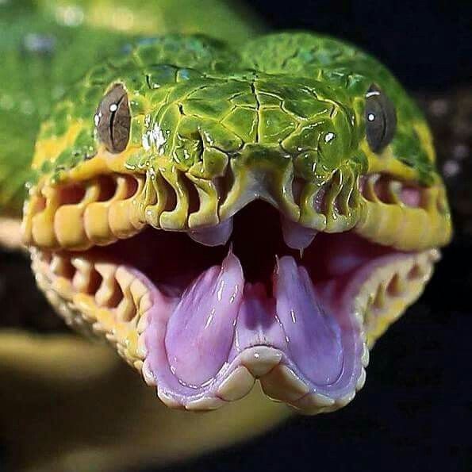
Reptiles
Notes:
Tree Boa

Slide 23
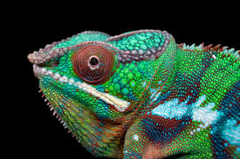
Reptiles
Cold-blooded
Breathe with lungs; those in water need to come up to the surface to breathe in oxygen
Three-chambered hearts
Do not go through metamorphosis
Have dry, scaly skin
Most molt their skin or shed it in patches
Lay eggs
Snakes, lizards, crocodiles, alligators, turtles, tortoises, dinosaurs, komodo dragons

Slide 24
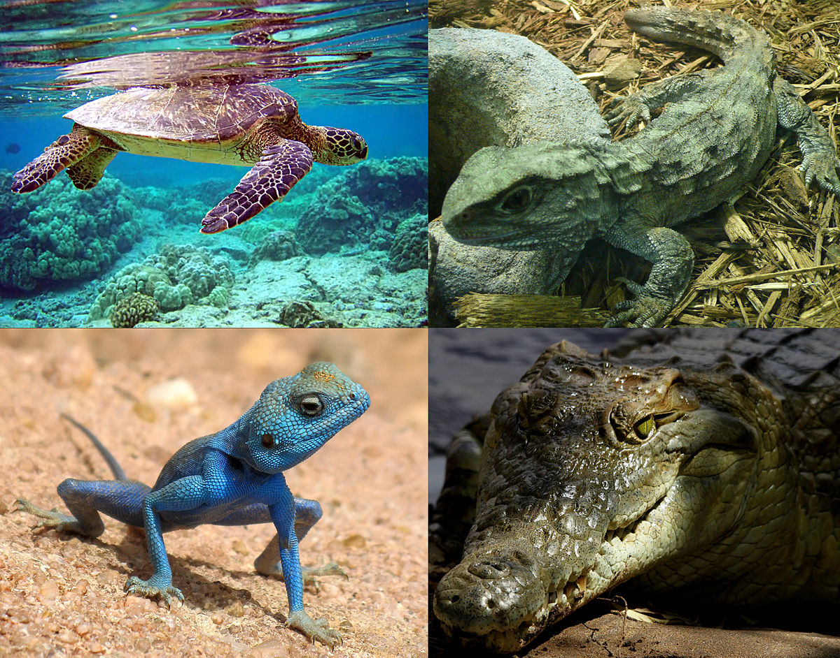

Slide 25
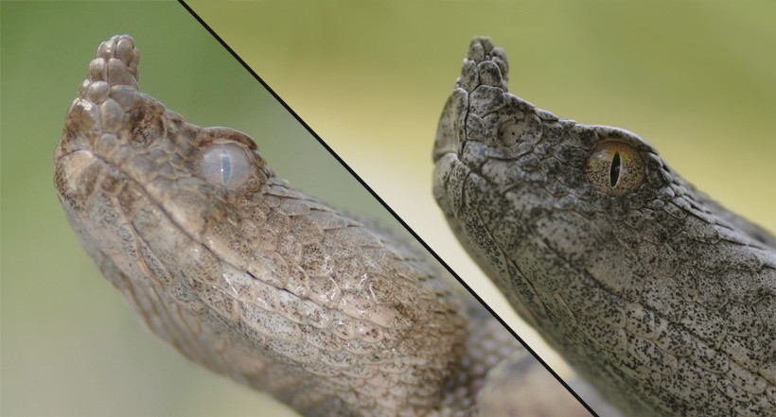
Molting

