Slide 1
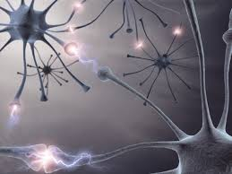
The Nervous System: control through electricity
Control through electricity
(And chemistry)

Slide 2
Nerves and Brain

Slide 3
Control
The two systems which control the entire body are the nervous system and the endocrine system.
There is active, voluntary control
as well as passive, involuntary control
Your brain does both.

Slide 4
Nervous System
The Nervous System has two parts:
Central
Peripheral

Slide 5
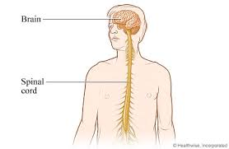
Central Nervous System
The CNS consists of the
Brain
Spinal Cord

Slide 6
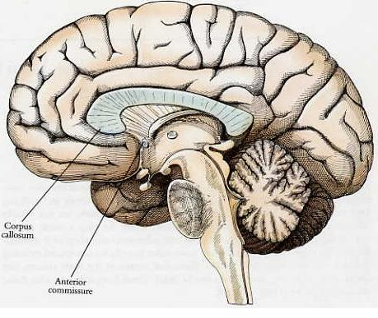
Cerebrospinal fluid fills the brain cavity and spinal column
The blood-brain barrier keeps most harmful chemicals out
Corpus Collosum is in the middle, connects right and left hemispheres

Slide 7
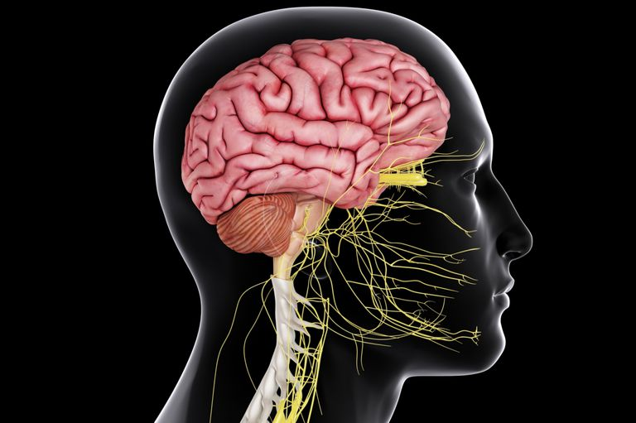
Important Parts of the Brain
Cerebrum
All conscious activities
Cerebellum
All subconscious activities including balance and involuntary muscles
Brain Stem
Breathing, heartrate, involuntary functions

Slide 8
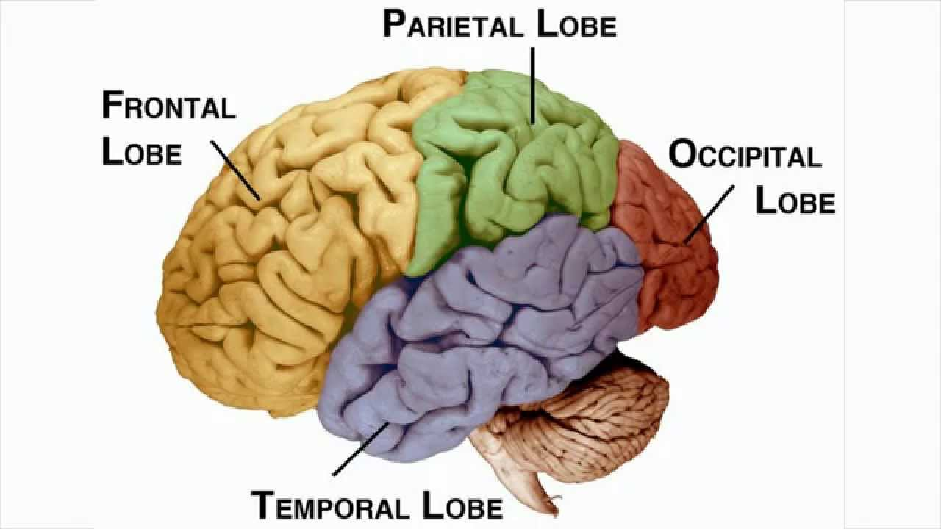
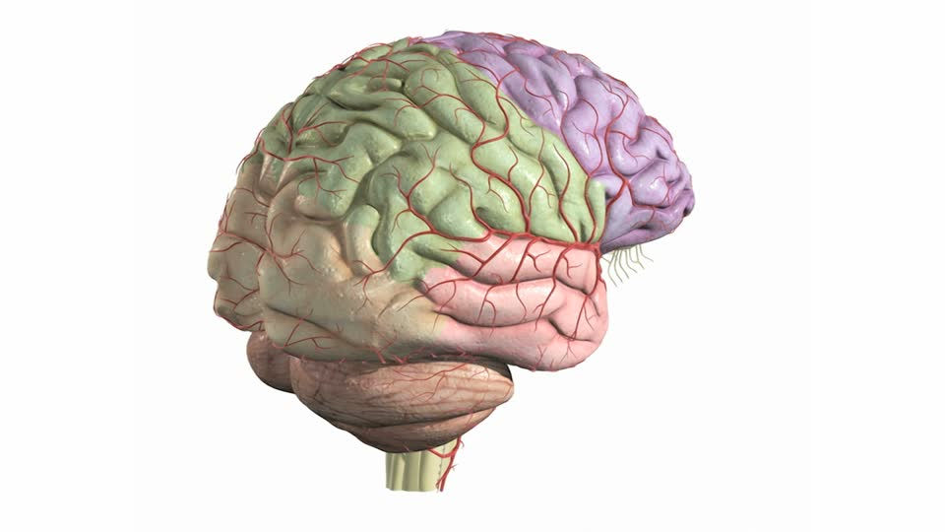
Lobes of the Brain
Frontal
All thinking, speech, voluntary movements
Parietal
All sensations: touch, pain, pressure, temperature
Temporal
Hearing, smelling, memory of sights/sounds/smells
Occipital
Vision, visual memory of objects and symbols (reading)

Slide 9
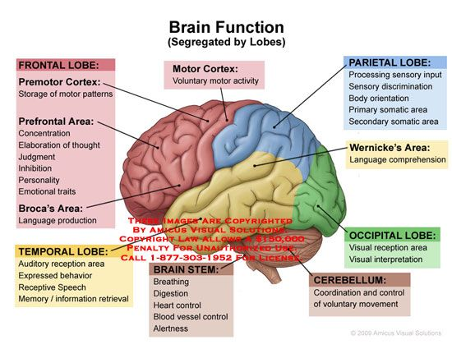

Slide 10
Brain Disorders
Hypoxia—brain damage, often from an accident
Seizure Disorders (Epilepsy)
Stroke/Aphasia—blood clots, blocking oxygen (motor, speech, memory defects)
Dementia (Alzheimers)
Cerebral Palsy
Motor-Degenerative (ALS, MS, Parkinsons, Huntingtons…)
Some forms of blindness, deafness

Slide 11
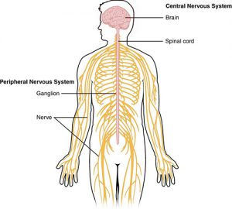
Peripheral Nervous System
Nerves throughout the body
Nerves connect to everything!
Heart, stomach
Hair follicles
Nerves are made of neurons.
PNS has both Sensory Neurons and Motor Neurons

Slide 12
Nerves
A lot of nerves connect to sensory organs (eyes, ears, tongue, nose, fingers…)
A lot of sensory receptors—special cells in those organs which are activated and then send signal back to the brain for interpretation

Slide 14
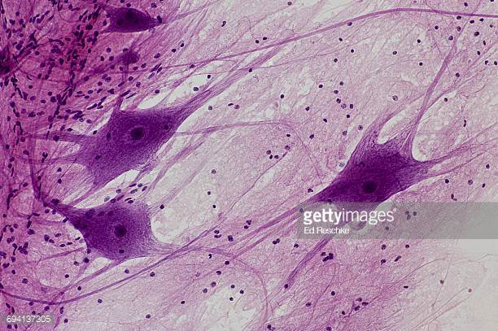
Neurons
Nerve cells are called neurons
Neurons work through electrical impulses, and connect like an electric circuit

Slide 16
At the Gaps

Slide 17
Neurons
Neurons (nerve cells) have gaps in between them that are bridged by chemicals in little packets
Synaptic gaps
Neurotransmitters
Vesicles
Electricity changes to chemicals, and those chemicals change back into electricity
Dendrites
Axons
Cell body

Slide 18
Nerves
The brain is the “battery” controlling this circuitry, some of it voluntary and some involuntary.
Neurons attached to muscles or glands are called motor neurons
They cause the muscle to move by electrical signal
Nerve impulses travel down nerves to fingers, legs, stomach, etc.

Slide 19
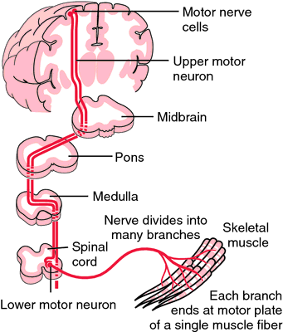
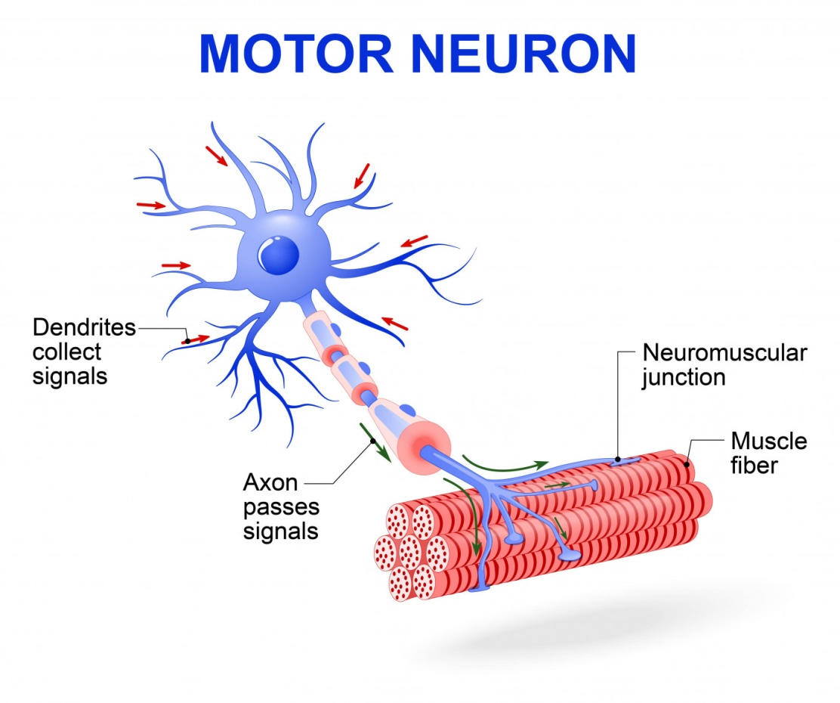

Slide 20
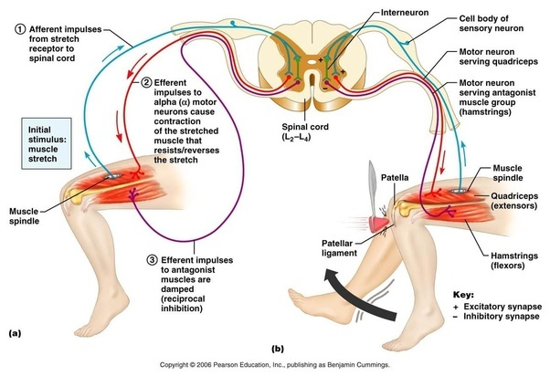

Slide 21
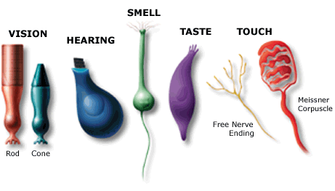
Nerves
Neurons attaching the brain to sensory organs are sensory neurons
Specificity: They receive signals for (are sensitive to) only one kind of stimulus (pain, cold, light, sound, taste, etc.)
They only “fire” when the right stimulus is triggered, and “rest” when the stimulus is not
These connect to the brain for quick interpretation and moderation (i.e. “Get off my hair!”)

Slide 22
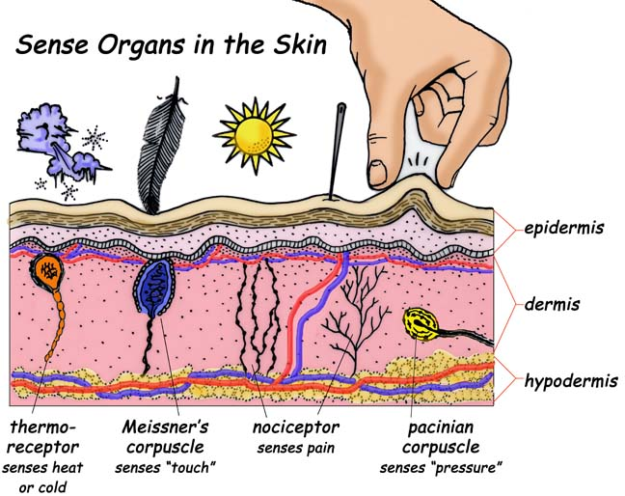
Types of Sensory Receptors

Slide 23
The Eye

Slide 24
Important Parts
Cornea
Lens
Iris
Pupil
Retina
Rod and Cones (cells in retina)
Optic nerve
Lacrimal glands
Lots of muscles around eye parts: iris, lens, pupil, lids…

Slide 25
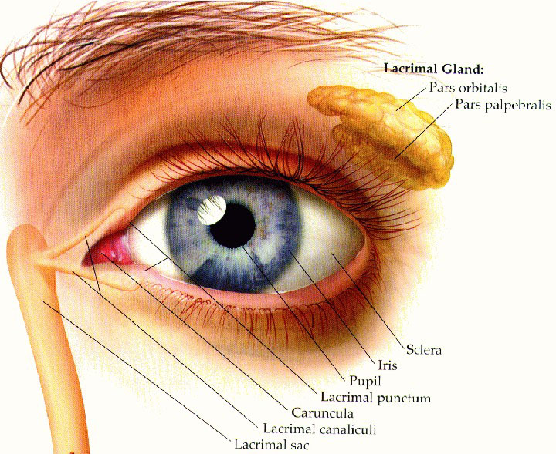
Parts of the Eye

Slide 26
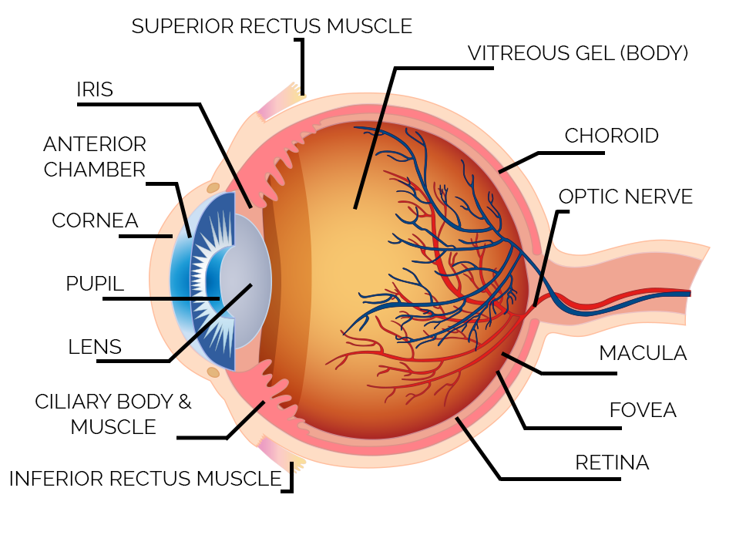

Slide 27
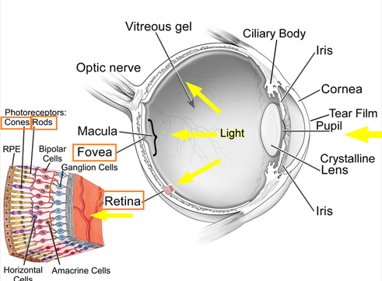

Slide 28
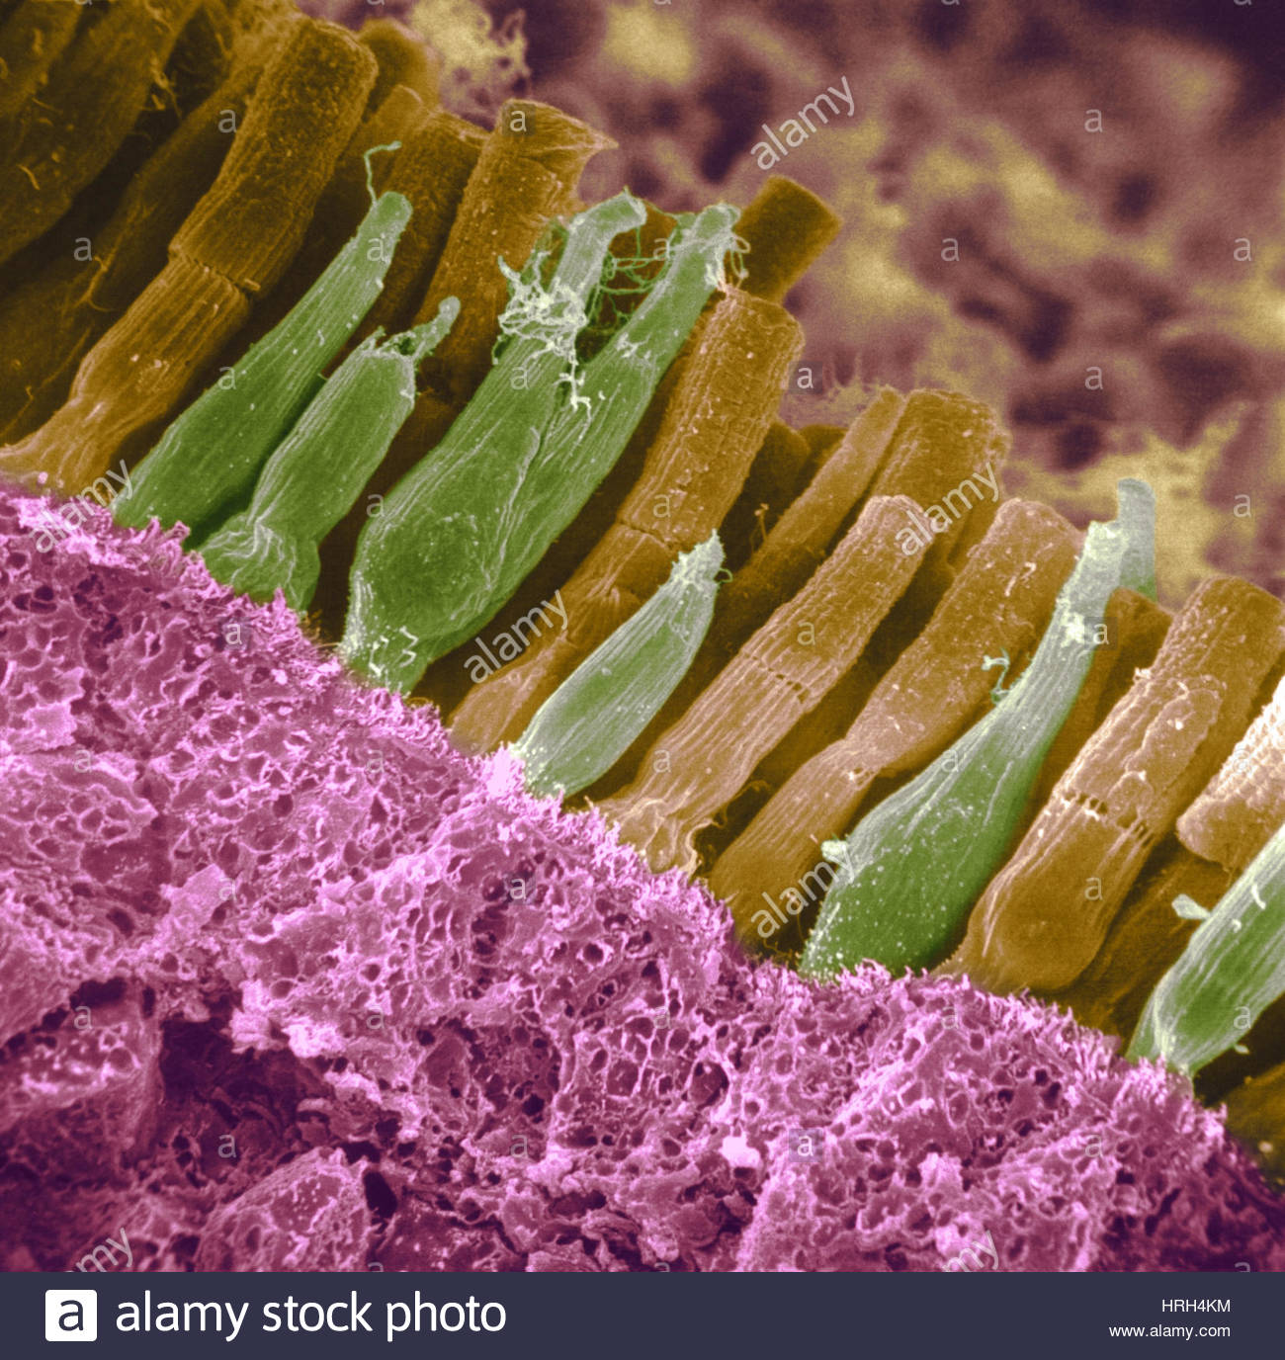

Slide 29
Eye problems
Glaucoma: fluid that puts pressure on the retina
Cataracts: blurring of the lenses
Myopia (near sightedness): image focuses in front of retina
Hyperopia (far sightedness): image focuses too far from retina
Astigmatism: wrong curvature of lens
Color blindness

Slide 30
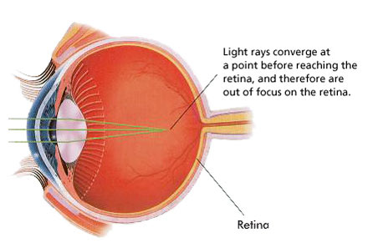
Near-Sightedness

Slide 31
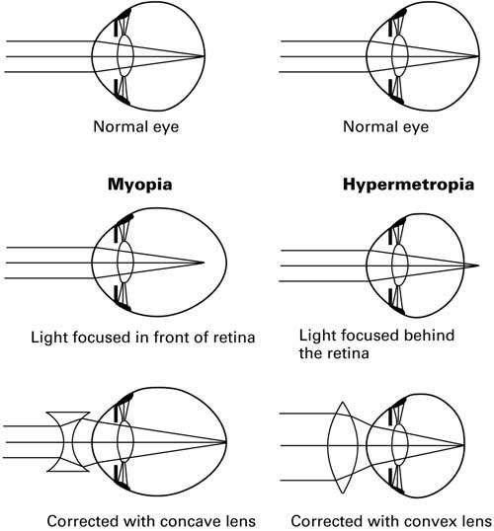

Slide 32
The Ear

Slide 33
Parts of the Ear
Outer Ear
Channels sound waves into the ear canal
Middle Ear
Maintains pressure between ear and outside
Inner Ear
Processes sound for hearing and conduction to the brain
Controls sense of balance (or dizziness)

Slide 34
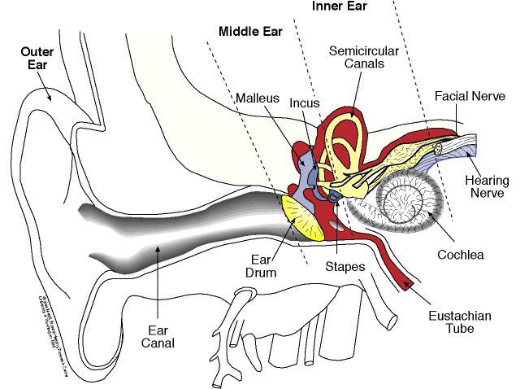

Slide 35
Important Parts
“Ear drum”; tympanic membrane (vibrates in response to sound waves)
Eustachian tubes (connect to throat)
Cochlea (processes sound)
Auditory nerve (sends sound signals to brain)
Semicircular canals (controls balance)

Slide 36
The Endocrine System
Control through chemicals

Slide 37
Hormones
Hormones are chemicals that are interpreted by the body to mean something specific:
Epinephrine: fight!
Norepinephrine: flee!
Cortisol: stress; curbs appetite, sleep, etc.
Leptin: slow appetite

Slide 38
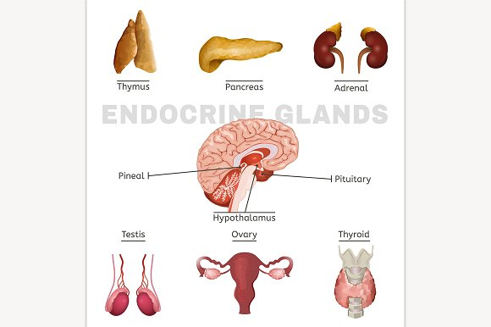
Hormone Production
Hormones are often produced inside glands

Slide 39
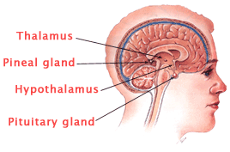
*The Endocrine System
Hypothalamus
Thalamus
Pineal
Pituitary
Adrenals
Pancreas
Thyroid

Slide 40
The Endocrine Control Center
The Endocrine System literally moderates dozens of important bodily functions:
Metabolism
Height
Appetite
Maturation
Aging
Hydration
Energy level
Body temperature
Aggression
Stress level

Slide 41
*Negative Feedback System
Hormones often self-regulate through negative feedback
Hormones release in response to stimulus
When too much hormone is sensed in the blood (because it hasn’t been used or metabolized for its intended purpose), it tells its production center to slow down or stop
There is sometimes a sense of intensity and rebound in the body (i.e. hunger, fear…)

Slide 42
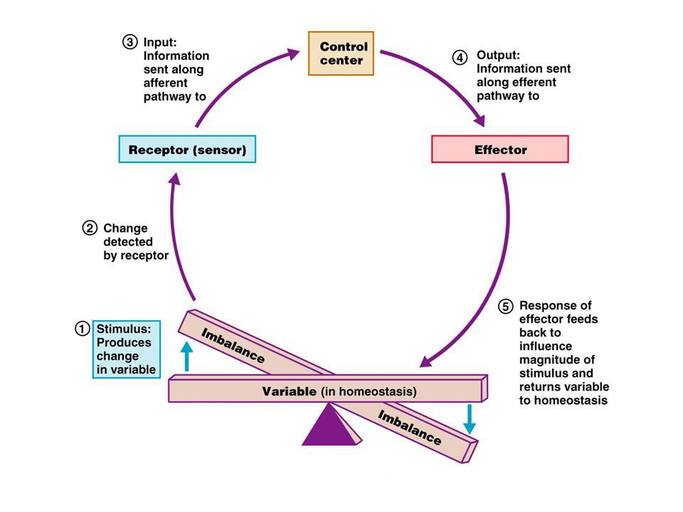
Back to Homeostasis

