Slide 1
The HUMAN BODY!!!
The Last Unit… ☺

Slide 2
List of systems
Integumentary (skin)
Skeletal
Muscular
Circulatory
Immune
Excretory
Respiratory
Digestive
Nervous
Endocrine
Reproductive
Protection, defense
Support, movement
Movement
Blood transport
Disease-fighting
Eliminating chemical wastes
Getting oxygen to blood
Absorb nutrients, eliminate wastes
Movement, sensory information
Regulating bodily functions
Producing offspring

Slide 3
RESPIRATION
Gaining energy (OXYGEN) for work

Slide 4
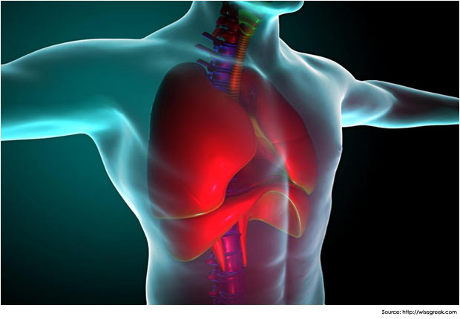
Respiratory system
To breathe in oxygen
To provide fuel for the body to do all of its work
To exhale carbon dioxide (the waste product)

Slide 5
Respiratory system
Connected to circulatory system because the oxygen in air must be transferred to the bloodstream
Blood carries oxygen all throughout the body
All living cells require oxygen to grow, reproduce, stay alive
“Cardio-pulminology”
You can breath 4500 mL of air in one breath!
When your muscles and heart require more oxygen to work, you breathe harder; your breathing slows at night when less oxygen is needed because you are still

Slide 6
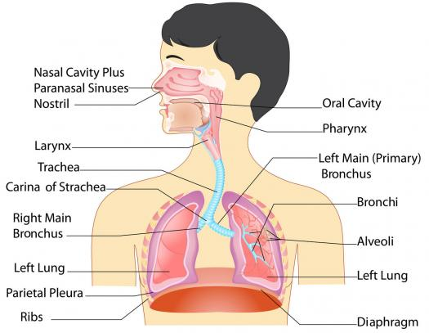
Respiratory organs
Nostrils, sinuses, mouth, trachea
Lungs and their parts
Bronchial tubes
Bronchioles
Alveoli
Diaphragm

Slide 7
The nose
Air coming through the nose is filtered by the hairs in the nasal passages, before it hits the nasal cavities (sinuses)
Hairs filter out dust, smoke, pollen, harmful particles
… sneezing!
Nasal cavities are lined with mucous membranes which absorb harmful materials.
Bacteria and other things are absorbed into the mucous and then either blown out or swallowed, where acids in the stomach destroy them.
Mucous membranes inflame during colds and viruses in response to germs breathed in.
Airborne germs make it into your body by being swallowed and therefore get initiated into the bloodstream.

Slide 8
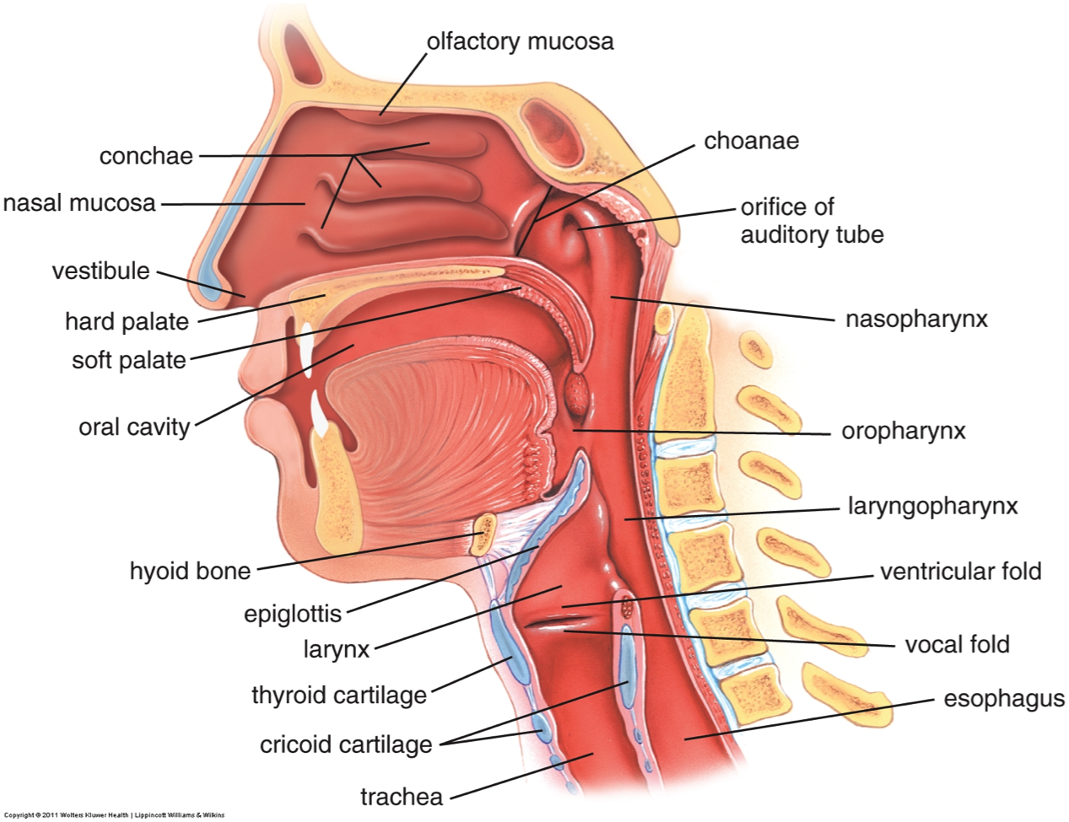

Slide 9
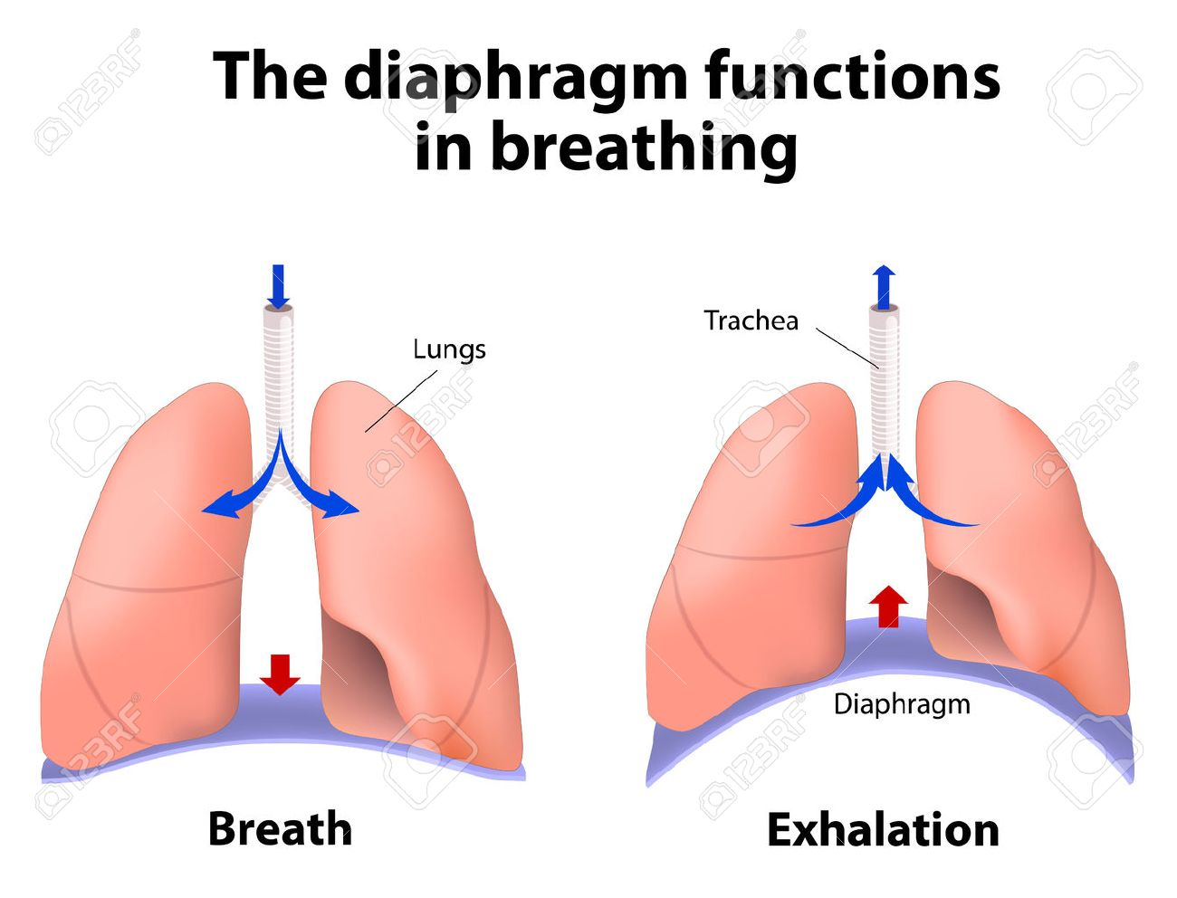
lungs
Lungs fill with oxygen as diaphragm moves down to accommodate air.
Diaphragm pops up to initiate exhaling.
Nerve cells in lungs and the brain regulate breathing involuntarily.
Oxygen moves into the blood by diffusion through lungs into blood vessels
Oxygen is carried by hemoglobin (red blood cells) throughout the body.
Oxygen is used up, hemoglobin cells are discarded once used.

Slide 10
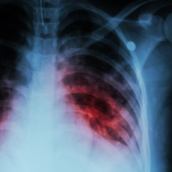
Respiratory disorders
Pneumonia (usually bacterial)
alveoli inflame and fill with fluid
Tuberculosis
bacteria damages lung tissue, causing lesions
Emphysema
alveoli stiffen, cannot flex for inhalation/exhalation
Lung Cancer
tumor cells invade lung tissue

Slide 11
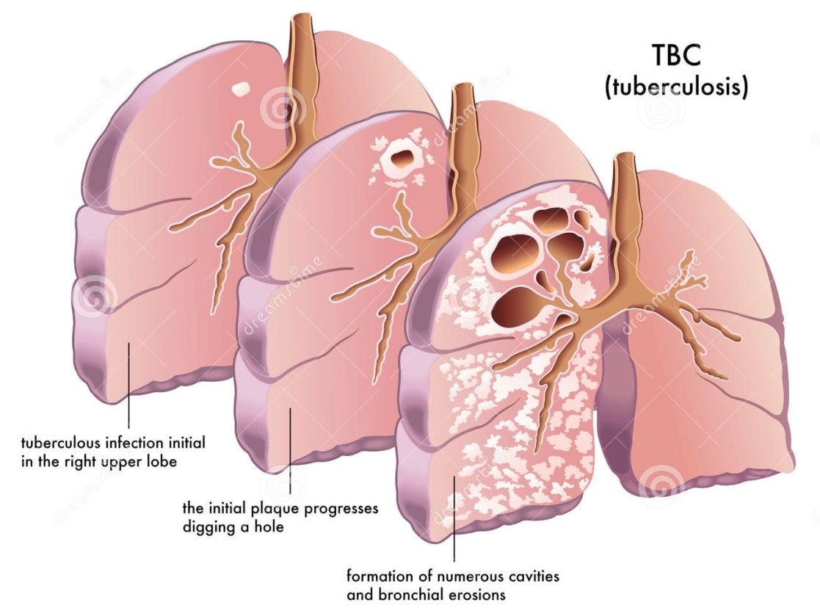
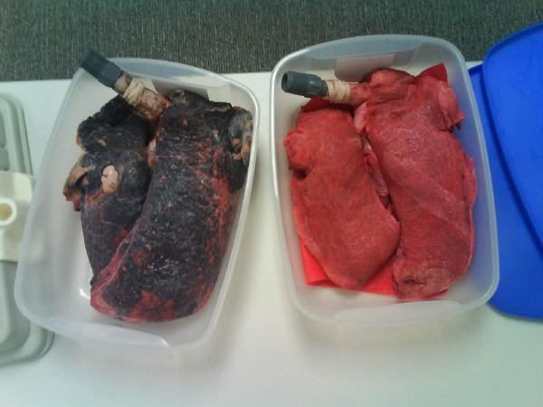
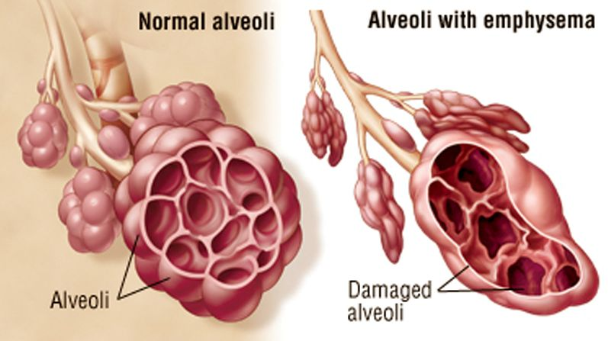

Slide 12
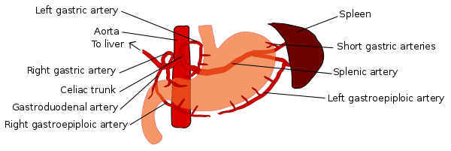
DIGESTION
TURNING POTENTIAL ENERGY FROM FOOD INTO USABLE ENERGY

Slide 13
Digestive system
Ingestion means to eat
Digestion means to break food down into chemicals
Assimilation means using those chemicals to build more living tissues, fuel life processes
Egestion means elimination of waste

Slide 14
Mechanical vS. chemical
Mechanical Digestion begins with your Teeth!
Teeth suit your diet
Teeth break down (mechanically) your food
Muscles in the esophagus and stomach also churn, physically moving or breaking up food
Chemical Digestion also begins in the mouth
Saliva contains enzymes like amylase to start digesting sugars
Salivary glands are stimulated by chewing
The stomach and other organs have digestive enzymes which continue to break down food.

Slide 15
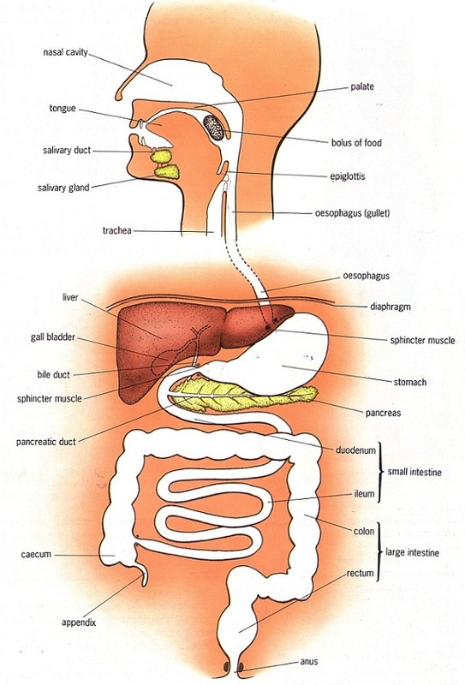
Alimentary canal
A long tube from tip to tail!
Each part completes another phase of digestion
Peristalsis refers to the movement of food through the canal

Slide 16
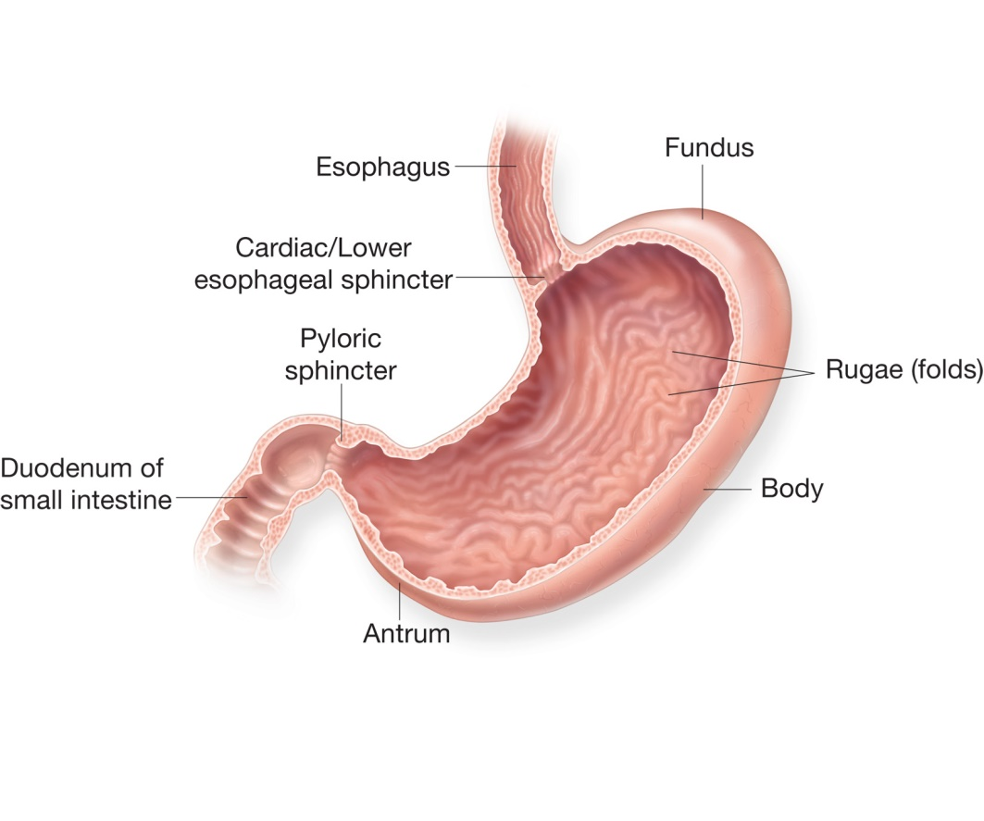
stomach
Breaks down food into small bits
Digestive enzymes tailored for specific carbohydrates, fats, proteins
Connected to esophagus on one end, small intestine (duodenum) on other end with important muscles at each location

Slide 17
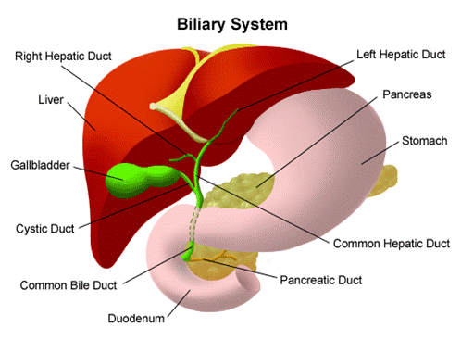
Liver, pancreas, gallbladder…
Other organs add different enzymes to the digestive process.
Liver and gallbladder help digest fats.
Liver also stores toxins that have been ingested, and stores sugar long-term.
Pancreas helps regulate the amount of sugar entering the bloodstream (quickly)
Trouble with any of
these causes major problems.

Slide 19
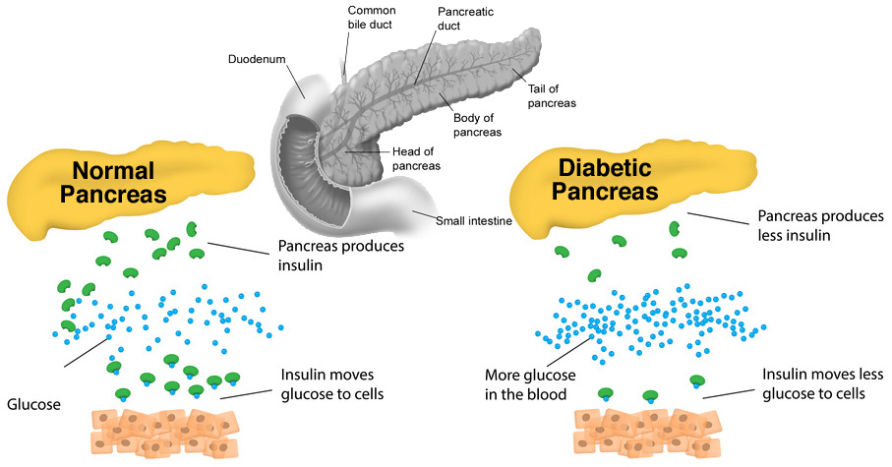

Slide 20
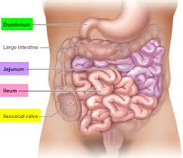
Small intestines
Small intestines are responsible for the absorption of food components into the bloodstream.
carbohydrates, fats, proteins, water, vitamins, minerals
“Nutrition” derives from the ability to absorb, and the reaction of the blood to what is absorbed into it
Carbohydrates are the quickest to digest and absorb; fats and proteins take longer in the small intestine (which is why it is so long)
Villi are the small projections that increase the surface area for absorption.

Slide 21
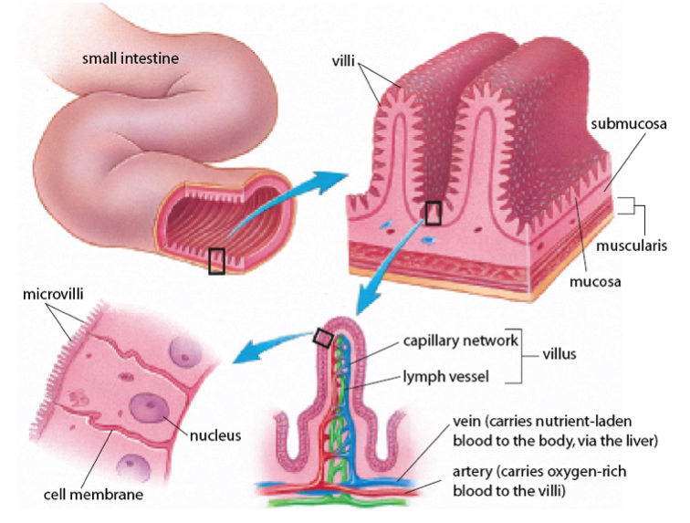
villi

Slide 22
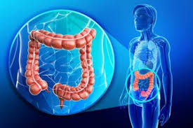
Large intestines
Large intestines hold waste.
They extract water from what is being digested, as the food moves through.
They often trigger peristalsis, or the movement of food through the tract.
They influence appetite.
Appendix is attached at the first end.

Slide 23
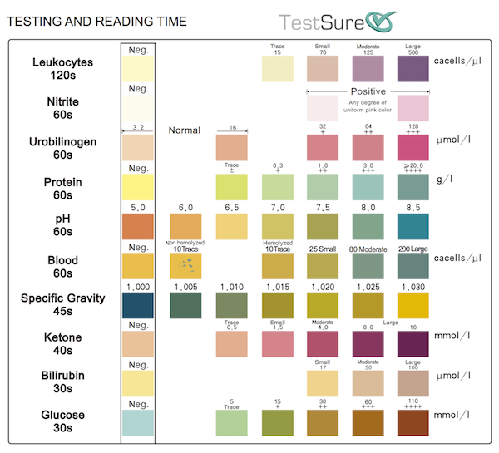
EXCRETORY
ELIMINATING WASTES FROM THE BLOODSTREAM

Slide 24
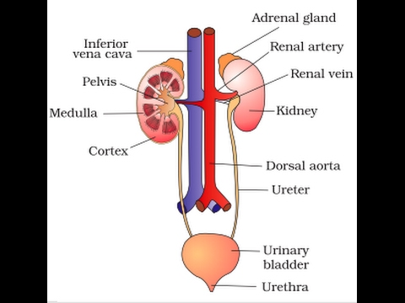
Excretory organs
Kidneys
Ureters
Bladder
Urethra

Slide 25
EXCRETORY SYSTEM
Filters toxins from bloodstream
Removes those toxins through urine
Replaces/Permits helpful materials to stay in the bloodstream
Repeats throughout the day, approximately every 8 minutes.
Is powered through the heartbeat.

Slide 26
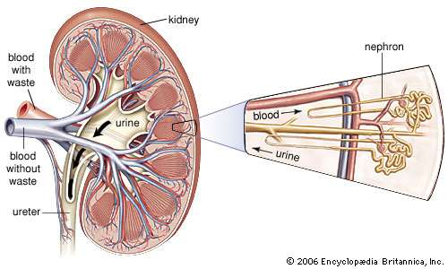
kidneys
Nephrons are the special tubules inside the kidney that “do the magic.”
They are similar to alveoli in lungs.

Slide 27
excretion
Toxins removed by the kidneys move through the ureters to the bladder.
Infection in the kidney is extremely serious; person/animal starts to “poison” themselves slowly, leading to organ failure.
Toxins are then mixed with water in the bladder to dilute their strength.
If not enough water is present, infection in the ureters, bladder, or urethra may occur. This is unpleasant but fixable with antibiotics.
Wastes are then passed safely out the body through urination.
Dehydration is a serious thing!
An athlete at top function may lose up to 4 pints of fluid an hour!

Slide 28
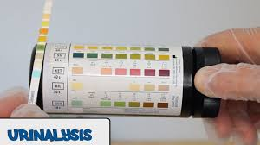
urinalysis
One of the easiest tests a doctor can perform!
White blood cells, bacteria, crystals all indicate infection.
Sugar indicates diabetes.
Alcohol or drug use is obvious.
Specific tests can be done to look for specific problems.

Slide 29
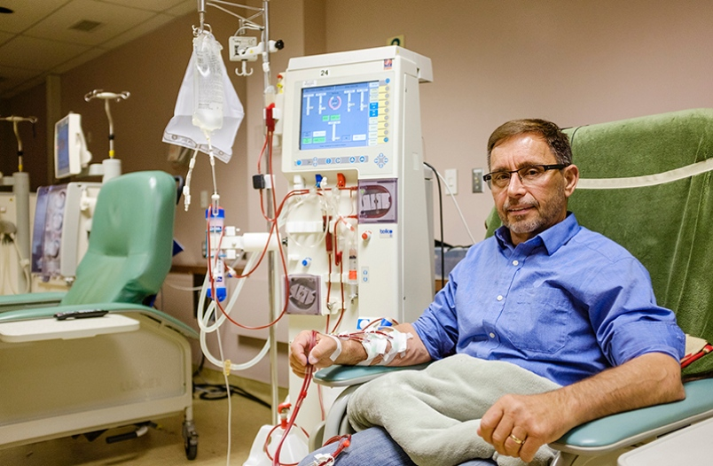
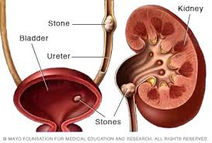
Kidney disease
Dialysis is a mechanical process of removing toxins from the blood if kidneys fail.
Kidney transplants are some of the most commonly performed transplants.
Kidney stones occur when toxins build up or clump together. They are extremely painful to pass because ureters and urethra are not meant to pass anything solid.

