Slide 1
The HUMAN BODY!!!
The Last Unit… ☺

Slide 2
Are humans animals?
similar
Different: only man
Intelligence
Can learn to do or not do things
Created by God
The amount and type of learning that is possible
A conscience and moral nature that understands right/wrong
Has a spirit, made in God’s image; is accountable to God

Slide 3
organization
Cells
Tissues
Organs
Systems
FOUR TYPES OF TISSUES:
Connective tissues: bone, cartilage, fat, blood, lymph
Epithelial tissues: skin and lining of internal organs
Muscle Tissues: voluntary and involuntary muscles (heart)
Nerve Tissues: brains, spinal cord, nerves

Slide 4
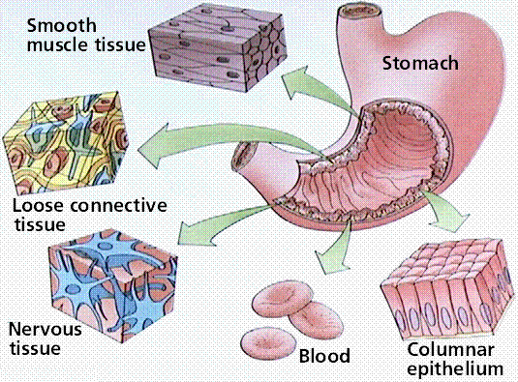
Organs often utilize all tissues together!
i.e. The stomach is lined with epithelial tissue, has muscles to digest your food, is coordinated by nerves connected to your brain, and is fed by blood which brings oxygen and nutrients to the stomach.

Slide 5
The Body
Your body is made of trillions of cells
God designed these cells like a machine—with parts designed to all work together, to make you function
Cells and Tissues are highly specialized; They work together to perform specific functions
Organs can overlap in bodily systems:
the heart is part of circulation and musculatory systems
the liver performs digestive and storage/excretory functions

Slide 6
List of systems
Intergumentary (skin)
Skeletal
Muscular
Circulatory
Immune
Excretory
Respiratory
Digestive
Nervous
Endocrine
Reproductive
Protection, defense
Support, movement
Movement
Blood transport
Disease-fighting
Eliminating chemical wastes
Getting oxygen to blood
Absorb nutrients, eliminate wastes
Movement, sensory information
Regulating bodily functions
Producing offspring

Slide 7
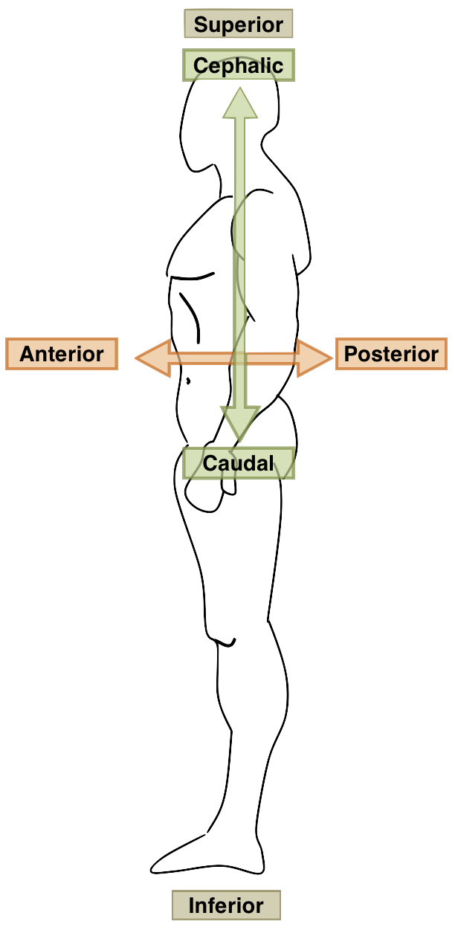
terms
Anterior (towards the stomach side)
Posterior (towards the backbone side)
Superior (up, towards the head)
Inferior (down, towards the feet)

Slide 8
SKIN, bones, muscles
Chapter 19

Slide 9
integumentary: skin, hair, nails
Functions of Skin:
Keeps chemicals and germs out
Keeps water, heat in; regulates body heat
Protects from contact/scratching, pressure
Provides sensory information (touch, temperature)
Manufactures Vitamin D
Excretes oil, wastes

Slide 10
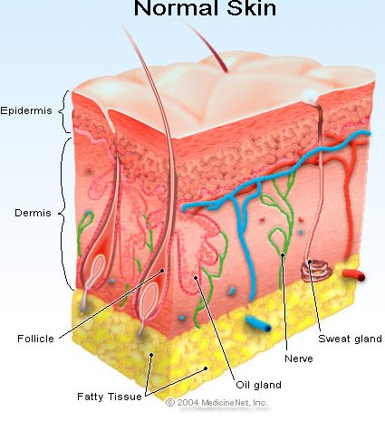
Parts of skin
Epidermis
Dermis
Subcutaneous Layer

Slide 11
epidermis
Epidermis
Surface is a layer of dead skin cells: constantly shed
Epithelial cells
Living cells underneath the dead cells: constantly dividing to replace
Dead cells fill with keratin (protein) and rise up
Nerve endings that sense pain
Nails protect the super sensory areas on fingers and toes
Has pores for substances (i.e. sweat) to be released onto skin surface

Slide 12
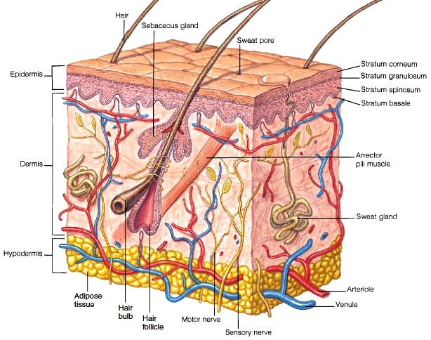

Slide 13
dermis
Dermis
Inner, thicker layer—has the most connective tissue
Blood vessels
nerve receptors
hair follicles: where hair grows from
Sweat glands, oil glands, wax glands that secrete these substances to keep skin soft, flexible, waterproof, protected, not drying out
Fibers are woven together and connect everything

Slide 14
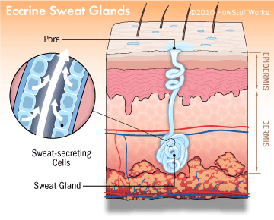
Sweat glands

Slide 15
How skin works
Regulating Body Temperature:
When you are hot, blood vessels in the skin dilate (open wider) to allow more blood flow near the surface of your skin—which cools it as it gets closer to the air
Sweat glands secret water through the pores on the epidermis, which evaporates and makes the skin feel cooler
When you are cold, blood vessels contract and the pores of your sweat glands close
All of this happens automatically!

Slide 16
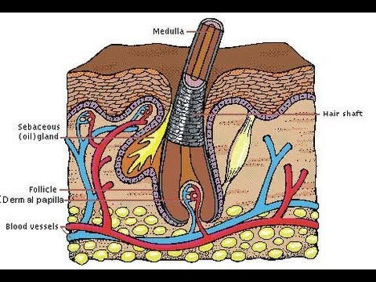
How hair grows
Living cells begin in the follicle
Die and fill with keratin
Band into a shaft and push upwards

Slide 17
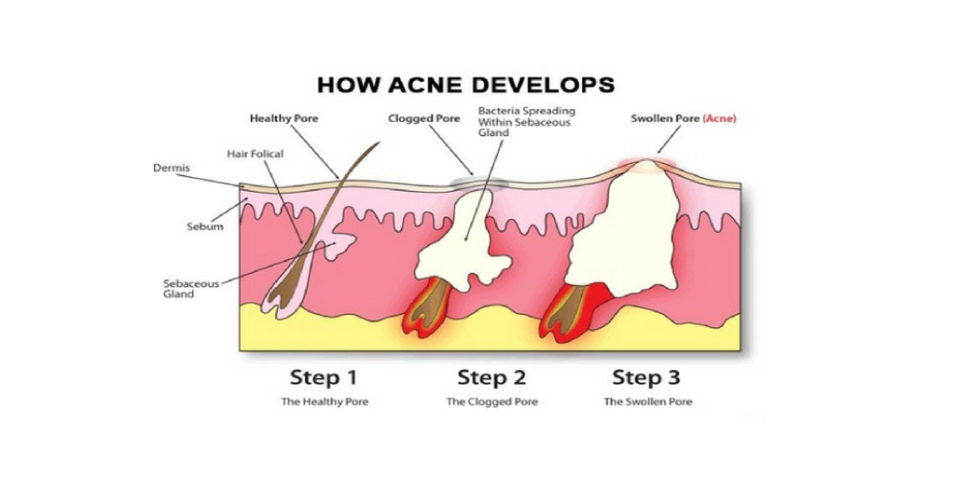
Oil glands

Slide 18
Subcutaneous layer
Fat cells cushion and insulate your body
Fibers attach the skin to the muscles under the skin
Blood vessels carry oxygen and nutrients to skin
Fibers are elastic. Loss of elasticity over time causes wrinkles and sagging.

Slide 19
How skin works
Sensation:
Nerve receptors respond to cold, heat, touch, pressure, pain
Nerve loops around the root of each hair follicle
A muscle also attaches to most hair follicles, causing goose bumps
Protection:
Keeps harmful chemicals and germs out
Keeps fluids and bodily substances in
Protects against friction and pressure by producing more cells in those areas
Thickened layers form calluses; broken layers form blisters

Slide 20
Skin appearance
Melanin and Carotene color people’s skin tone, as well as freckles, birthmarks, or sun spots
Melanin is produced during tanning, to protect the skin from UV light
Sun Burns: UV rays kill enough of your skin cells that increased blood flow to the surface of your skin causes redness and soreness
Skin Cancer: occurs when UV rays cause mutations in the DNA of skin cells which then undergo rapid and uncontrolled cell division
Burns: 1st degree damages the epidermis; 2nd degree damages the dermis, and 3rd degree destroys the skin completely

Slide 21
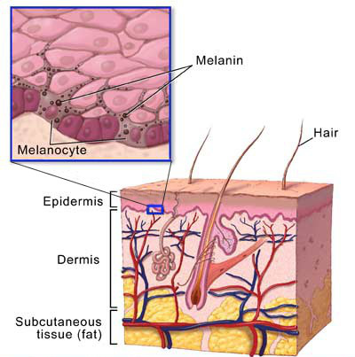
Skin color
Freckles
Birthmarks
Tanning
Overall skin color

Slide 22
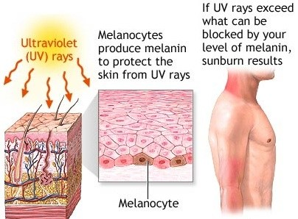
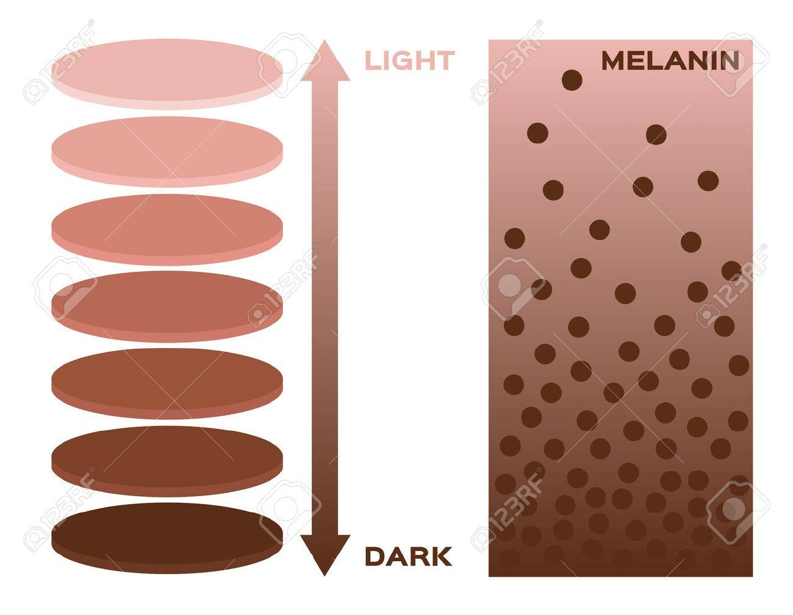
Skin color

Slide 23
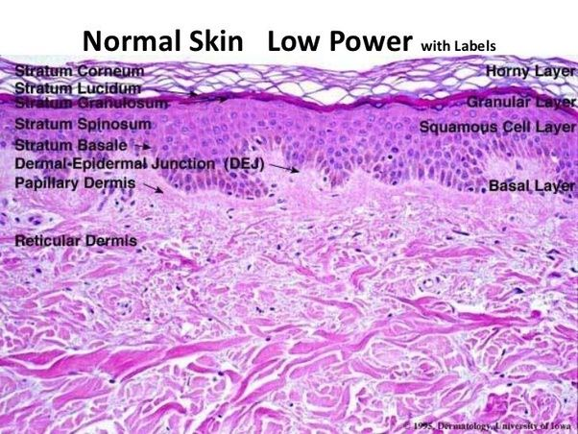
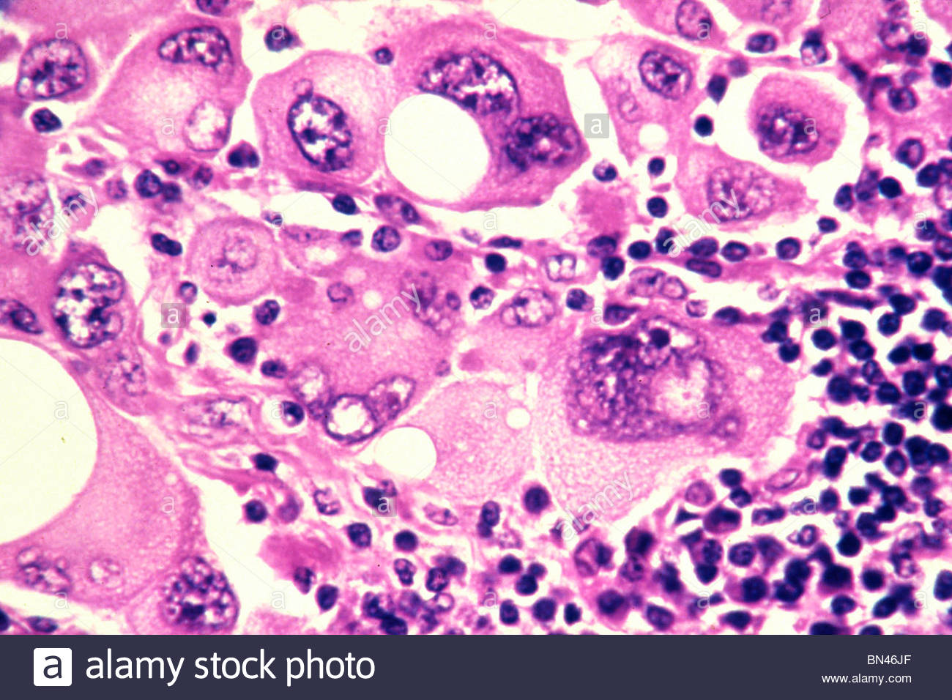
melanoma

Slide 24
Skin cancer

Slide 25
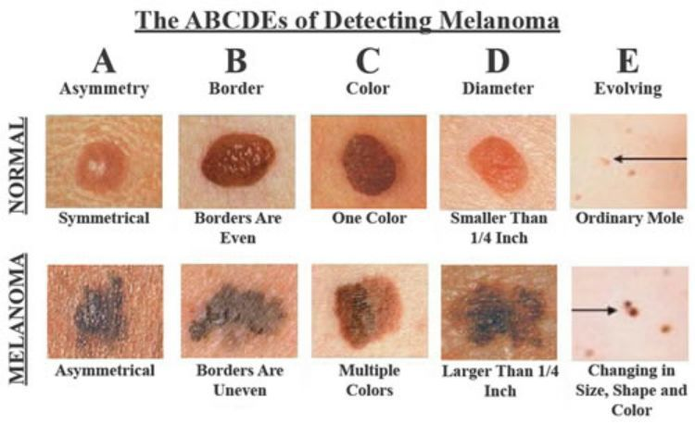

Slide 26
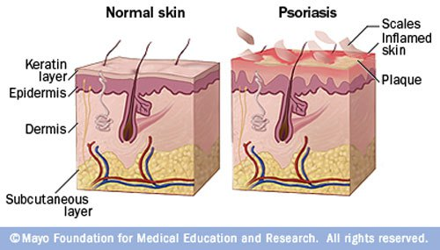
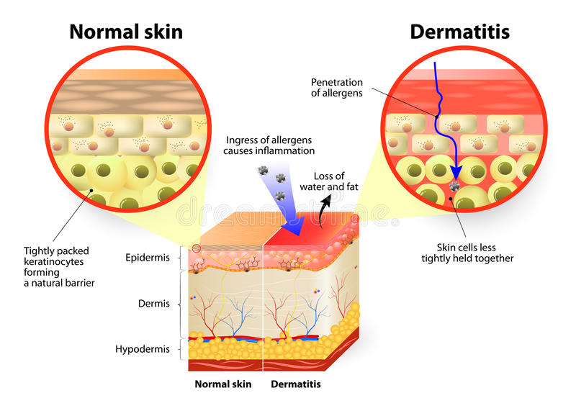
dermatitis

Slide 27
BONES

Slide 28
Skeletal: bones, joints, cartilage
An endoskeleton is lightweight, flexible, and permits a wide range of well-controlled movement
Function of Bones
Framework for shape, support , and movement
Protects organs inside, esp. the heart
Storage of Minerals: calcium, phosphorus
Produced blood cells from the bone marrow inside—almost a billion per day!

Slide 29
bones
Bone consists of a blood vessel + living bone cells + the mineral, non-living material they secrete which forms circular layers
Most bones have a hard, solid layer on the outside with spongy bone layers on the inside, and bone marrow which makes blood cells.
Many bones have openings for blood vessels and nerves to pass through
The white covering is the periosteum.

Slide 30
cartilage
A soft, flexible connective tissue
Covers the end of your bones, which helps them slide smoothly and provides a cushion for the harder ends
Tips of ears, nose, kneecaps
Your body was all cartilage when you were a developing embryo; cartilage can grow into bony tissue
Cartilage plates divide and change into bone tissue, which makes your bones grow larger as you get taller. When they are completely changed, you stop growing.

Slide 31
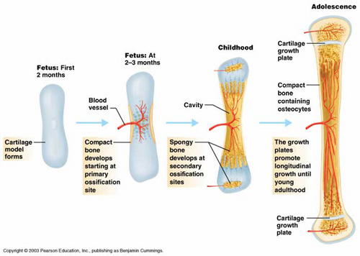
Bone growth

Slide 32
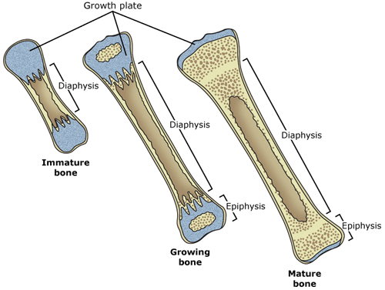
Bone growth

Slide 33
joints
Joints are where bones meet, bound by ligaments.
Hinge joints (elbows & knees—open/close)
Gliding joints (connect spinal bones together)
Ball and Socket joints (shoulders and hips--rotating)
Pivot joints (permit twisting of the arms)
Fused joints (skull bones—become unified)

Slide 35
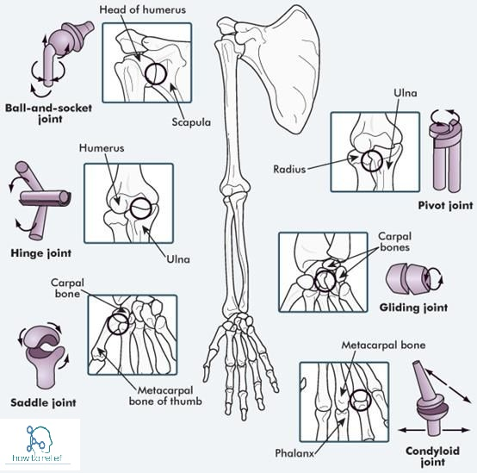
Types of joints

Slide 36
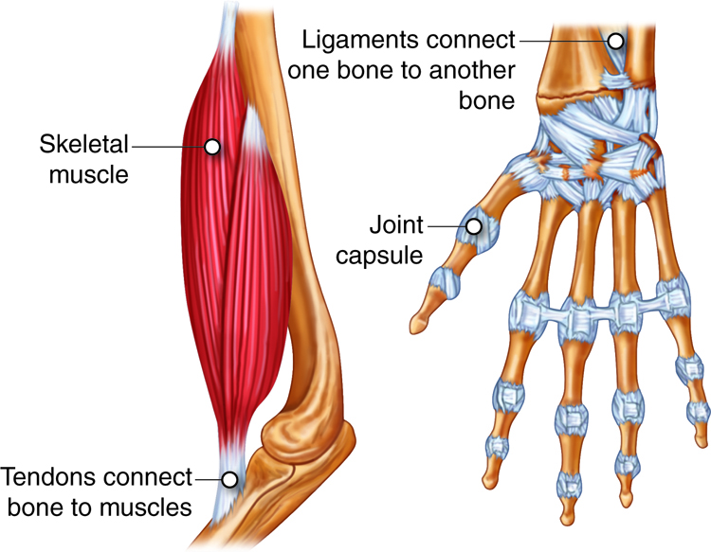
Tendons and ligaments
Irregular shapes allow other connective tissues to attach to them:
Ligaments are joined to the periosteum, and connect to other bones
Tendons are also joined to the periosteum, and connect bones to muscles

Slide 37
Bone trouble
Incomplete Fractures are when a bone cracks
Complete Fractures are when a bone breaks into two pieces
Comminuted Fractures are when a bone splinters
Osteoporosis is a thinning of the bones that makes bones break easily, due to loss of calcium and minerals
Arthritis (rheumatism) occurs when cartilage dissolves, making joints swell and movement painful
The older a person is, the more likely they are to acquire osteoporosis, arthritis, and loss of red bone marrow.

Slide 38
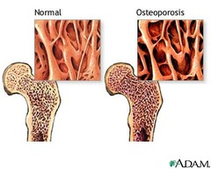
osteoporosis
Lack of calcium
Thinning of bones

Slide 39
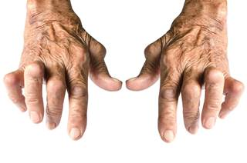
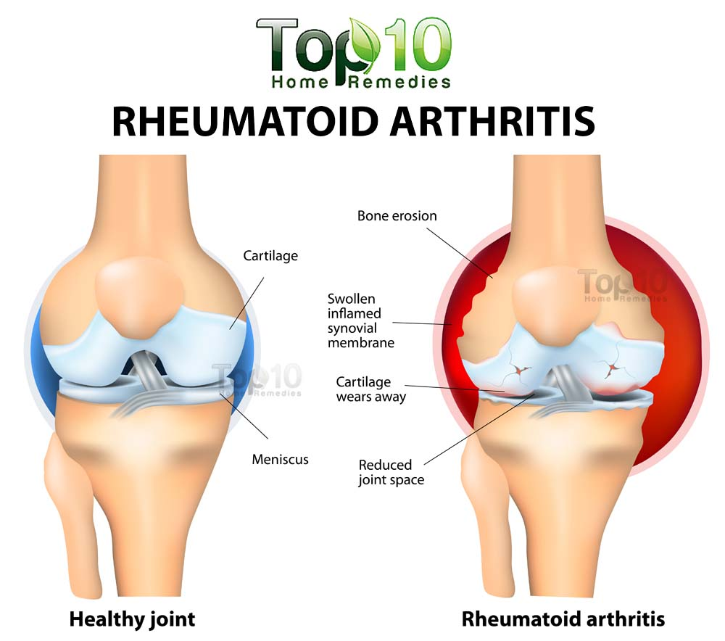
arthritis

Slide 40
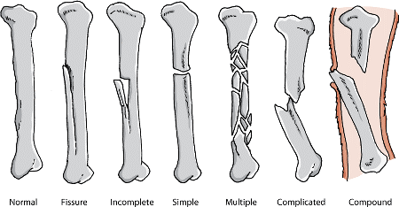
fractures

Slide 41
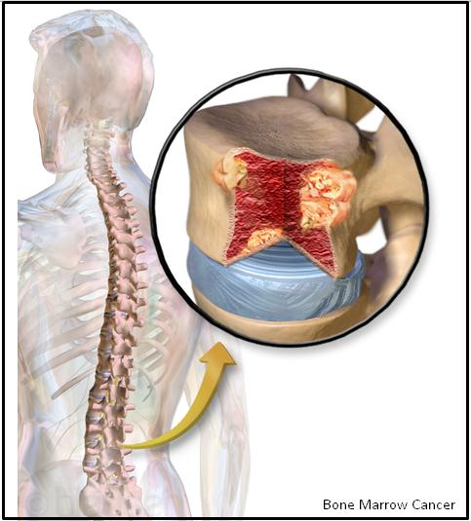
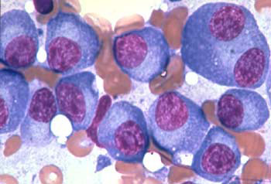
Bone cancer
Myeloma
Osteo-sarcoma

Slide 42
MUSCLES

Slide 43
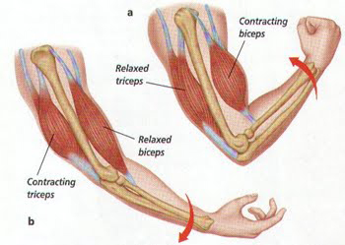
Voluntary muscles
Those muscles you can control at will.
Mostly your skeletal muscles, attached to bones.
Made of striated muscle, which appears as light and dark bands.

Slide 44
movement
Move by stretching/contracting in pairs (pulling)
Most extend across a joint and attach to two different bones.
Some exceptions are eyes, mouth, tongue, and throat, which attach to other muscles or skin
Control your posture
Increase body temperature when contracted (exercise, shivering)

Slide 45
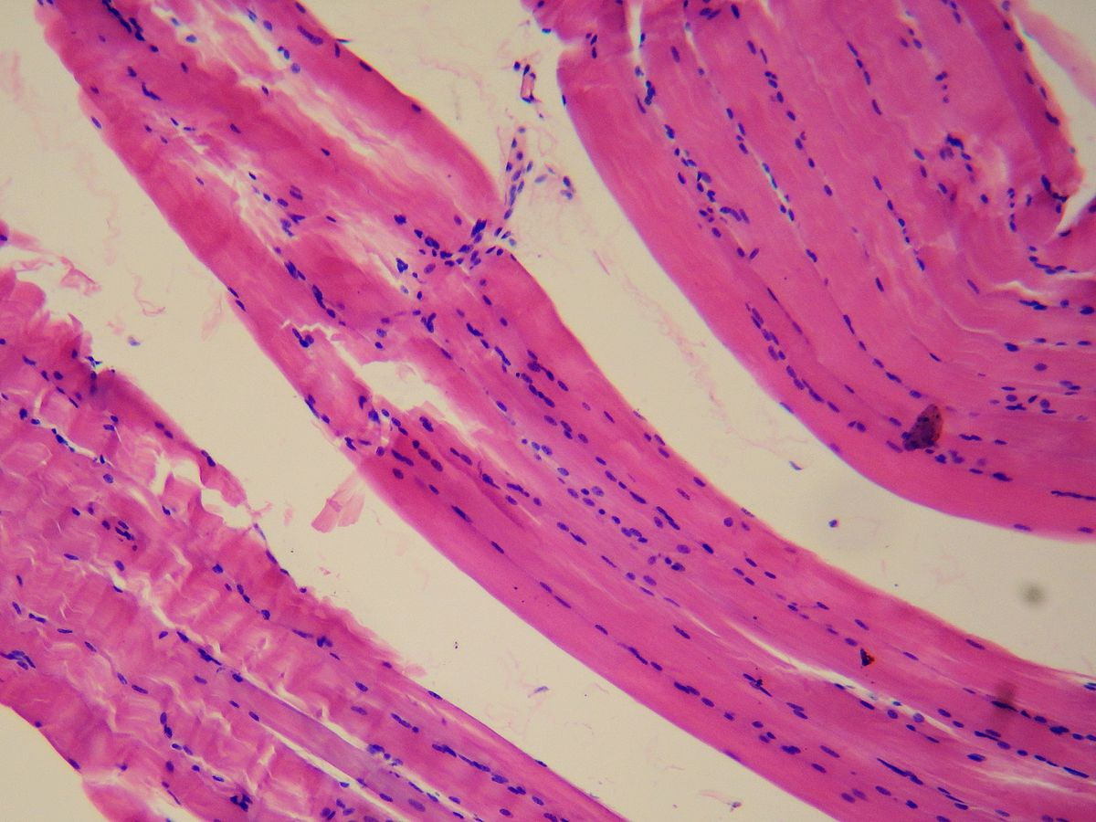
Involuntary muscles
Muscles you cannot control; automatic.
Heart, stomach, intestines, other organs and vessels.
Generally controlled by your nervous system which keeps going even if you are asleep, unconscious, etc.
They can function a LOT longer before tiring; but do slow down when sleeping, or super cold.
Are smooth muscles with no striations…

Slide 46
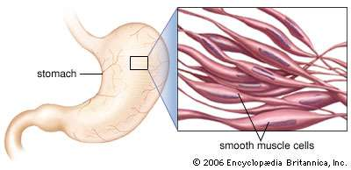
Smooth muscle (viscera)

Slide 47
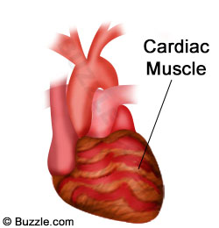
Cardiac muscle
Striated but Involuntary
Tough fibers, like skeletal muscles

Slide 48
Movement… and a trip down memory lane
Do you remember???
Require a constant supply of energy, usually stored sugar (glucose)
Muscles burn glucose for energy (ATP), through cellular respiration
This requires a constant supply of oxygen, which is why you start to breathe hard when you are exercising.
If no oxygen is used, muscles will break down glucose without oxygen (anaerobic respiration) which produces lactic acid
As lactic acid builds up in muscles, your muscles ache/tire. Broken muscle fibers may account for soreness several days later.

Slide 49
Muscle growth
Muscles are built through use (lost through disuse)
More muscle means more energy, tiring less-- more sugar can be burned
Are built with protein
Are burned last

